Slide 1


Slide 2
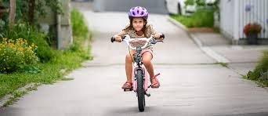
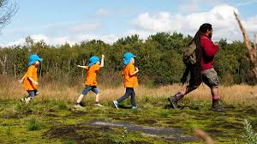
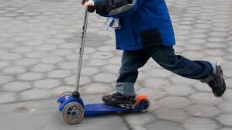
Wherever possible we would love for you to get outside and be active. If you have the chance to get outside maybe you could:
Go for a walk
Get on your bike
Use your scooter / hoverboard / skateboard
Have a kick about with family members
Play on any apparatus you may have in the garden e.g. swings, slides etc…
Play with any sports equipment you own e.g. football, netball, rugby ball, basketball

Slide 3
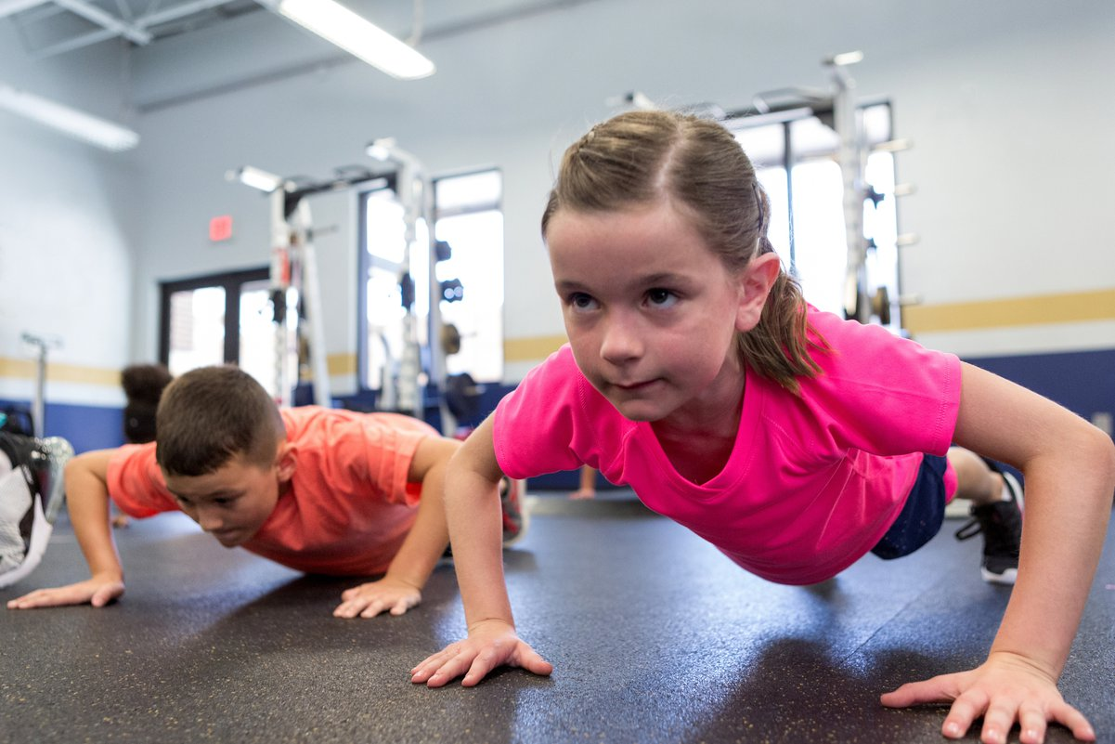
There is also Miss Price’s Circuit Training Challenge (it’s on the school website)!

Slide 4

Now we know that you cannot always go outside so here are a few activities to do inside.
GoNoodle – Trolls – Can’t Stop The Feeling
https://www.youtube.com/watch?v=KhfkYzUwYFk

Slide 5

Koo Koo Kanga Roo – Superheros Unite
https://www.youtube.com/watch?v=ok7V1pWtRzs

Slide 6


Maybe you could have a go at the Virtual School Games Dance and Rugby Competition
Can you create a dance no longer than 1 minute to the theme ‘Express Yourself’.
For further information click here
https://strideactive.org/events/virtual-school-games-dance-competition/
Please send you emails to teacher@kingslandengland.hereford.sch.uk and put Virtual School Games Dance as the subject.
Videos need to be in by Tuesday 2nd February 2021.

Slide 7

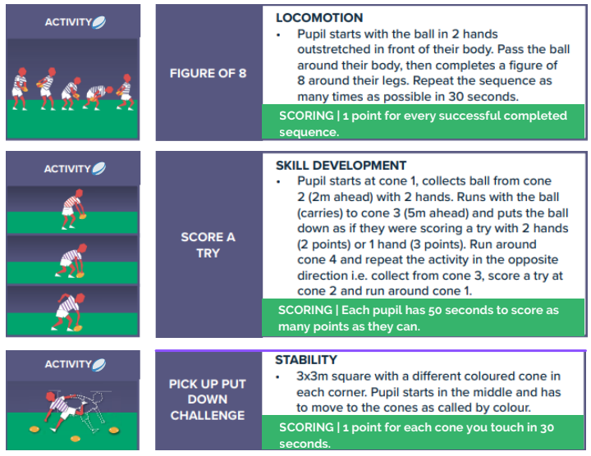
Can you total up your scores for all 3 challenges and send it to teacher@kingslandengland.hereford.sch.uk
Please put Virtual School Games Rugby as the subject.
For further information click here
https://strideactive.org/events/virtual-school-games-rugby-competition/
Scores need to be in by Tuesday 9th February 2021.

