Slide 1


Tuesday 26th January 2021
Below is the timetable for today.
It is here to give you a guide on today’s work.
For maths you will need access to the worksheet.
 | phonics | RWI |  | maths – White Rose Vimeo link and worksheet |  | afternoon | 2:45 assembly via email | time to share a book
9am On-line registration | Rainbow Group ou – shout it out Sunshine Group ur – nurse with a purse | We can all swim Bats -Speed Sounds -Red and Green words -Read story -Hold a Sentence | BREAK | Add by counting on https://vimeo.com/490879463 worksheet | LUNCH | Topic/Art Linda Lang(a polar artist) | Mr Debenham | Reading Time

Slide 2

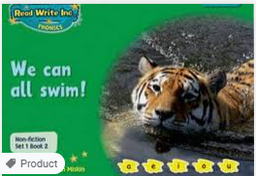


RWI
You will need:
Rainbow Group Sunshine Group
We can all swim! Bats book book
‘Weekly Writing sheet’ RWI (from your pack)

Slide 3
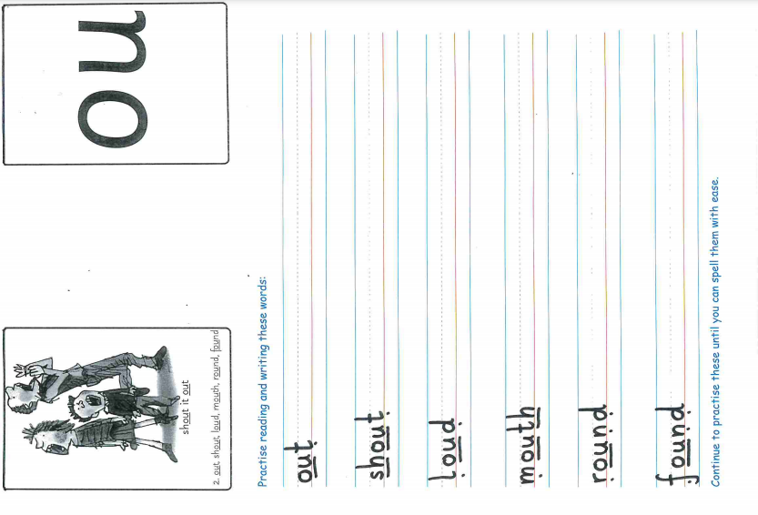
Rainbow Group ou is our sound for this week
After a brief phonic session can you complete this phonic sheet that is
in the folder.
Once you have finished it, it can be stuck into your green home-learning book.

Slide 4
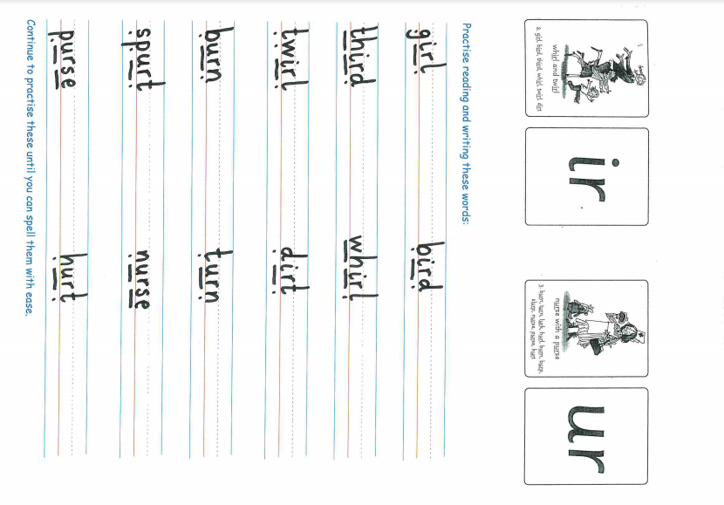
Sunshine Group ur is our sound for this week
After a brief phonic session can you complete this phonic sheet that is
in the folder.
Once you have finished it, it can be stuck into your green home-learning book.

Slide 5


Continue with RWI
Begin by reading the Speed Sounds to an adult, as you did yesterday.

Slide 6

Continue with RWI
After that, you are ready to read through the Green and Red Words to an adult like you did yesterday.

Slide 7
Continue with RWI
Once you have read the speed sounds, green and red words, you are now ready to read the book to an adult. Remember to pause at the full stops.

Slide 8

Our Structure for RWI
Now you are ready for the second Hold a Sentence (see next slide for the sentence for each group)
Get your Weekly Writing Sheet for Tuesday and listen to your adult say the sentence out loud to you. Remember to do the actions for capital letter and full stop. Repeat at least 3 times before you write it down.

Slide 9

Rainbow Group
Today’s Hold a Sentence is:
Frogs can swim in a pond.
remember:
Sunshine Group
remember:
igh
Today’s Hold a Sentence is:
Bats can sleep high up in trees.

Slide 10
Our Structure for RWI
Now you are ready to write the Hold a Sentence down on your paper.
Don’t forget to use
a capital letter
a full stop
finger spaces
neat handwriting.
Look at slide 11 so you can check your Hold a Sentence.

Slide 11
Time to check
Rainbow Group
Frogs can swim in a pond.
Sunshine Group
Bats can sleep high up in trees.

Slide 12

Stick your sheet in the front of your purple book.
Thank you for working hard.
Now have a break and a snack.

Slide 13


White Rose Maths
Add by counting on
You will need:
- maths booklet (Tuesday – Add by counting on)

Slide 14
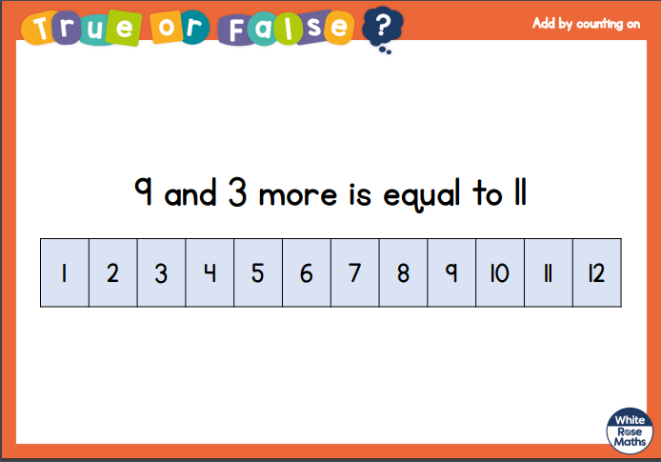
White Rose Maths
Is this true or false?

Slide 15
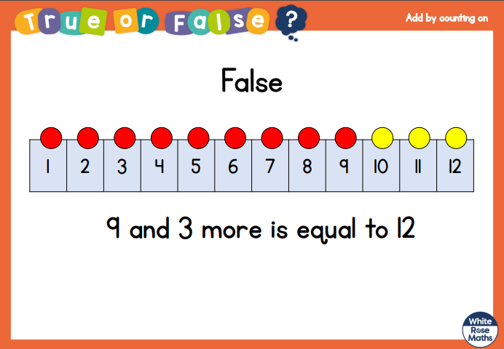
White Rose Maths

Slide 16
White Rose Maths
Use this video link https://vimeo.com/490879463 and have a go at the ‘questions to think about’ slide.
Work through the video, feel free to pause it to explain any of the teaching.
Now you are ready to have a go at the worksheet.
Remember you can write your answers in your blue maths book or use the ppt link to save printing it.

Slide 17
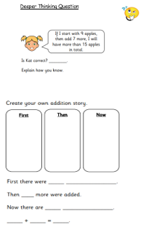
Choose at least 2 of the questions on the ‘add by counting on – question’ sheet. Which way do you prefer to work out the answers:
- drawing the objects and counting them up
- using a number line
-counting on using your fingers/head?
If you would like to have a challenge, why don’t you have a go at the Deeper
Thinking question?

Slide 18

If you have used a sheet, stick it into the front of your blue maths book.
We will continue with some White Rose teaching again tomorrow.
I think it is time for lunch and a break from your work.
There is a topic session this
afternoon but enjoy your lunch
first.

Slide 19
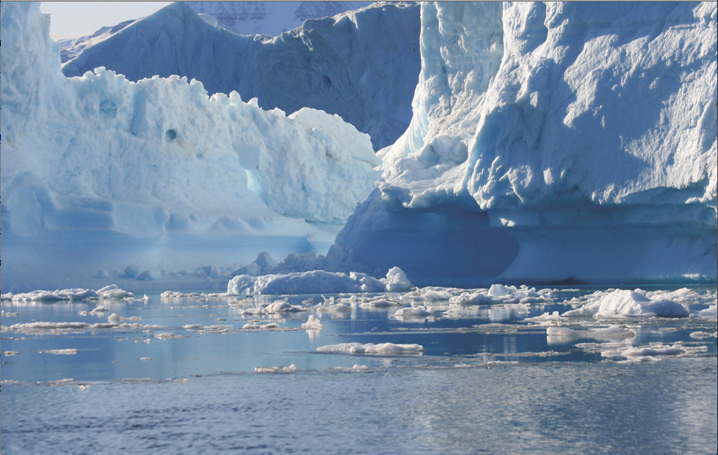
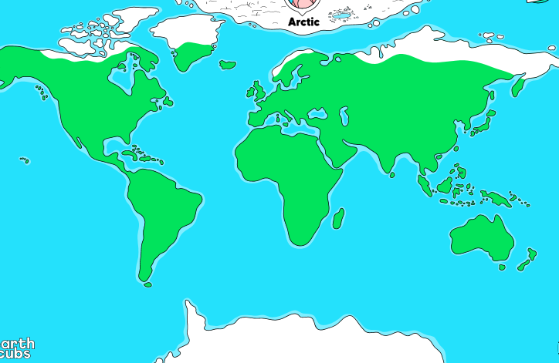
The Arctic
Remember that the Arctic is found in the far North (top) of our earth. The North Pole is located in the Arctic.

Slide 20
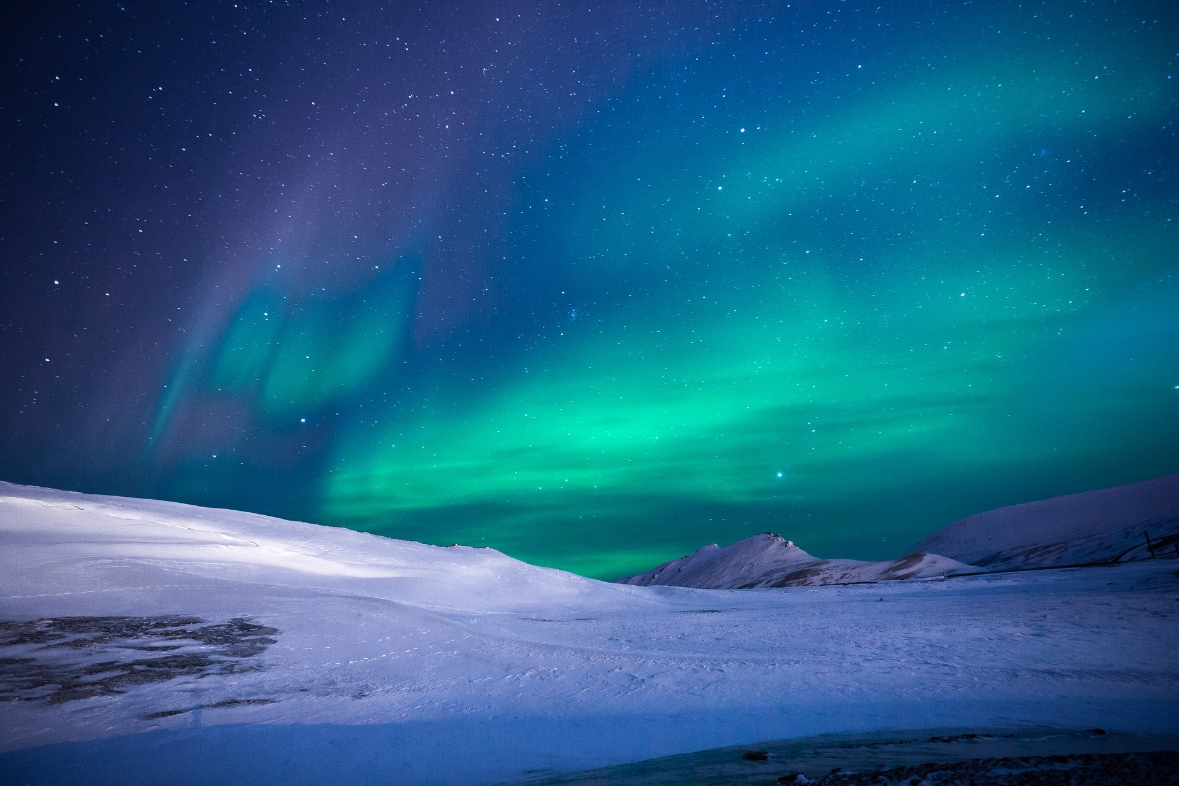
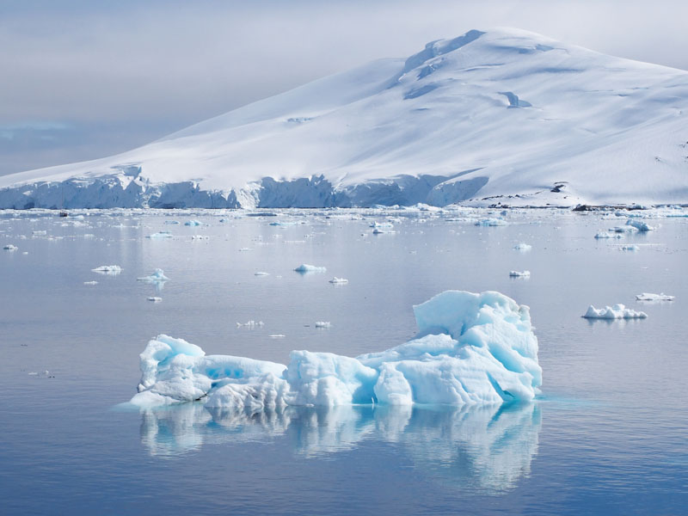
The Arctic
What can you see in these pictures? Think about the landscape and colours.

Slide 21
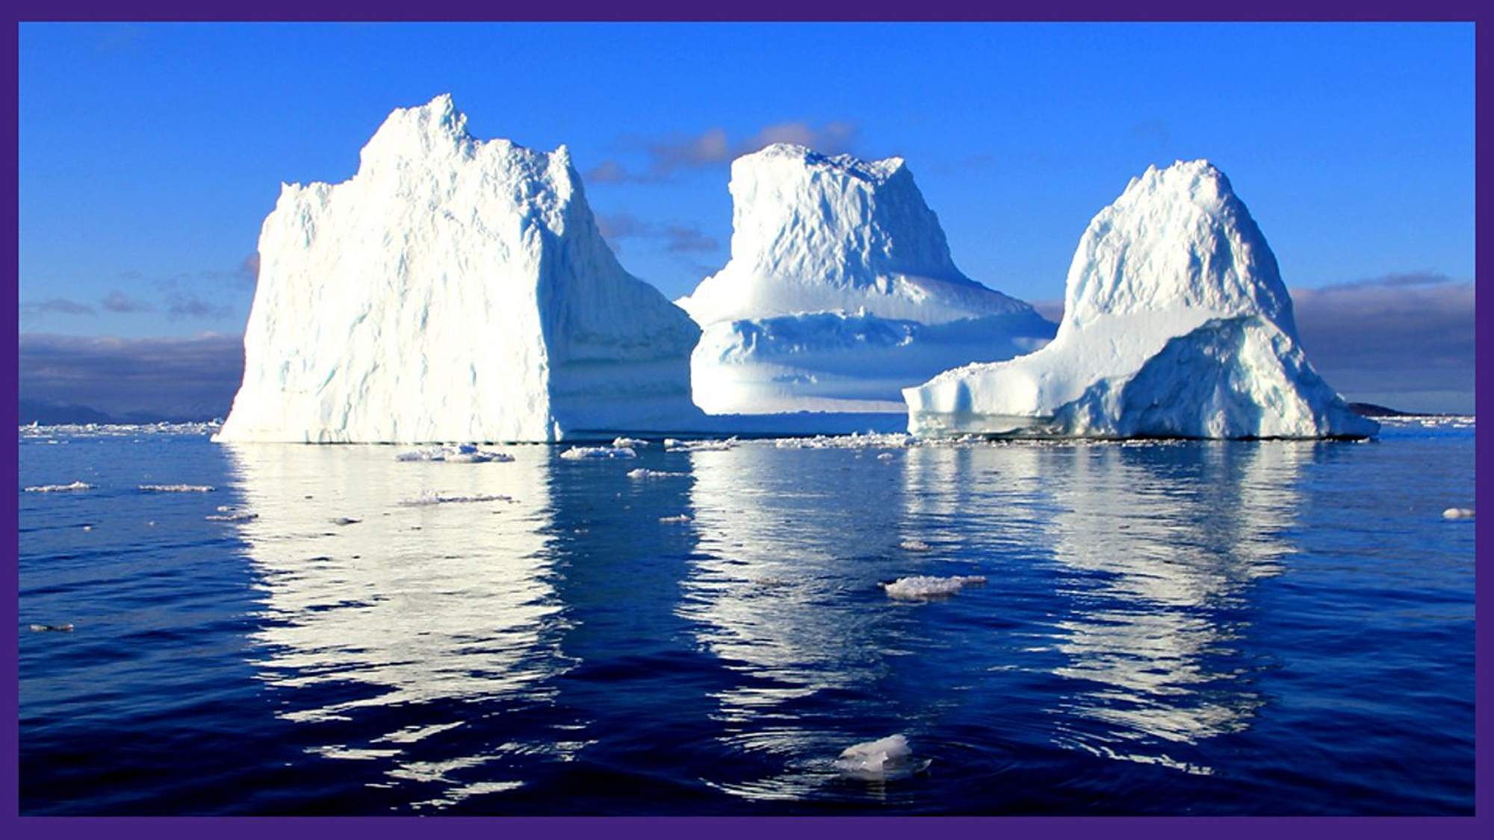
The Arctic

Slide 22
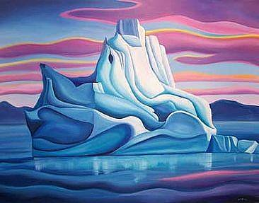
The Arctic
I would like you to use the Power Point on Linda Lang the Polar artist, that is in Tuesday’s file. Read through the slides and follow the instructions to produce your own piece of Arctic artwork.

Slide 23

Most importantly encourage your child to read a suitable book to you. Later on it would be great if you could read a bedtime story to them.
Please remember to send an email containing the work that they have done to teacher@kingslandengland.hereford.sch.uk

Slide 24

Worship Time with:
Mr. Debenham

