Slide 1


Monday 25th January 2021
Below is the timetable for today.
It is here to give you a guide on today’s work.
For maths you will need a dice, number cards from 0 – 20, Addition Revision sheet and
the Addition Cover-up sheet .
For RWI you will need a copy of the We can all Swim or Bats book.
 | phonics | RWI |  | maths – White Rose Vimeo link and worksheet |  | afternoon | 2:45 assembly via email | time to share a book
9am On-line registration Story | Rainbow Group ou - shout it out Sunshine Group ur – nurse with purse | We Can All Swim Snow -Speed Sounds -Red and Green words -Read story -Hold a Sentence | BREAK | Practical add by counting on https://vimeo.com/490879063 Addition Revision and Addition Cover-up sheets | LUNCH | RE Shahadah Music | Rev Julie | Reading Time

Slide 2




RWI
Each day for RWI you will need:
Rainbow Group Sunshine Group
We can all Swim! Bats book book book
‘Weekly Writing sheet’ RWI (from your pack)
Could you please download the relevant book for your child as we will continue to read it throughout the week.

Slide 3

Rainbow Group
Our new sound for this week: ou

Slide 4
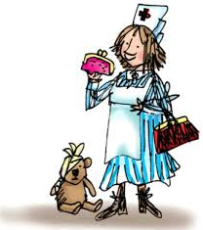
Sunshine Group
Our new sound for this week: ur

Slide 5


Our Structure for RWI
Begin by reading the Speed Sounds to an adult (just like we do in class).

Slide 6

Our Structure for RWI
After that you are ready to read through the Green and Red Words to an adult (just like we do in class).

Slide 7
Our Structure for RWI
Adults could you look at the vocabulary list and make sure that your child knows what each word means. Then you are ready to talk through the introduction with your child.

Slide 8
Our Structure for RWI
You are now ready to read your book to an adult. Remember to pause at a full stop.

Slide 9

Our Structure for RWI
Once you have completed this, then you are ready to work on the Hold a Sentence (see next slide for the sentence for each group)
Get your Weekly Writing Sheet for Monday and listen to your adult say the sentence out loud to you. Remember to do the actions for capital letter and full stop. Repeat at least 3 times before you write it down.

Slide 10

Rainbow Group
Today’s Hold a Sentence is:
I am a big cat.
tricky word:
Sunshine Group
Today’s Hold a Sentence is:
A bat will feed at night.
tricky word:

Slide 11
Our Structure for RWI
Now you are ready to write the Hold a Sentence down on your paper.
Don’t forget to use
a capital letter
a full stop
finger spaces
neat handwriting.
Look at slide 12 so you can check your Hold a Sentence.

Slide 12
Time to check
Rainbow Group
I am a big cat.
Sunshine Group
A bat will feed at night.

Slide 13

Stick your sheet in the front of your purple book.
Thank you for working hard.
Now have a break and a snack.

Slide 14

White Rose Maths
Add by counting on (practical)
You will need:
8 – 15 number cards (written on squares of paper)
dice
Addition Cover up – in Monday Maths
Addition Revision – in Monday Maths

Slide 15
White Rose Maths
Use this video link https://vimeo.com/490879063
and have a go at the ‘questions to think about’ slide.
Work through the video, feel free to pause it to explain any of the teaching.
Please can you write your answers in your blue maths book.

Slide 16
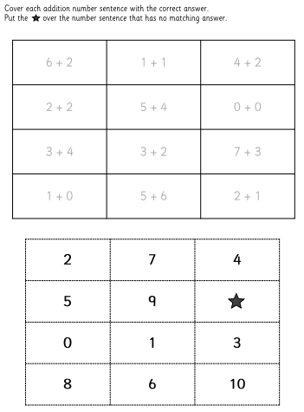
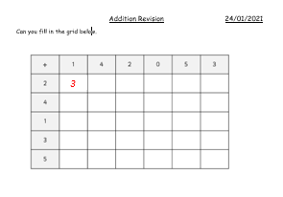
White Rose Maths
Have a look in files for Addition Revision and Addition Cover-up. First of all, I would like you to see how quickly you can fill in the addition grid and then play the addition cover up.

Slide 17


We will continue with some White Rose teaching again tomorrow.
I think it is time for lunch and a break from your work.
This afternoon I would like you to
complete the R.E session, find the
Power Point in the files. Then follow
the link for music (also in files); but
enjoy your lunch first.

Slide 18

Worship Time with:
Rev. Julie

Slide 19

Most importantly encourage your child to read a suitable book to you. Later on it would be great if you could read a bedtime story to them.
Please remember to send an email containing the work that they have done to teacher@kingslandengland.hereford.sch.uk

