Slide 1


Friday 22nd January 2021
Below is the timetable for today.
It is here to give you a guide on today’s work.
For maths you need to be able to see or have a copy of the Consolidation card and a print out of the game. For RWI you need the red words to spell sheet.
 | phonics | RWI |  | maths – White Rose Vimeo link and worksheet |  | afternoon | 2:45 assembly via email | time to share a book
9am On-line registration | Rainbow Group ir – whirl and twirl Sunshine Group are – care and share | The Web Snow -Speed Sounds -Red and Green words -Read story -Big Write | BREAK | Consolidation of Place Value to 20 | LUNCH | PE and Golden Time | Big Joe | Reading Time

Slide 2




RWI
This is our final day on these books.
Rainbow Group Sunshine Group
The Web Snow book book
‘Weekly Writing sheet’ RWI (from your pack)

Slide 3

Rainbow Group
Today we are going to have a very brief start to our phonic session to read through the graphemes.

Slide 4
Sunshine Group
are – care and share
Today we are going to have a very brief start to our phonic session to read through the graphemes.

Slide 5
Sunshine and Rainbow Groups
Yesterday we had the Spelling Quiz.
I would like you to look back at your quiz and see which words (if any) you found a challenge.
I would like you to practise these words so you are able to spell them with ease.

Slide 6
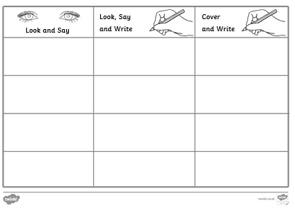
Sunshine and Rainbow Groups
In the Friday file are the red (tricky) words that you have been reading in your RWI book this week.
I would now like you to try to learn how to spell these words so you are able to spell them with ease.

Slide 7
Sunshine and Rainbow Groups
Look at the words in the Look and Say column. You need to take your time to look at each word, say the letters out loud, look at the shape of the word and try to write it in the air.
Once you think you know how to spell them, have a go in the second column.
In the final column, cover the words up and write them.

Slide 8
Sunshine and Rainbow Groups
Write two different sentences using these words.
Use the handwriting lines to help you to keep it neat.

Slide 9


Continue with RWI
Begin by reading the Speed Sounds to an adult, as you did yesterday.

Slide 10

Continue with RWI
After that, you are ready to read through the Speed Words (on page 15 of your book) to an adult.

Slide 11
Continue with RWI
Now you are ready to read the story to an adult. You have been working on this story all week so you should be getting very confident!
Remember to think about your expression to make it interesting to listen to and pausing for punctuation.

Slide 12

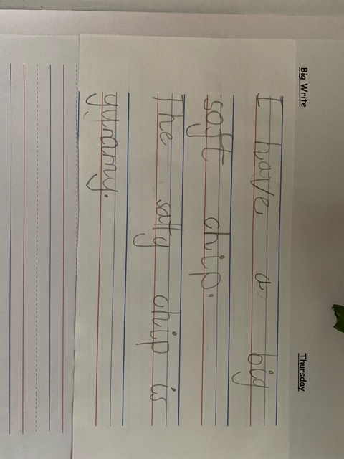
Star Big Write Work

Slide 13
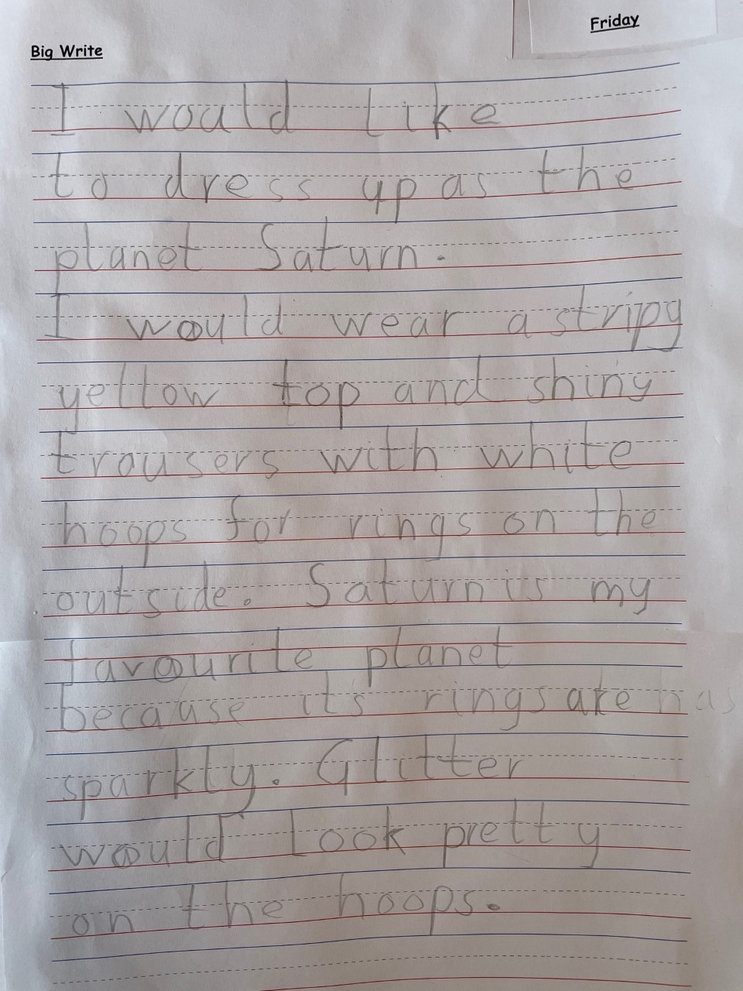
Star Big Write Work

Slide 14
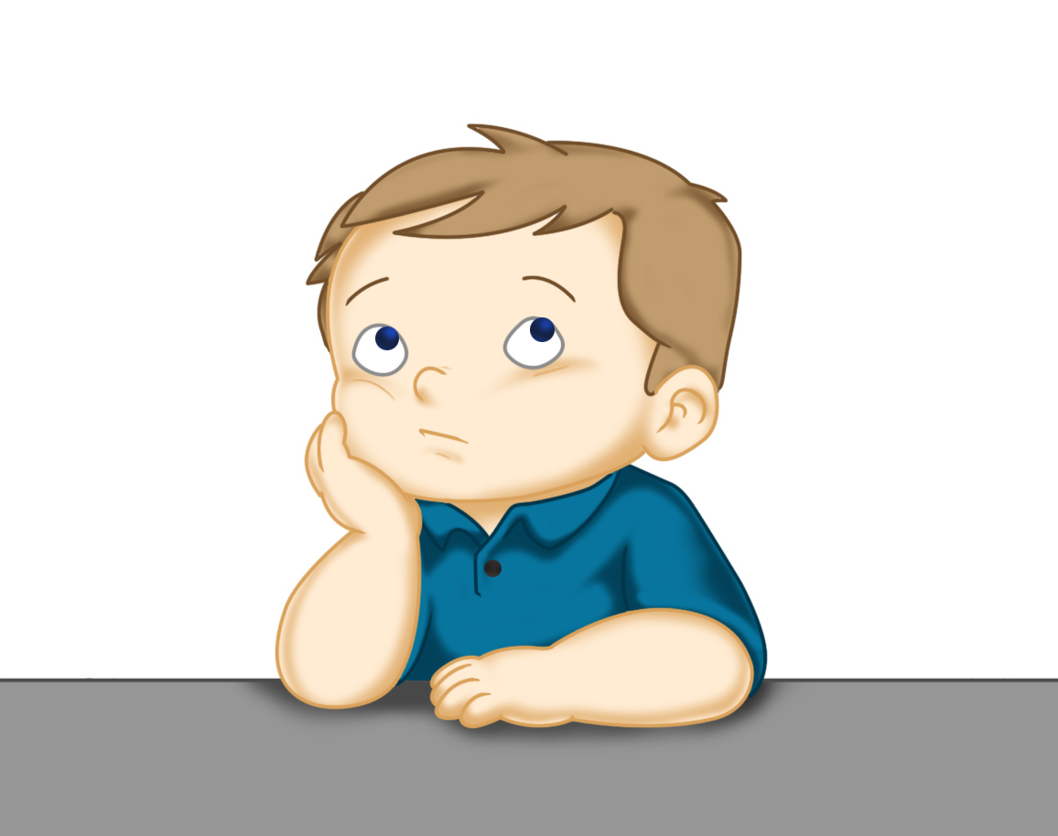
Our Structure for RWI
Today is the final day of RWI for the week.
This is when we do our Big Write. We base this around the book that we have been reading in RWI.
This Photo by Unknown Author is licensed under CC BY

Slide 15
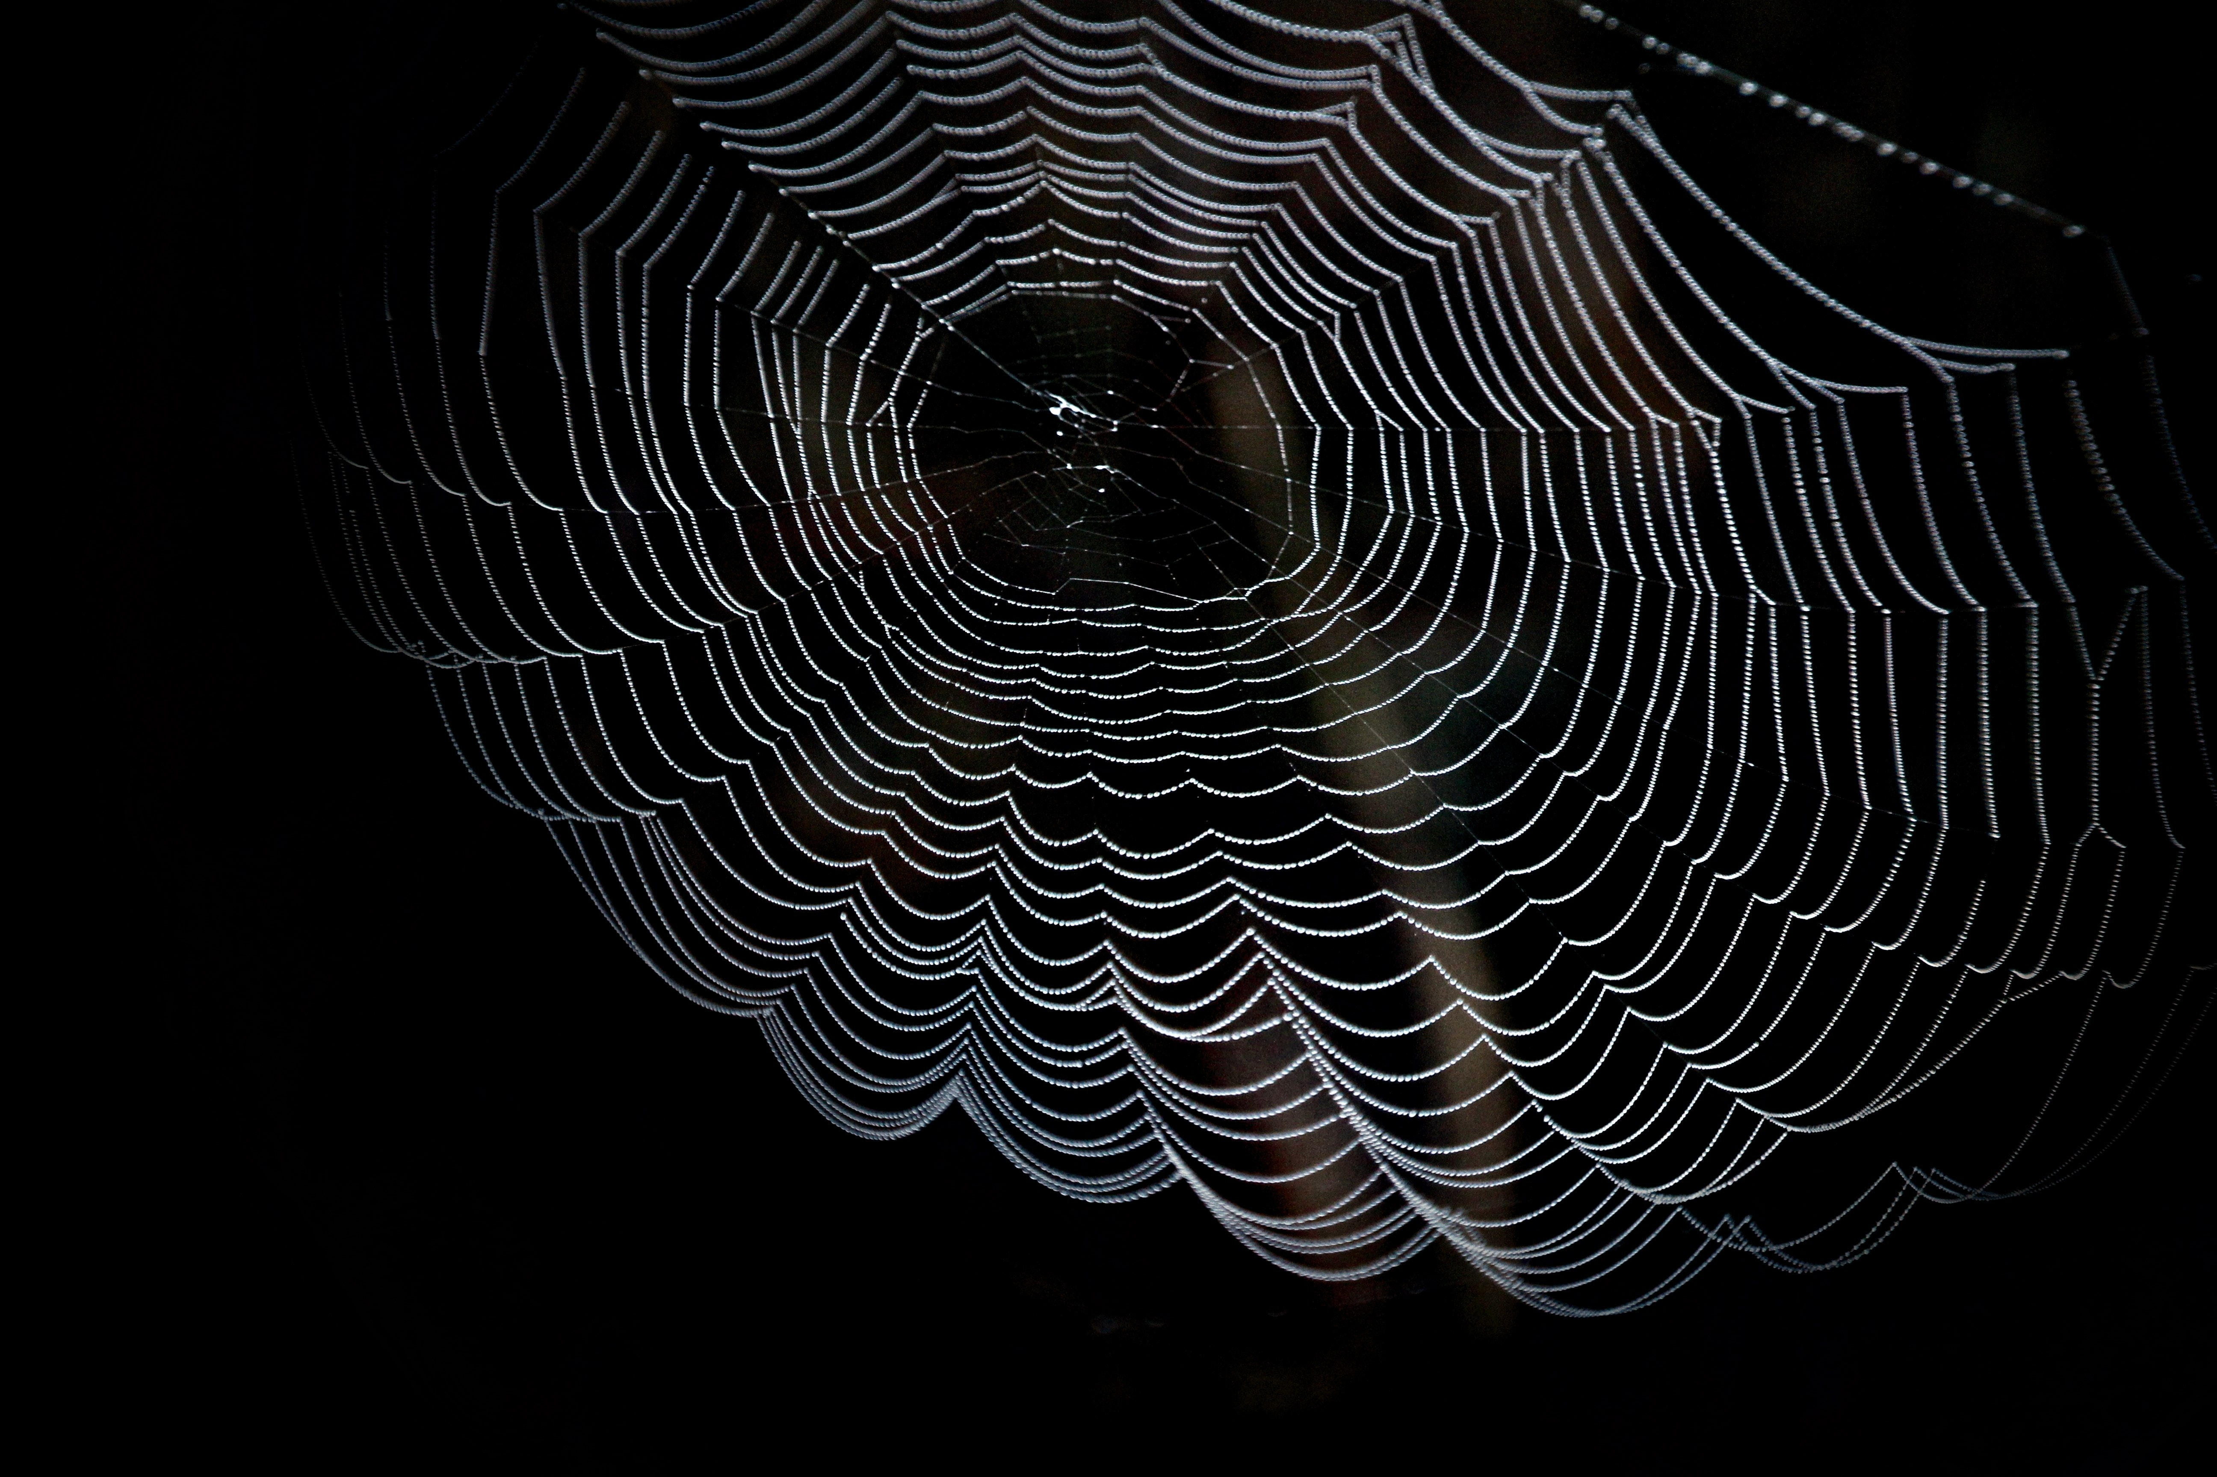
Rainbow Group - Big Write
Today we are thinking about Spin the spider. What is thinking about when he is in his web?
I would like you pretend that you are
Spin in your web and are looking at the bugs.
How are they making you feel?

Slide 16
Rainbow Group - Big Write
I would like you and your adult to think of some words to help you with your writing:
1. Think about how you are feeling?
2. What can you see?
3. Describe what you going to do.
Now use this to help you to begin your writing.

Slide 17
Rainbow Group - Big Write
Here is an example of how to begin.
Today I am feeling very hungry. In my web I can see a huge spotty bug. I want to gobble and crunch it up. Then I won’t feel hungry anymore.
Think of at least two different things you will eat. Don’t forget to use adjectives (describing words) and the wow words from yesterday’s Build a Sentence.

Slide 18
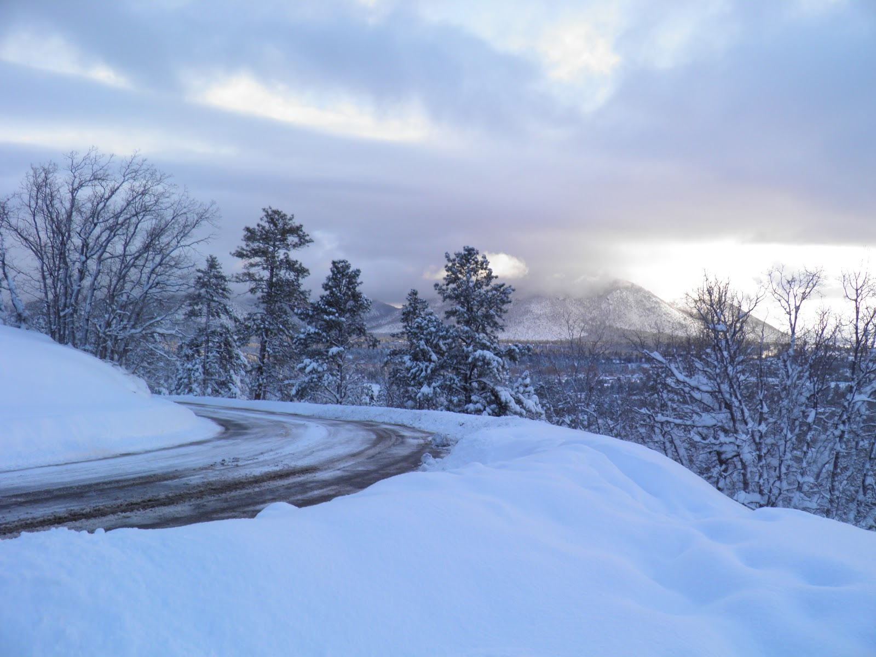
Big Write
Sunshine Group - Big Write
Today we are going to write a snow poem. Just to remind you that poems don’t have to rhyme.
1. Talk to your adult about some different ways that you can describe the snow. Don’t forget to use fantastic adjectives.
2. Now think about what you like to do in the snow.
This Photo by Unknown Author is licensed under CC BY-NC-ND

Slide 19
Sunshine Group - Big Write
Using your ideas can you write your poem?
Begin each line with
I want to
I want to crunch my boots into the crisp snow.
I want to slip and slid along the icy lane.
Each line is a new idea. You don’t need lots of words.

Slide 20

Big Write
You are ready to think about how you can use these words in some super sentences.
Talk through your sentences with an adult, one sentence at a time. When you are happy with your sentence, ‘put your headphones on’ say it again and then write it down.
I will look forward to reading your finished pieces of writing.
Don’t forget to use neat handwriting, finger spaces, capital letters and full stops.

Slide 21

Stick your sentence on the next page at the front of your purple book.
Thank you for working hard.
Now have a break and a snack.

Slide 22





White Rose Maths
Revision of Place Value to 20
You will need:
challenge sheet * or ** or *** (depending on the level of challenge you think will suit your child)
game again with varying challenge levels.
just print 1 page – not answers

Slide 23
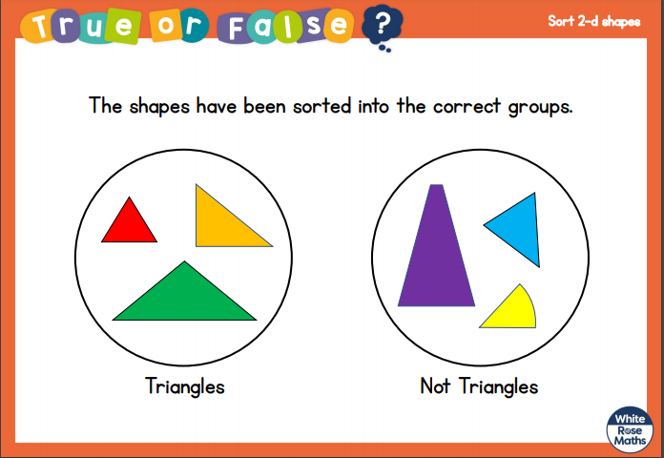
White Rose Maths
Talk about this to your adult.

Slide 24
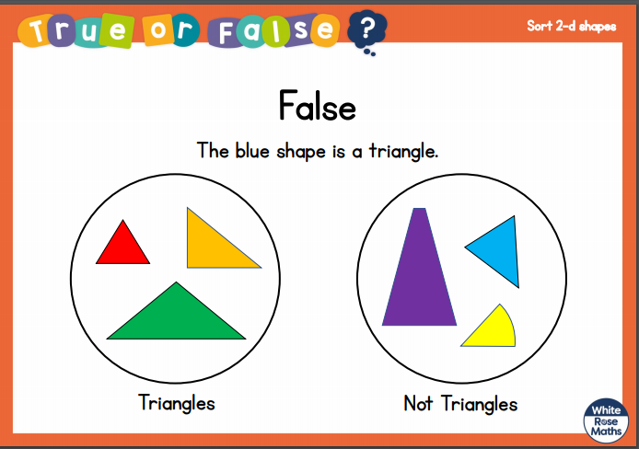
White Rose Maths

Slide 25
White Rose Maths
Today we don’t have a video link as it is the end of the unit on Place Value to 20.
I am so pleased to see how well your child has managed with this and they all seem to have a good understanding of what we have covered.
Choose the level of challenge that you feel is right for your child(* easiest to ***the most challenging). You know which level is best as you have been working with your child throughout the past 2 weeks.

Slide 26
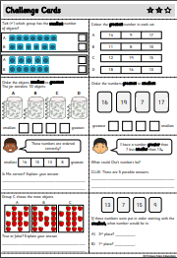
White Rose Maths
One way that we do this in class is to cut up the sheet into the 8 different questions and ask your child to choose one to work on, stick it into their book and then to work out the answer.
Repeat with the other questions.
After that enjoy the game.

Slide 27

If you have used a sheet, stick it into the front of your blue maths book.
We will continue with some White Rose teaching again tomorrow.
I think it is time for lunch and a break from your work.
.
This afternoon there is a PE session
and after that it is Golden Time.
First of all go and enjoy your lunch.

Slide 28

Worship Time:
Big Joe

Slide 29

Most importantly encourage your child to read a suitable book to you. Later on it would be great if you could read a bedtime story to them or let them watch this clip of the Little Polar Bear story.
https://www.youtube.com/watch?v=CAIwd_Uemqs
Please remember to send an email containing the completed work to teacher@kingslandengland.hereford.sch.uk

