Slide 1

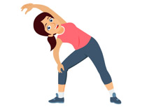
PE
If you can get outdoors please do. You could try these activities to keep active:
Go for a long brisk walk
Ride your bike or scooter
Play some football or just kick a ball around
Play on outdoor equipment
If you can’t get out, follow the link on the slide for a workout or dance session.

Slide 2
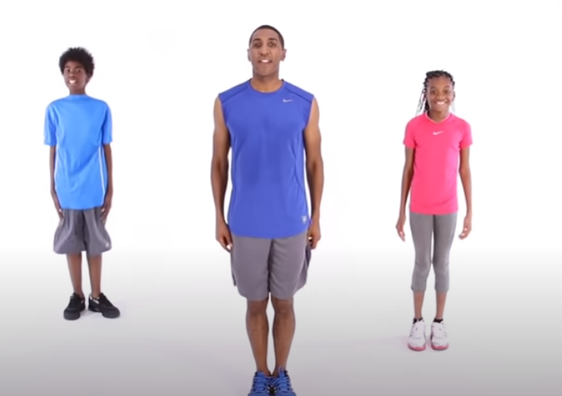
Today for PE, I would like you to follow the link below for a PE workout and then
Cosmic Yoga on the next slide.
https://www.youtube.com/watch?v=L_A_HjHZxfI&t=162s

Slide 3
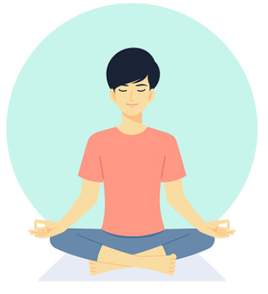
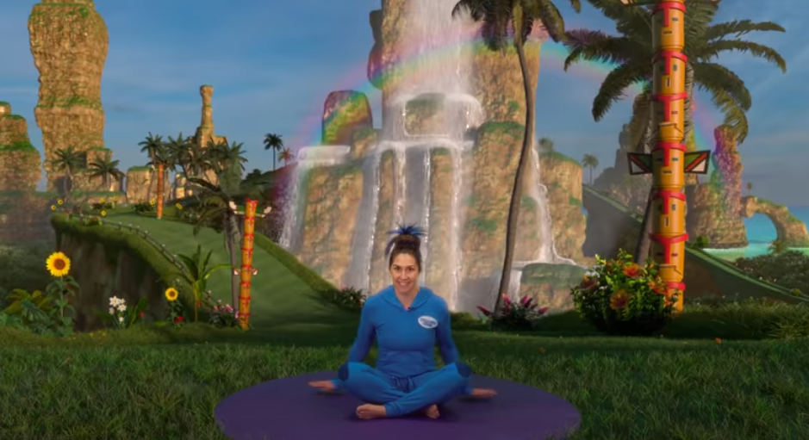
Cosmic Yoga
Before starting make sure you are comfortably dressed and sitting in a quiet spot.
Sonic The Hedgehog
https://www.youtube.com/watch?v=QM8NjfCfOg0

