Slide 1


Thursday 21st January 2021
Below is the timetable for today.
It is here to give you a guide on today’s work.
For RWI you will need to be able to see a copy of the words for the Spelling Quiz. For maths you need to be able to see a copy of the worksheet.
 | phonics | RWI |  | maths – White Rose Vimeo link and worksheet |  | afternoon | 2:45 assembly via email | time to share a book
9am On-line registration | Rainbow Group ir –whirl and twirl Sunshine Group are – care and share | The Web Snow -Speed Sounds -Red and Green words -Read story -Build a Sentence | BREAK | Order Numbers https://vimeo.com/483539572 | LUNCH | ICT and PE | Mark Harrington | Reading Time

Slide 2




RWI
You will need:
Rainbow Group Sunshine Group
The Web Snow book book
‘Weekly Writing sheet’ RWI (from your pack)

Slide 3
Rainbow Group ir – whirl and twirl
Today we are going to have a very brief start to our phonic session to read through the graphemes and then we will move onto our Spelling Quiz. The words for the quiz are in Thursday’s file.

Slide 4
Sunshine Group are – care and share
Today we are going to have a very brief start to our phonic session to read through the graphemes and then we will move onto our Spelling Quiz. The words for the quiz are in Thursday’s file.

Slide 5


Continue with RWI
Begin by reading the Speed Sounds to an adult, as you did yesterday.

Slide 6

Continue with RWI
After that, you are ready to read through the Speed Words (on page 15 of your book) to an adult.

Slide 7
Continue with RWI
Once you have read the speed sounds and Speed Words you are ready to read the story to an adult. Remember to think about your expression to make it interesting to listen to.

Slide 8

Our Structure for RWI
Build a Sentence
The aim of this task is to help to build (improve) your vocabulary.
On the next slide there are some words that I would like you to discuss with your adult. Make sure you know what they mean, think of other words that mean the same (synonyms).
Now think of an exciting sentence for each of these words.
This Photo by Unknown Author is licensed under CC BY

Slide 9

Build a Sentence
crunch chomp crush in a fix
You may like to think about:
What/who it happened to?
What was it like?
Why did it happened?
to help you to build an exciting sentence.
Write out 2 of your sentences using capital letters and full stops.

Slide 10
Build a Sentence
crunches fluffy skid slip creep pad
You may like to think about:
Who did it happened to?
Where did it happened?
What happened?
When it happened?
to help you to build an exciting sentence.
Write out 2 of your sentences using capital letters and full stops.

Slide 11

Stick your sentence on the next page at the front of your purple book.
Thank you for working hard.
Now have a break and a snack.

Slide 12



White Rose Maths
Order Numbers
You will need:
maths sheet from Thursday’s file
number strip puzzle

Slide 13
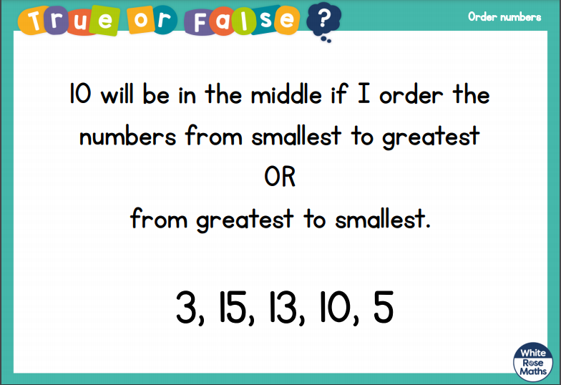
White Rose Maths
Is this true or false? (answer on slide 19)

Slide 14
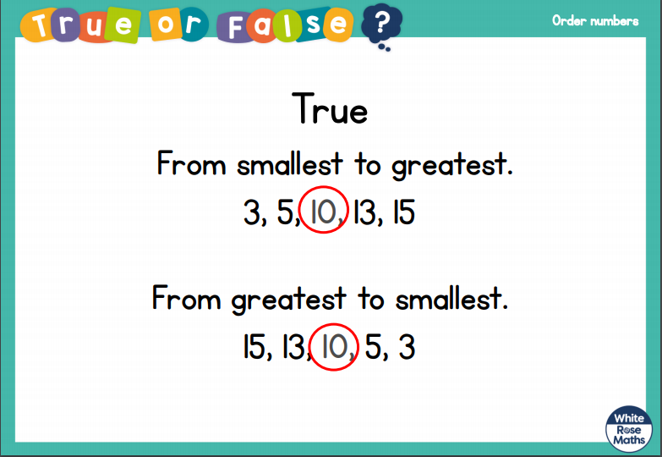
White Rose Maths

Slide 15
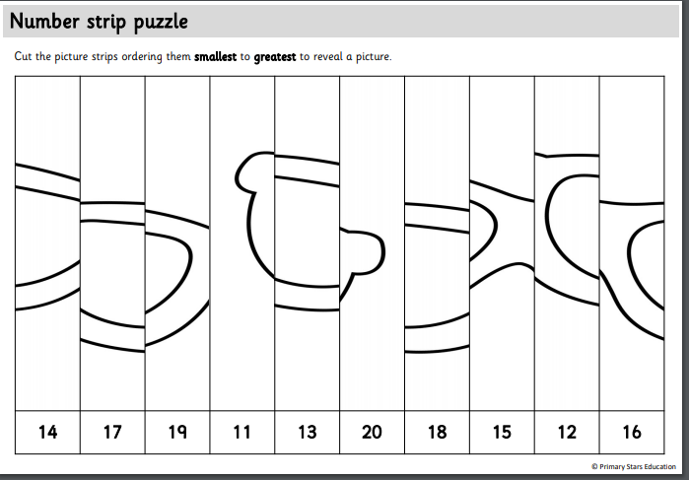
White Rose Maths

Slide 16
White Rose Maths
Use this video link https://vimeo.com/483539572
and have a go at the ‘questions to think about’ slide.
Work through the video, feel free to pause it to explain any of the teaching.
Now you are ready to have a go at the maths sheet – it isn’t a White Rose worksheet today.
Remember you can write your answers in your blue maths book to save printing it out.

Slide 17

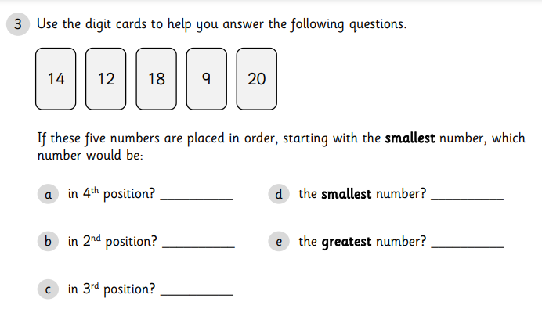
White Rose Maths
Deeper Thinking Question

Slide 18

If you have used a sheet, stick it into the front of your blue maths book.
We will continue with some White Rose teaching again tomorrow.
I think it is time for lunch and a break from your work.
.
This afternoon there is an ICT
lesson and a PE session. First of all
enjoy your lunch.

Slide 19

Worship Time:
Mark Harrington

Slide 20

Most importantly encourage your child to read a suitable book to you. Later on it would be great if you could read a bedtime story to them.
Please remember to send an email containing the completed work to teacher@kingslandengland.hereford.sch.uk

