Slide 1


Wednesday 13th January 2021
Below is the timetable for today.
It is here to give you a guide on today’s work.
For RWI you will need access to the Roll and Read sheet, a dice and the Edit a Sentence. For maths you need to be able to see a copy of the worksheet.
 | phonics | RWI |  | maths – White Rose Vimeo link and worksheet |  | afternoon | 2:45 assembly via email | time to share a book
9am On-line registration via TEAMS link | Rainbow Group ir – whirl and twirl Sunshine Group are – care and share | The Web Snow -Speed Sounds -Red and Green words -Read story -Edit a Sentence | BREAK | Order Groups of Objects https://vimeo.com/483537557 | LUNCH | Science | I Sing Pop | Reading Time

Slide 2

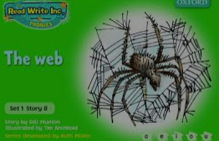


RWI
You will need:
Rainbow Group Sunshine Group
The Web Snow book book
‘Weekly Writing sheet’ RWI (from your pack)

Slide 3
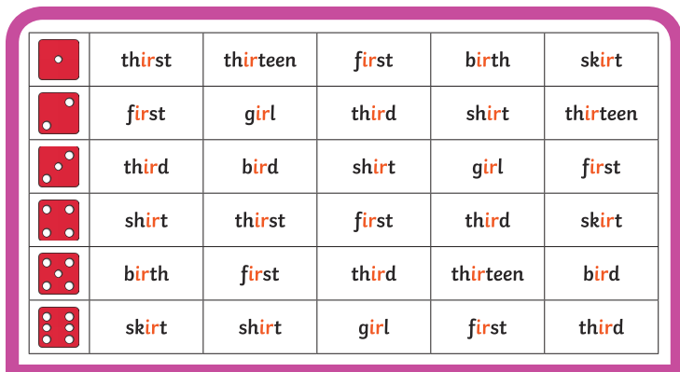
Rainbow Group ir – whirl and twirl
After a brief phonic session can you complete this game that is in Wednesday’s folder. You don’t necessarily have to print it.
Once finished, it can be stuck into the front of your purple book.

Slide 4
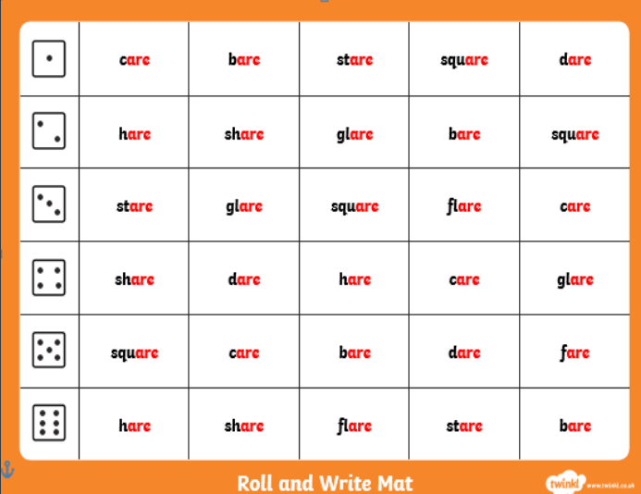
Sunshine Group are – care and share
After a brief phonic session can you complete this game that is in Wednesday’s folder. You don’t necessarily have to print it.
Once finished, it can be stuck into the front of your purple book.

Slide 5
How to Play Roll and Read
You can either: print this off and tick or colour in the words your child has read; or leave it on the screen to read.
Roll the dice and read the first word in that row, keep on rolling the dice and reading the words until you fill a complete row.

Slide 6


Continue with RWI
Begin by reading the Speed Sounds to an adult, as you did yesterday.

Slide 7

Continue with RWI
After that, you are ready to read through the Green and Red Words to an adult like you did yesterday.

Slide 8
Continue with RWI
Once you have read the speed sounds, green and red words, you are now ready to read the story to an adult. Remember to pause at the full stops.

Slide 9
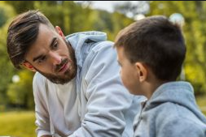
Our Structure for RWI
Today we have two activities to do:
Questions to Answer - see page 14 of your reading book.
Get an adult ask you the questions. Don’t
forget to turn to the correct page to help
you to find the answer.
Remember to answer in full sentences.

Slide 10

Our Structure for RWI
2. Edit a Sentence.
On the following pages there is a sentence, one for each group to read.
We do this every week in class so they know that there are some mistakes and their job is to look carefully at the sentence to try to spot all of the errors.
Once they have done this they circle them and then copy the corrected sentence onto the Wednesday section of the Weekly Handout Sheet.

Slide 11

Edit a Sentence six bigs are stuck in my wib
There are 4 mistakes:
1 capital letter 2 spelling mistakes
1 full stop
Once you have found the mistakes, circle them and then look at the next slide to check that you have found them all.

Slide 12
Edit a Sentence
six bigs are stuck in my wib .
Now copy it up neatly (correct sentence on slide 15).
Did you spot all of the mistakes?

Slide 13
Edit a Sentence it snowed last nit i can stamp in the sno
There are 6 mistakes:
2 capital letters 2 spelling mistakes
2 full stops
Once you have found the mistakes, circle them and then look at the next slide to check that you have found them all.

Slide 14
Edit a Sentence
it snowed last nit . i can stamp in the sno .
Now copy it up neatly (correct sentence on slide 15).
Did you spot all of the mistakes?

Slide 15
Edit a Sentence – correct sentences
Six bugs are stuck in my web.
It snowed last night. I can stamp in the snow.

Slide 16

Stick your sheet in the front of your purple book.
Thank you for working hard.
Now have a break and a snack.

Slide 17


White Rose Maths
Order Groups of Objects
You will need:
maths booklet (Wednesday – Order Groups of Objects)
tens frames drawn on paper

Slide 18
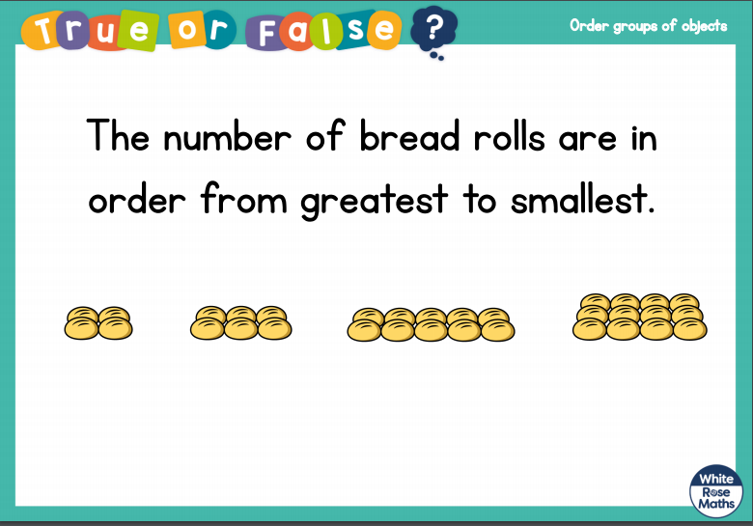
White Rose Maths
Is this true or false? (answer on slide 19)

Slide 19
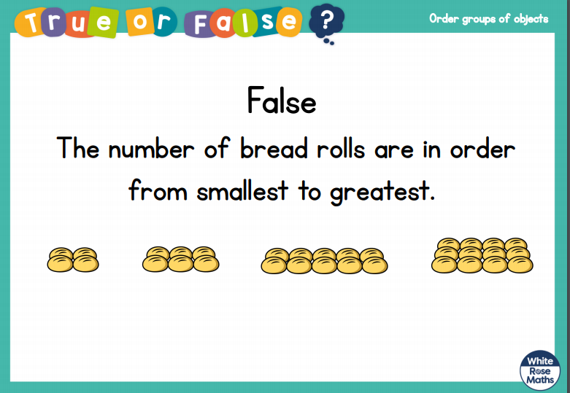
White Rose Maths

Slide 20
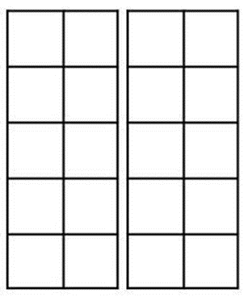
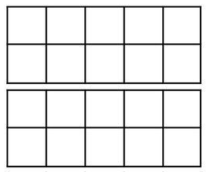
White Rose Maths
Today we are building on comparing groups of objects by moving on to ordering groups of objects.
To begin this session I would like you to get your child to draw two tens frames side by side so they can fit in up to 20 (or you could draw them if you prefer).

Slide 21
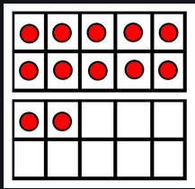
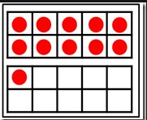
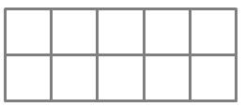
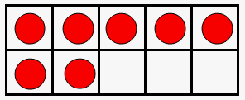
White Rose Maths
Using tens frames. Ask your child to place dots
to represent any number between 0 -20.
Repeat so you have 3 different numbers represented.
Then ask your child to order them from smallest to greatest and then from greatest to smallest.
Repeat until they are confident.

Slide 22
White Rose Maths
Use this video link https://vimeo.com/483537557
and have a go at the ‘questions to think about’ slide.
Work through the video, feel free to pause it to explain any of the teaching.
Now you are ready to have a go at the worksheet.
Remember you can write your answers in your blue maths book to save printing it out.

Slide 23

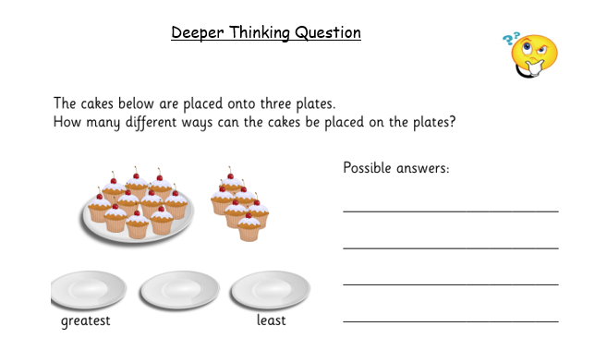
White Rose Maths
Deeper Thinking Question

Slide 24

If you have used a sheet, stick it into the front of your blue maths book.
We will continue with some White Rose teaching again tomorrow.
I think it is time for lunch and a break from your work.
There is a science session this
afternoon but enjoy your lunch
first.

Slide 25

Worship Time:
I Sing Pop

Slide 26

Most importantly encourage your child to read a suitable book to you. Later on it would be great if you could read a bedtime story to them.
Please remember to send an email containing the work that they have done to teacher@kingslandengland.hereford.sch.uk

