Slide 1


Tuesday 19th January 2021
Below is the timetable for today.
It is here to give you a guide on today’s work.
For maths you will need access to the worksheet.
 | phonics | RWI |  | maths – White Rose Vimeo link and worksheet |  | afternoon | 2:45 assembly via email | time to share a book
9am On-line registration | Rainbow Group ir – whirl and twirl Sunshine Group are – care and share | The Web Snow -Speed Sounds -Red and Green words -Read story -Hold a Sentence | BREAK | Compare Numbers https://vimeo.com/483169674 | LUNCH | Topic Where is the Arctic and what is it like? | Mr Debenham | Reading Time

Slide 2




RWI
You will need:
Rainbow Group Sunshine Group
The Web Snow book book
‘Weekly Writing sheet’ RWI (from your pack)

Slide 3
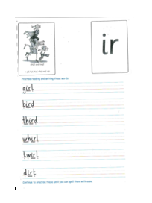
Rainbow Group ir is our sound for this week
After a brief phonic session can you complete this phonic sheet that is
in the folder.
Once you have finished it, it can be stuck into your green home-learning book.

Slide 4
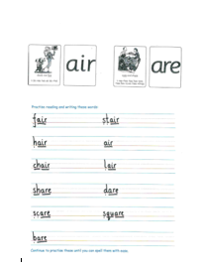
Sunshine Group are is our sound for this week
After a brief phonic session can you complete this phonic sheet that is
in the folder.
Once you have finished it, it can be stuck into your green home-learning book.

Slide 5


Continue with RWI
Begin by reading the Speed Sounds to an adult, as you did yesterday.

Slide 6

Continue with RWI
After that, you are ready to read through the Green and Red Words to an adult like you did yesterday.

Slide 7
Continue with RWI
Once you have read the speed sounds, green and red words, you are now ready to read the book to an adult. Remember to pause at the full stops.

Slide 8

Our Structure for RWI
Now you are ready for the second Hold a Sentence (see next slide for the sentence for each group)
Get your Weekly Writing Sheet for Tuesday and listen to your adult say the sentence out loud to you. Remember to do the actions for capital letter and full stop. Repeat at least 3 times before you write it down.

Slide 9

Rainbow Group
Today’s Hold a Sentence is:
A bug is stuck in the web.
remember:
ck
Sunshine Group
tricky word: my
Today’s Hold a Sentence is:
I throw my hat in the deep snow.

Slide 10
Our Structure for RWI
Now you are ready to write the Hold a Sentence down on your paper.
Don’t forget to use
a capital letter
a full stop
finger spaces
neat handwriting.
Look at slide 11 so you can check your Hold a Sentence.

Slide 11
Time to check
Rainbow Group
A bug is stuck in the web.
Sunshine Group
I throw my hat in the deep snow.

Slide 12

Stick your sheet in the front of your purple book.
Thank you for working hard.
Now have a break and a snack.

Slide 13


White Rose Maths
Compare Numbers
You will need:
- 0 – 20 number line (use the one on this slide)
- maths booklet (Tuesday – Compare Numbers)

Slide 14
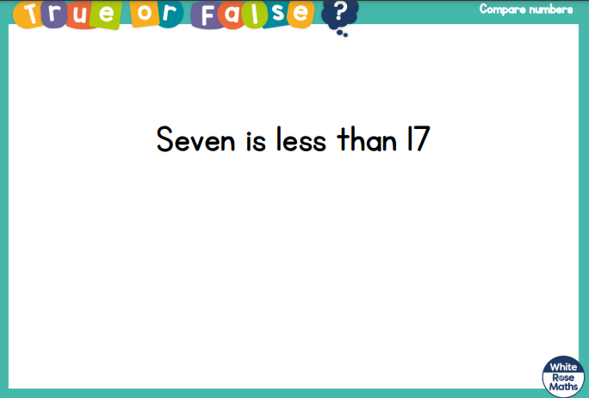
White Rose Maths
Is this true or false?

Slide 15
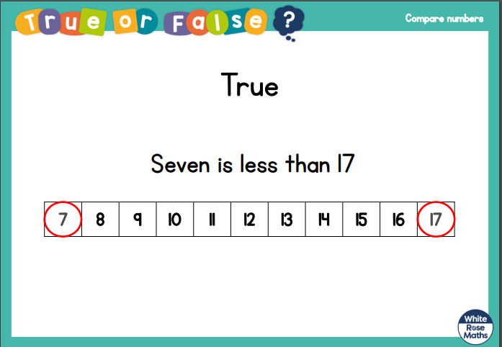
White Rose Maths
Is this true or false?

Slide 16


White Rose Maths
is greater than is less than
The small end is next to the smallest number.
The big end is next to
the biggest number.

Slide 17
White Rose Maths
Write numbers from 0 – 20 on number cards and place upside down on the table.
Pick 2 cards and say what the numbers are.
Compare them using less than, equal to or greater than.
Now pick 4 cards and point to the one that is least and then the one that is most.
14
9
20
11
14
9

Slide 18
White Rose Maths
Use this video link https://vimeo.com/483169674 and have a go at the ‘questions to think about’ slide.
Work through the video, feel free to pause it to explain any of the teaching.
Now you are ready to have a go at the worksheet.
Remember you can write your answers in your blue maths book or use the ppt link to save printing it.

Slide 19

If you have used a sheet, stick it into the front of your blue maths book.
We will continue with some White Rose teaching again tomorrow.
I think it is time for lunch and a break from your work.
There is a topic session this
afternoon but enjoy your lunch
first.

Slide 20
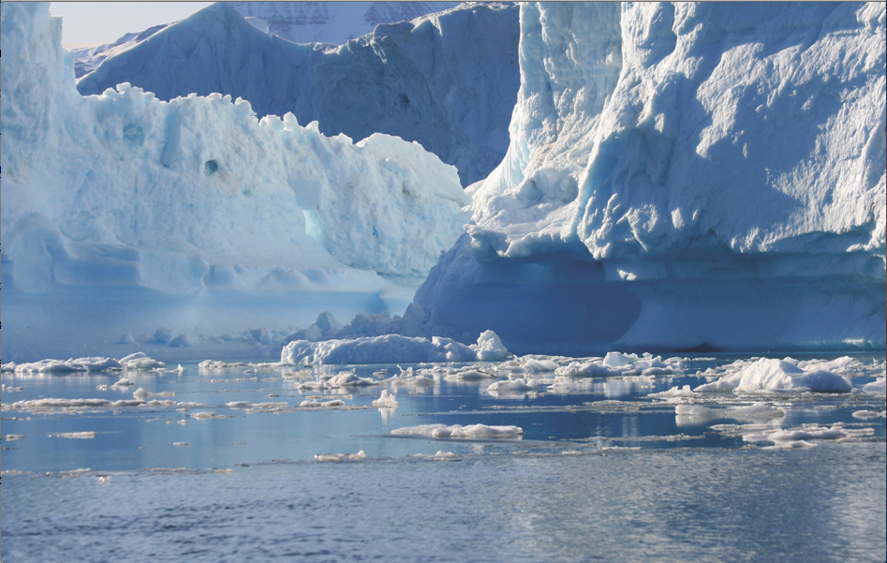
Topic
(Topic work will go at back of your
purple book. Can an adult draw a line at
the top for the date and another for the title?)
Listen to the following story
https://www.youtube.com/watch?v=LYK8ERKPnNM
This week we are looking at two questions:
Where is the Arctic?
What is it like there?

Slide 21
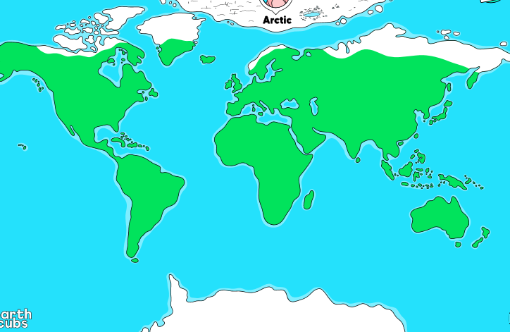
The Arctic
The Arctic is found in the far North (top) of our earth. The North Pole is located in the Arctic.

Slide 22
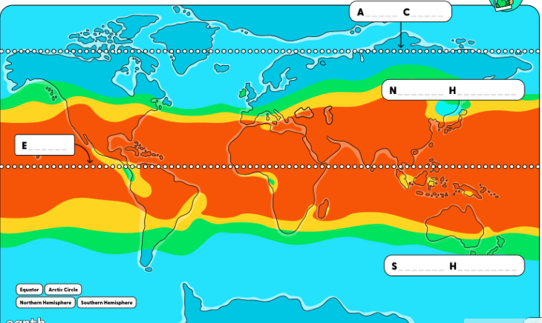
The Arctic
On this world map you can see climatic bands. Around the middle of the earth (the equator) it is hot and the further you go towards the north and south (North and South Pole), the colder it gets.

Slide 23
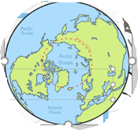
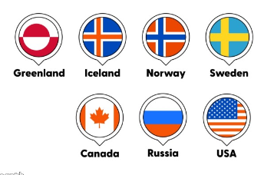
The Arctic
The dotted red line is an imaginary line around the top of our earth. This marks the Arctic Circle.
The countries that are inside
the circle are parts of
Canada, Greenland, Norway,
Sweden, Finland, Russia,
USA (Alaska) and Iceland.

Slide 24
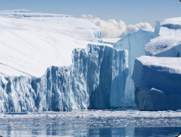
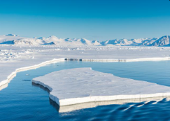
The Arctic
These are pictures of a Polar Habitat in the Arctic.
- What can you see?
- What words can you use to describe the Arctic?
- Why is there a lot of white?

Slide 25
The Arctic
The Arctic has very few plants because it is very cold .
The ice acts as the land.
There are icebergs in the Arctic Ocean which surrounds the Arctic.
Icebergs are pieces of ice that have broken off and are floating in the Ocean.

Slide 26
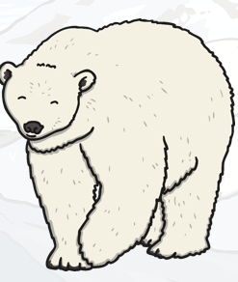
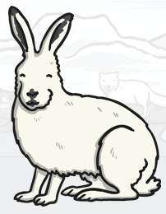
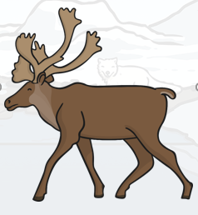
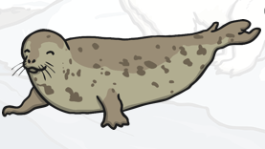
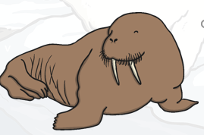
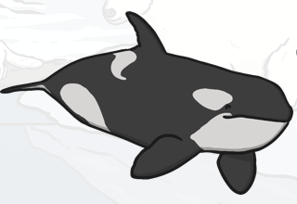
The Arctic
There are many different animals that live in the Arctic including:
walrus seal
Polar Arctic reindeer
bear hare orca whale

Slide 27
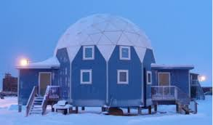
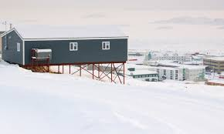
The Arctic
People (Inuits) live in the Arctic in houses that are built up off the ground. This stops the people
from getting snowed in for weeks at a time. Also
it is easier for them to keep their houses warm.

Slide 28
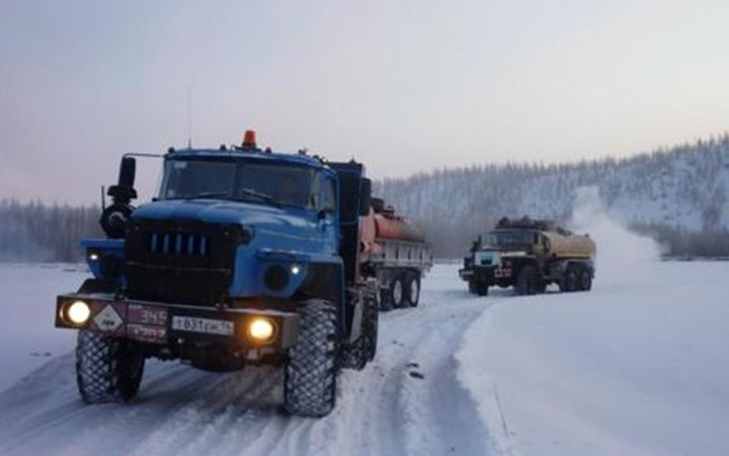
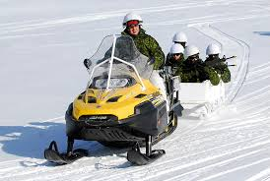
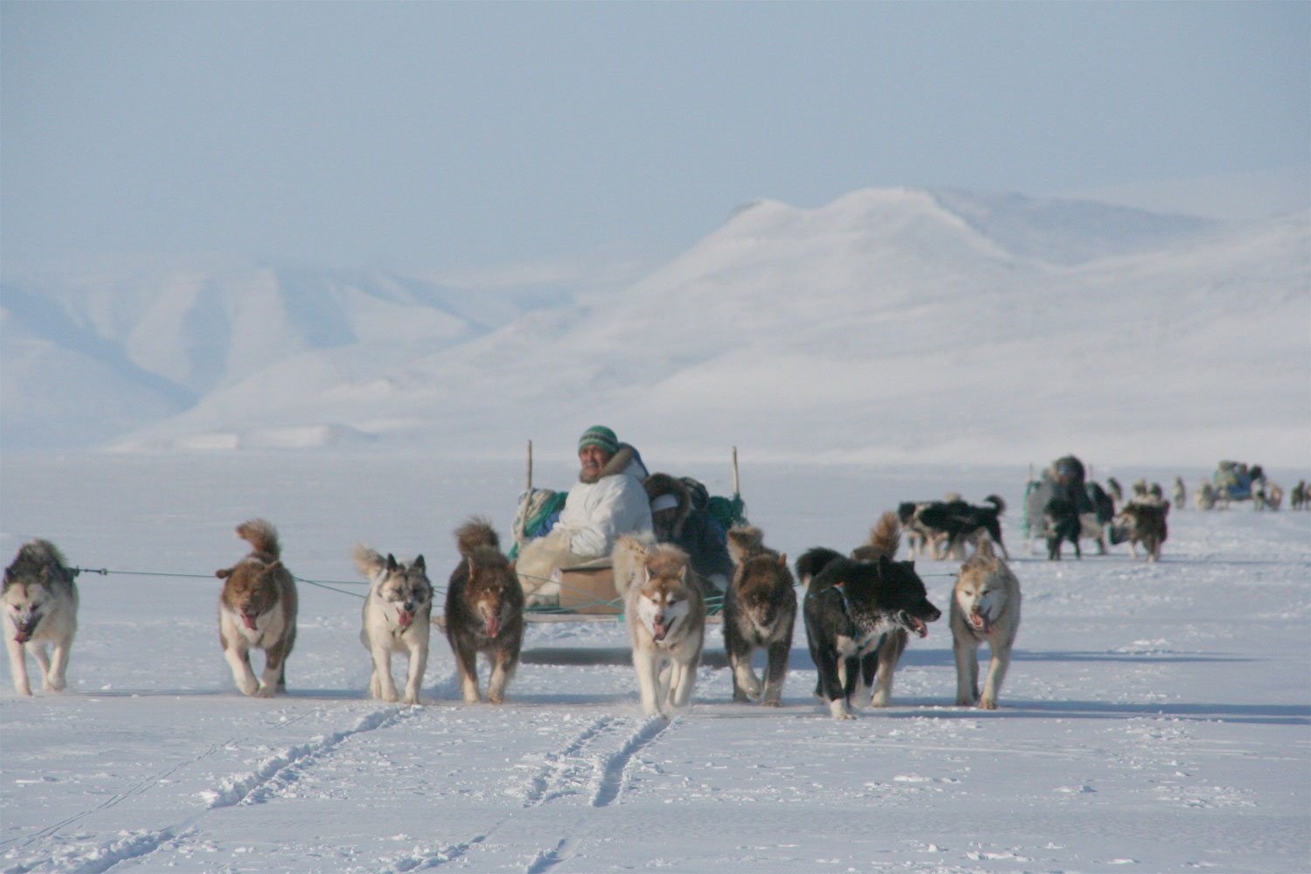
The Arctic
Some people use vehicles with special snow tyres to travel from place to place. Others use snow mobiles or even sleds that are pulled by dogs to skim across the snow and ice.

Slide 29
The Arctic
As plants don’t grow, they have to hunt and fish for their food. When fishing, they have to break a hole in the ice to get to the water and then put a fishing line through the hole and wait to catch the fish.

Slide 30
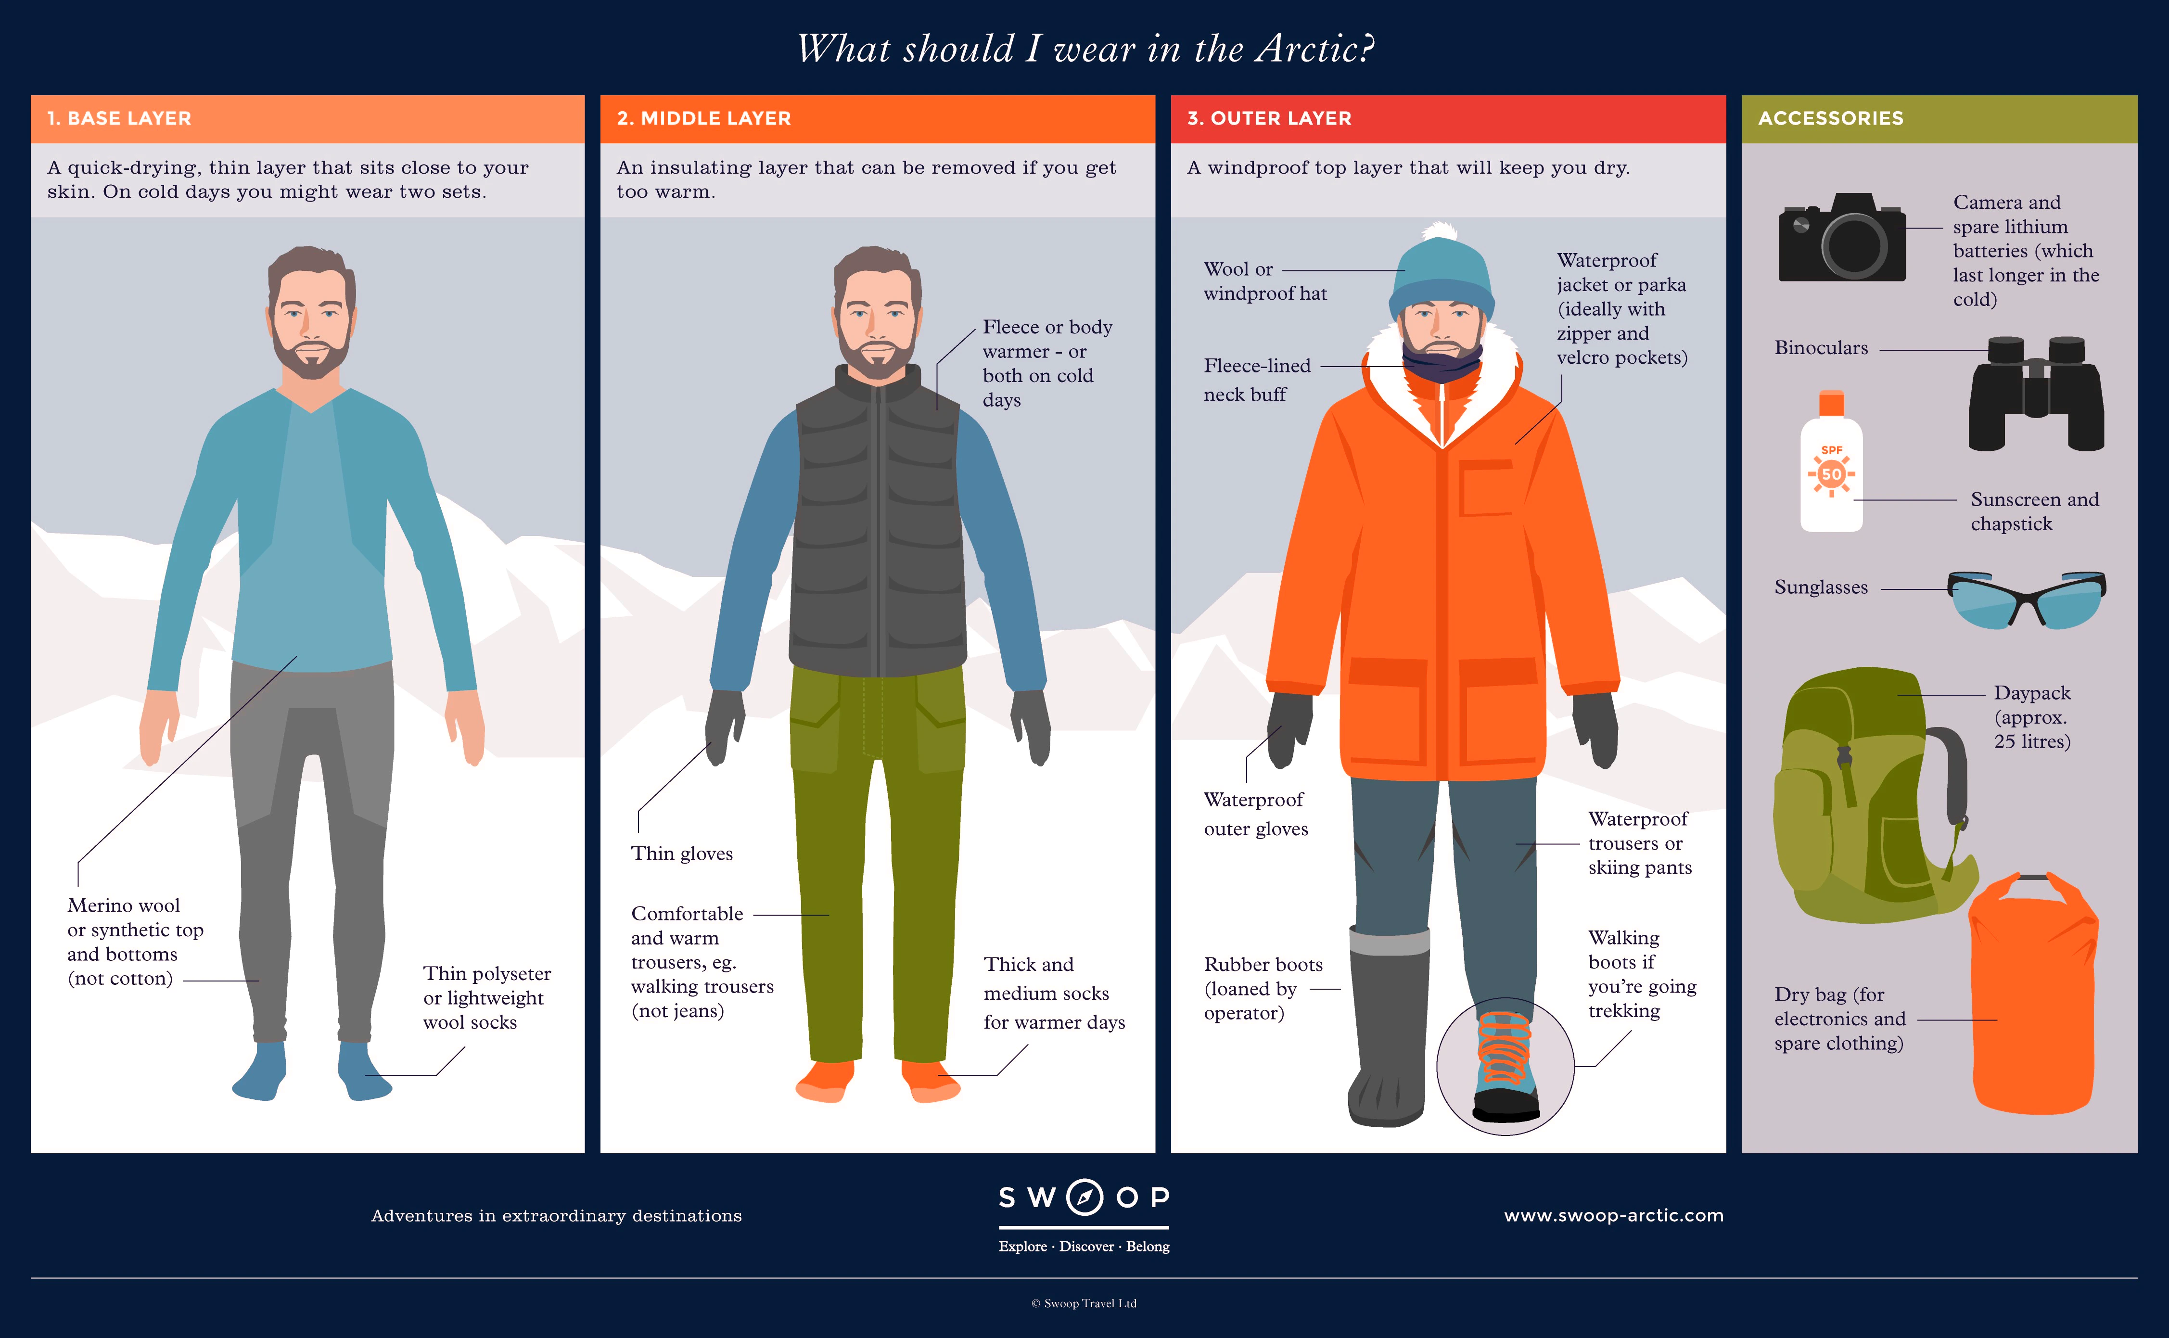
The Arctic
As it is so cold, it is important to wear gloves, hats, boots and lots of thin layers of clothing to keep you warm.

Slide 31
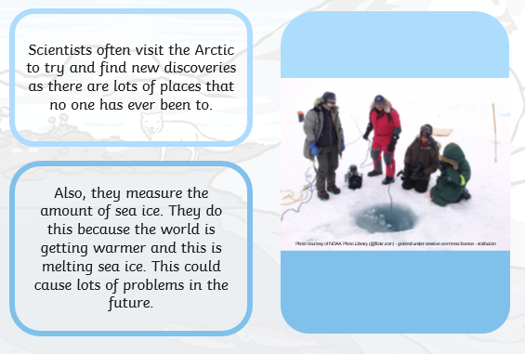
The Arctic
Now watch https://www.youtube.com/watch?v=b-9xDztBhzE

Slide 32
The Arctic
In the back of your purple book write the date
Tuesday 19th January
and title
The Arctic

Slide 33
The Arctic
I would like you to draw and label a picture about what you have found out about the Arctic. Or you could make an information page about the Arctic.
I am looking forward to seeing what you have produced.

Slide 34

Most importantly encourage your child to read a suitable book to you. Later on it would be great if you could read a bedtime story to them.
Please remember to send an email containing the work that they have done to teacher@kingslandengland.hereford.sch.uk

Slide 35

Worship Time with:
Mr. Debenham

