Slide 1


Monday 18th January 2021
Below is the timetable for today.
It is here to give you a guide on today’s work.
For maths you will need access to the worksheet and have some counting equipment.
 | phonics | RWI |  | maths – White Rose Vimeo link and worksheet |  | afternoon | 2:45 assembly via email | time to share a book
9am On-line registration Story | Rainbow Group ir – whirl and twirl Sunshine Group are – care andshare | We can all Swim Bats -Speed Sounds -Red and Green words -Read story -Hold a Sentence | BREAK | Compare Groups of Objects https://vimeo.com/483168827 Worksheet | LUNCH | RE What do people think about God? What do Muslims think about God? | Rev Julie | Reading Time

Slide 2

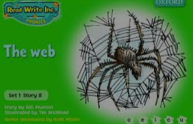
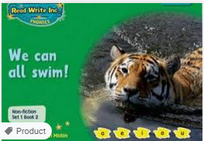



RWI
Each day for RWI you will need:
Rainbow Group Sunshine Group
The Web Snow book book
‘Weekly Writing sheet’ RWI (from your pack)
Could you please download the relevant book for your child as we will continue to read it throughout the week.

Slide 3
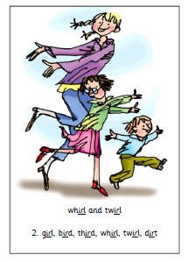
Rainbow Group
Our new sound for this week: ir

Slide 4

Sunshine Group
Our new sound for this week: are

Slide 5


Our Structure for RWI
Begin by reading the Speed Sounds to an adult (just like we do in class).

Slide 6

Our Structure for RWI
After that you are ready to read through the Green and Red Words to an adult (just like we do in class).

Slide 7
Our Structure for RWI
Adults could you look at the vocabulary list and make sure that your child knows what each word means. Then you are ready to talk through the introduction with your child.

Slide 8
Our Structure for RWI
You are now ready to read your book to an adult. Remember to pause at a full stop.

Slide 9

Our Structure for RWI
Once you have completed this, then you are ready to work on the Hold a Sentence (see next slide for the sentence for each group)
Get your Weekly Writing Sheet for Monday and listen to your adult say the sentence out loud to you. Remember to do the actions for capital letter and full stop. Repeat at least 3 times before you write it down.

Slide 10


Rainbow Group
Today’s Hold a Sentence is:
It is a bug with spots.
tricky word:
Sunshine Group
Today’s Hold a Sentence is:
I stamp my cold feet in the snow.
tricky words: my cold

Slide 11
Our Structure for RWI
Now you are ready to write the Hold a Sentence down on your paper.
Don’t forget to use
a capital letter
a full stop
finger spaces
neat handwriting.
Look at slide 12 so you can check your Hold a Sentence.

Slide 12
Time to check
Rainbow Group
It is a bug with spots.
Sunshine Group
I stamp my cold feet in the snow.

Slide 13

Stick your sheet in the front of your purple book.
Thank you for working hard.
Now have a break and a snack.

Slide 14


White Rose Maths
Compare Groups of Objects
You will need:
maths booklet - Monday Compare Groups of Objects
0 – 20 number line (refer to this one on the screen)
counting objects – see next slide

Slide 15
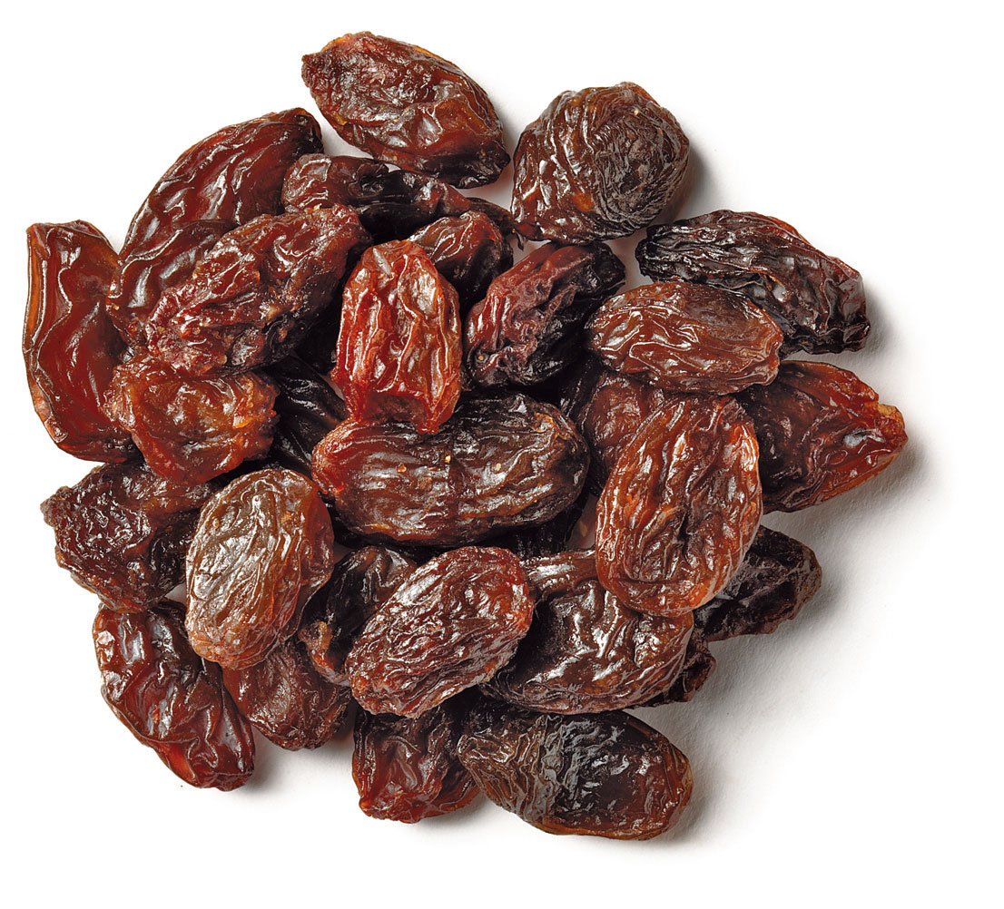
White Rose Maths
To begin today’s session I would like you to get some counting objects, such as: Cheerios, Shreddies, cubes, pasta, raisins, socks etc.
I would like each person to take an amount of the counting objects and compare your amounts using vocabulary: least or less than; the same as or equal to; most, more than or greater than.
“I have more than you.”

Slide 16
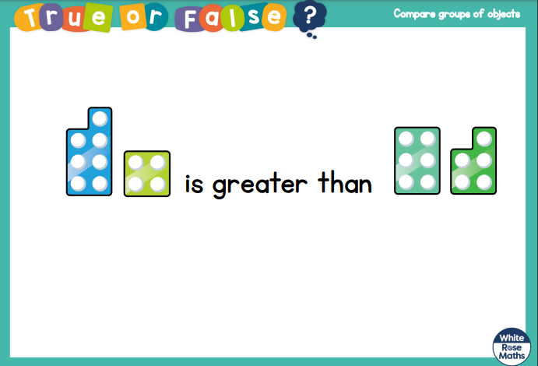
White Rose Maths
Is this true or false?

Slide 17
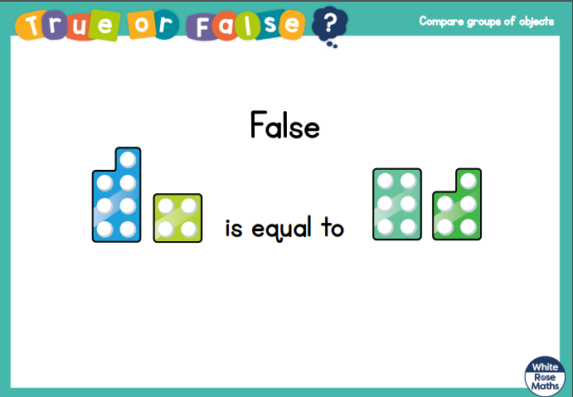
White Rose Maths
7 and (add) 4 is the same as 6 and (add) 5

Slide 18
White Rose Maths
Use this video link https://vimeo.com/483168827
and have a go at the ‘questions to think about’ slide.
Work through the video, feel free to pause it to explain any of the teaching.
Now you are ready to have a go at the worksheet. Question 4 is a deeper thinking question.
Remember you can write your answers in your blue maths book to save printing it out or use the PowerPoint version.

Slide 19
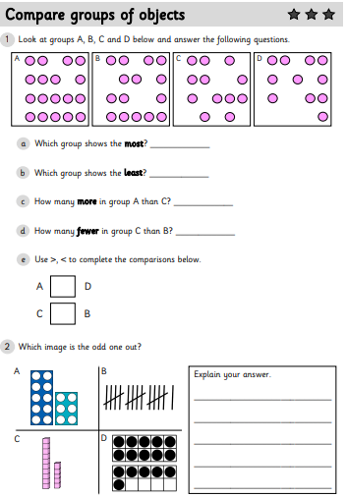
White Rose Maths
If you want a ‘challenge’, there is a deeper thinking sheet in the file.

Slide 20

If you have used a sheet, stick it into the front of your blue maths book.
We will continue with some White Rose teaching again tomorrow.
I think it is time for lunch and a break from your work.
There is an R.E session for this
afternoon but enjoy your lunch
first.

Slide 21

Religious Education
Today we are continuing our topic on Islam.
Last week you all agreed that people matter more than things.
We know that GOD is most important for both Christians, Jews but today you are also going to find out that God is most important for Muslims (people who follow Islam).

Slide 22
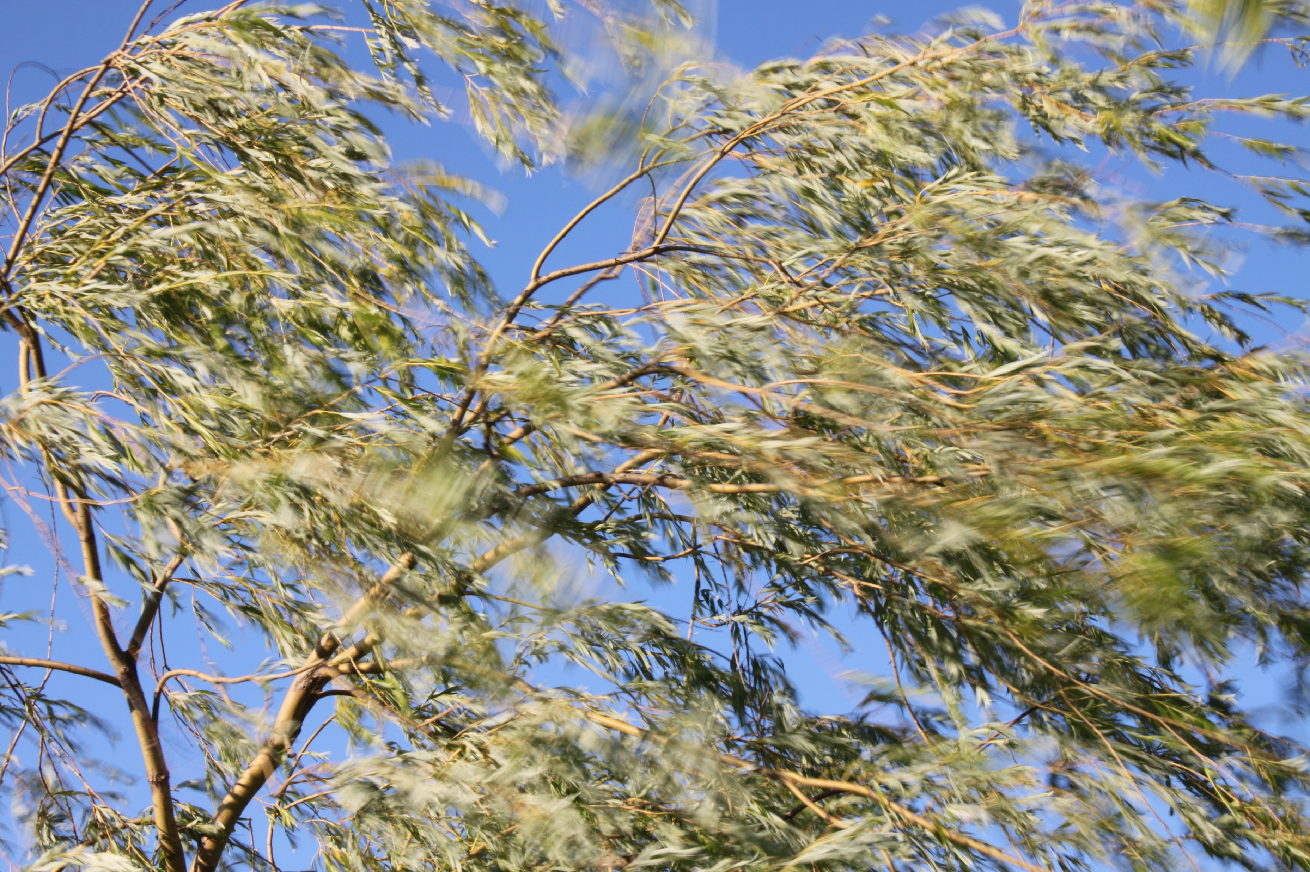

Religious Education
What is making the leaves on this tree move?
Can you see the wind?
What does this represent?
Can you see love?
We can’t see it but know that it exists.

Slide 23

Religious Education
What is inside this balloon?
Can we see it?
We can’t see the air but it doesn’t mean that there is nothing there.

Slide 24
Religious Education
Muslims believe that the world would
not function without God. A bit like the
balloon would not inflate without air.
Even though people can’t see God, some people think that the world would not be the place that it is without God.

Slide 25
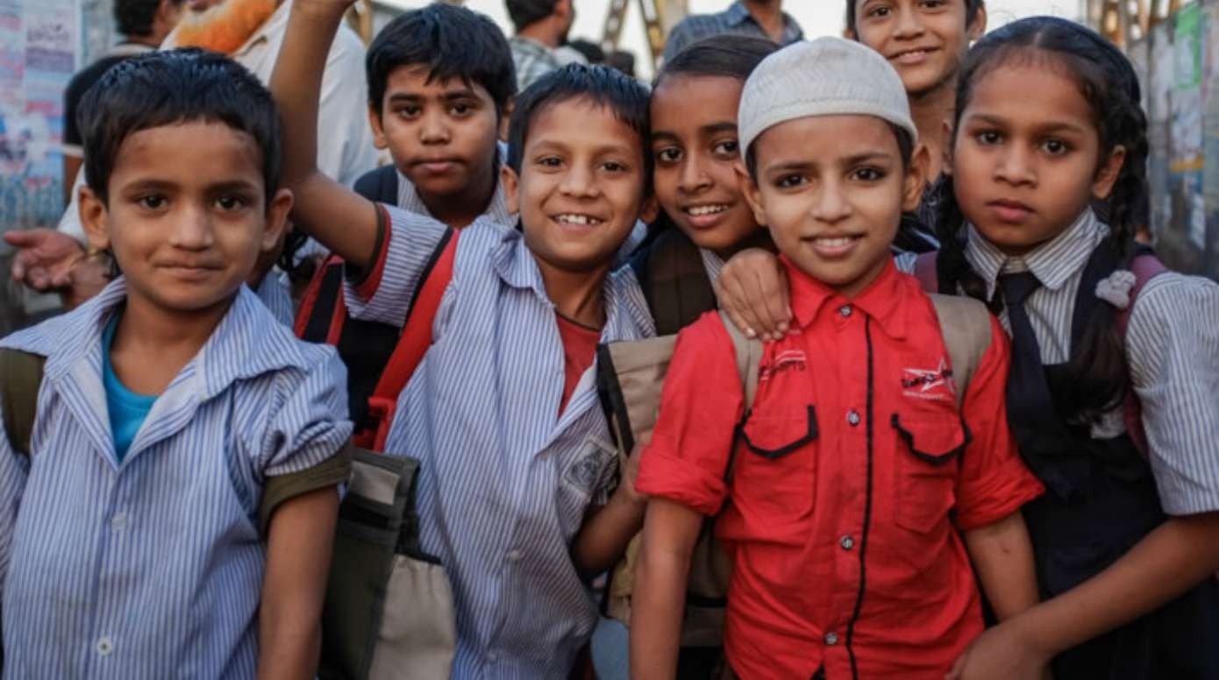
Religious Education
These children are Muslim children.
They are similar to us.
They enjoy things we enjoy,
They like/get upset like we
do.
There are about 360 Muslims living in Hereford.

Slide 26


Religious Education
Muslims believe in one God, Allah, who is all powerful.
The Muslim word for God in Arabic is
Allah .
Muslim people are not allowed to draw Allah so always write the word.

Slide 27
Religious Education
Can you think about: Where you think you could find God? What is God like?
In the back of your purple books, write the date Monday 18th January and title God.
Draw, colour in or paint a picture of where you think that you would find God (There are some ideas on the next slide).

Slide 28
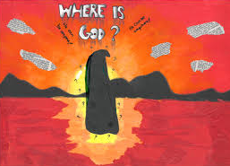
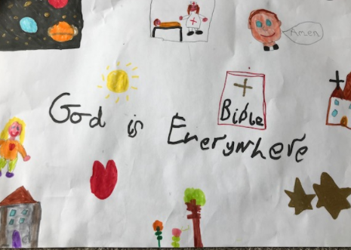

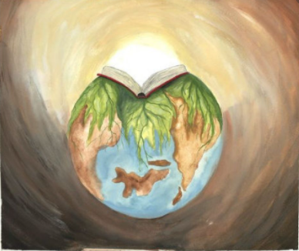
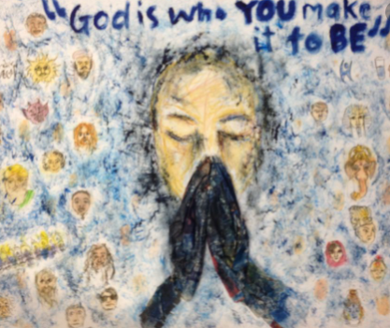
Religious Education
https://www.youtube.com/watch?v=DhRuKt5b0y0

Slide 29

Worship Time with:
Rev. Julie

Slide 30

Most importantly encourage your child to read a suitable book to you. Later on it would be great if you could read a bedtime story to them.
Please remember to send an email containing the work that they have done to teacher@kingslandengland.hereford.sch.uk

