Slide 1


Friday 15th January 2021
Below is the timetable for today.
It is here to give you a guide on today’s work.
For RWI you will need to be able to see a copy of the words for the Spelling Quiz. For maths you need to be able to see a copy of the worksheet.
 | phonics | RWI |  | maths – White Rose Vimeo link and worksheet |  | afternoon | 2:45 assembly via email | time to share a book
9am On-line registration via TEAMS link | Rainbow Group air –that’s not fair Sunshine Group aw – yawn at dawn | Chips Dressing-up Box -Speed Sounds -Red and Green words -Read story -Big Write | BREAK | Count One More/One Less https://vimeo.com/480325729 | LUNCH | PE and Golden Time | Big Joe | Reading Time

Slide 2



RWI
This is our final day reading these books:
Rainbow Group Sunshine Group
Chips The Dressing-Up Box book book
‘Weekly Writing sheet’ RWI (from your pack)

Slide 3

Rainbow Group
Today we are going to have a very brief start to our phonic session to read through the graphemes.

Slide 4

Sunshine Group
Today we are going to have a very brief start to our phonic session to read through the graphemes.

Slide 5
Sunshine and Rainbow Groups
Yesterday we had the Spelling Quiz.
I would like you to look back at your quiz and see which words (if any) you found a challenge.
I would like you to practise these words so you are able to spell them with ease.

Slide 6
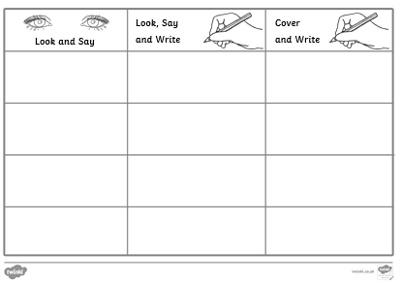
Sunshine and Rainbow Groups
In the Friday file are the red (tricky) words that you have been reading in your RWI book this week.
I would now like you to try to learn how to spell these words so you are able to spell them with ease.

Slide 7
Sunshine and Rainbow Groups
Look at the words in the Look and Say column. You need to take your time to look at each word, say the letters out loud, look at the shape of the word and try to write it in the air.
Once you think you know how to spell them, have a go in the second column.
In the final column, cover the words up and write them.

Slide 8
Sunshine and Rainbow Groups
Write four different sentences using these words. Use one word in each sentence.
Use the handwriting lines to help you to keep it neat.

Slide 9


Continue with RWI
Begin by reading the Speed Sounds to an adult, as you did yesterday.

Slide 10

Continue with RWI
After that, you are ready to read through the Speed Words (on page 15 of your book) to an adult.

Slide 11
Continue with RWI
Now you are ready to read the story to an adult. You have been working on this story all week so you should be getting very confident!
Remember to think about your expression to make it interesting to listen to and pausing for punctuation.

Slide 12
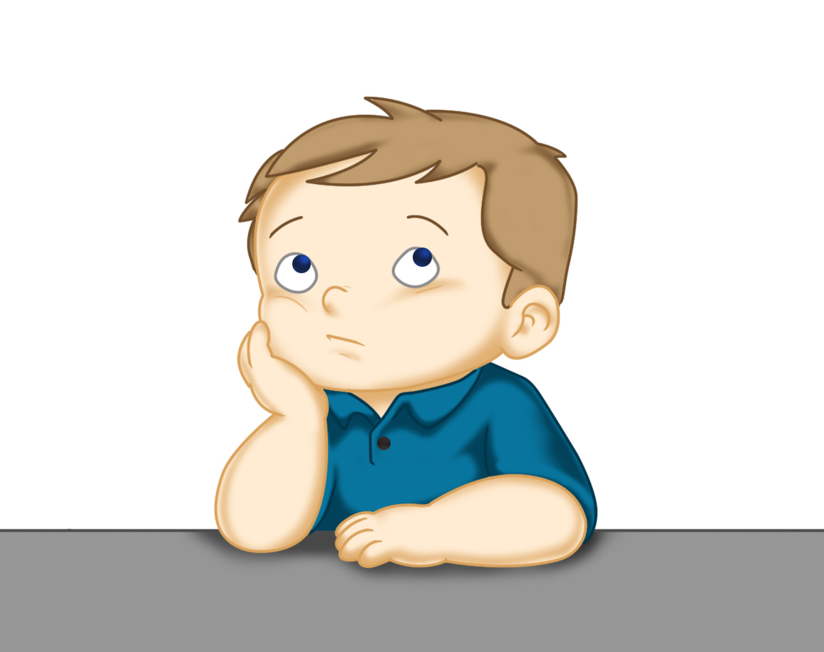
Our Structure for RWI
Today is the final day of RWI for the week.
This is when we do our Big Write. We base this around the book that we have been reading in RWI.
This Photo by Unknown Author is licensed under CC BY

Slide 13
Rainbow Group - Big Write
Today we are thinking about the chips that Kim had.
What words can you use to describe them?
Make a list of the words(adjectives) that you could use to describe the chips. steamy, thick etc.

Slide 14
Big Write
Sunshine Group - Big Write
Today we are thinking about dressing up. What clothes would you choose to wear? How would you describe them?
Make a list of the words (nouns) of the things that you would dress up in. Now make another list (adjectives) that you could use to describe the clothes. e.g spotty, shiny, scruffy, silky etc.

Slide 15

Big Write
You are ready to think about how you can use these words in some super sentences.
Talk through your sentences with an adult, one sentence at a time. When you are happy with your sentence, ‘put your headphones on’ say it again and then write it down.
I will look forward to reading your finished pieces of writing.
Don’t forget to use neat handwriting, finger spaces, capital letters and full stops.

Slide 16

Stick your sentence on the next page at the front of your purple book.
Thank you for working hard.
Now have a break and a snack.

Slide 17





White Rose Maths
Count One More/One Less
You will need:
- maths sheet from Friday’s file

Slide 18
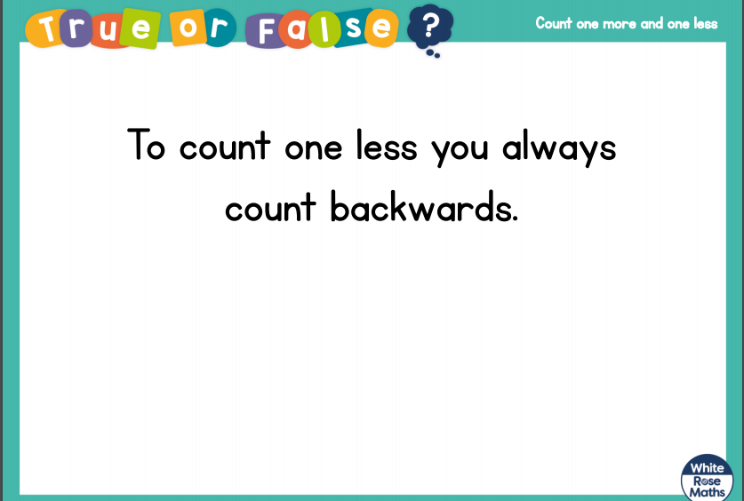
White Rose Maths
Talk about this and then see if you can show some examples.

Slide 19
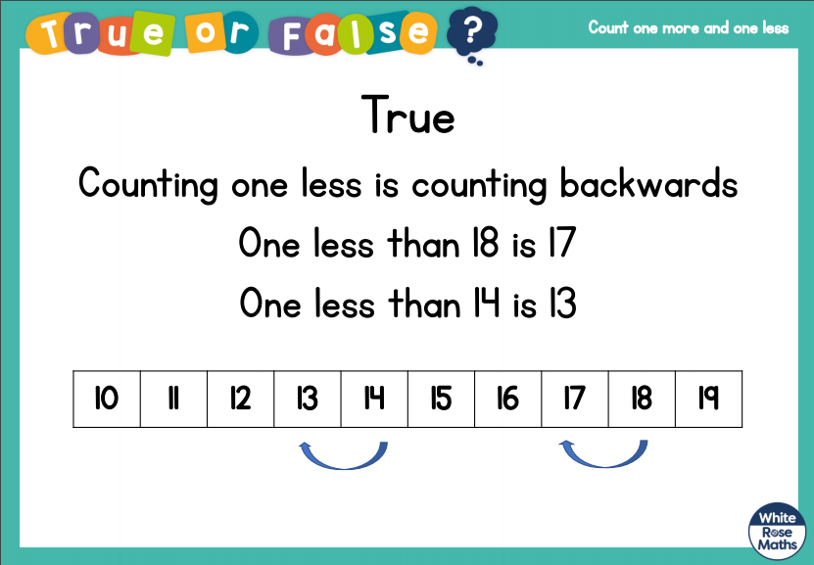
White Rose Maths

Slide 20
White Rose Maths
Use this video link https://vimeo.com/480325729
and have a go at the ‘questions to think about’ slide.
Work through the video, feel free to pause it to explain any of the teaching.
Now you are ready to have a go at the White Rose worksheet for today. Question 6 is a challenge question.
Remember you can write your answers in your blue maths book to save printing it out.

Slide 21

If you have used a sheet, stick it into the front of your blue maths book.
We will continue with some White Rose teaching again tomorrow.
I think it is time for lunch and a break from your work.
.
This afternoon there is an ICT
lesson about what is a computer
and how it helps us. Also there is a
PE session where you can choose from
a range of activities. First of all
enjoy your lunch.

Slide 22

Most importantly encourage your child to read a suitable book to you. Later on it would be great if you could read a bedtime story to them.
Please remember to send an email containing the completed work to teacher@kingslandengland.hereford.sch.uk

