Slide 1

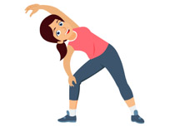
PE
If you can get outdoors please do. You could try these activities to keep active:
Go for a long brisk walk
Ride your bike or scooter
Play some football or just kick a ball around
Play on outdoor equipment
If you can’t get out, follow the link on the slide for a workout or dance session.

Slide 2
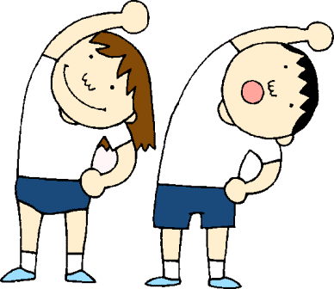
https://www.youtube.com/watch?v=jUkUIAbAwOs

