Slide 1


Wednesday 13th January 2021
Below is the timetable for today.
It is here to give you a guide on today’s work.
For RWI you will need access to the Roll and Read sheet, a dice and the Edit a Sentence. For maths you need to be able to see a copy of the worksheet.
 | phonics | RWI |  | maths – White Rose Vimeo link and worksheet |  | afternoon | 2:45 assembly via email | time to share a book
9am On-line registration via TEAMS link | Rainbow Group air –that’s not fair Sunshine Group aw – yawn at dawn | Chips Dressing-up Box -Speed Sounds -Red and Green words -Read story -Edit a Sentence | BREAK | Tens and Ones https://vimeo.com/480324356 | LUNCH | Science | I Sing Pop | Reading Time

Slide 2


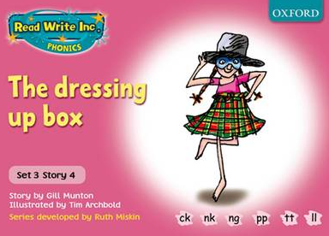

RWI
Each day for RWI you will need:
Rainbow Group Sunshine Group
Chips The Dressing-Up Box book book
‘Weekly Writing sheet’ RWI (from your pack)

Slide 3
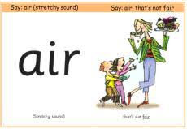
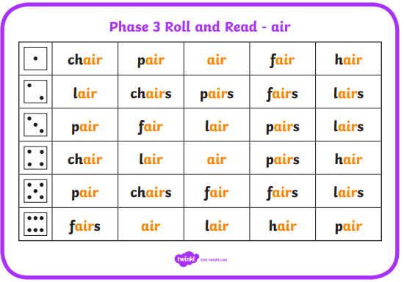
Rainbow Group
After a brief phonic session can you complete this game that is in Wednesday’s folder. You don’t necessarily have to print it.
Once finished, it can be stuck into the front of your purple book.

Slide 4

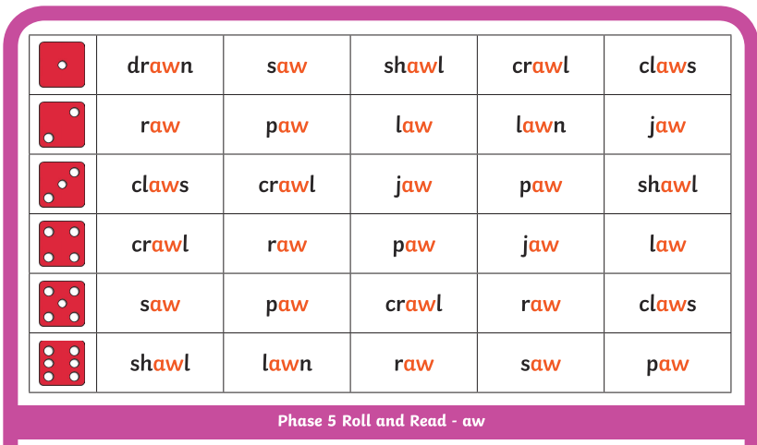
Sunshine Group
After a brief phonic session can you complete this game that is in Wednesday’s folder. You don’t necessarily have to print it.
Once finished, it can be stuck into the front of your purple book.

Slide 5
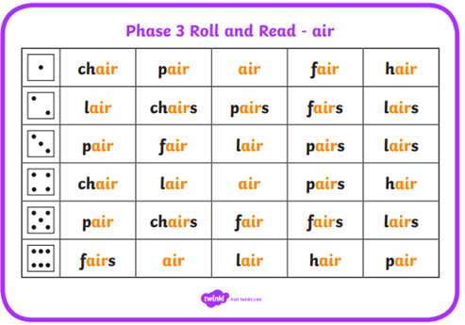
How to Play Roll and Read
You can either: print this off and tick or colour in the words your child has read; or leave it on the screen to read.
Roll the dice and read the first word in that row, keep on rolling the dice and reading the words until you fill a complete row.

Slide 6


Continue with RWI
Begin by reading the Speed Sounds to an adult, as you did yesterday.

Slide 7

Continue with RWI
After that, you are ready to read through the Green and Red Words to an adult like you did yesterday.

Slide 8
Continue with RWI
Once you have read the speed sounds, green and red words, you are now ready to read the story to an adult. Remember to pause at the full stops.

Slide 9
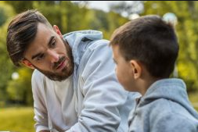
Our Structure for RWI
Today we have two activities to do:
Questions to Answer - see page 14 of your reading book.
Get an adult ask you the questions. Don’t
forget to turn to the correct page to help
you to find the answer.
Remember to answer in full sentences.

Slide 10

Our Structure for RWI
2. Edit a Sentence.
On the following pages there is a sentence, one for each group to read.
We do this every week in class so they know that there are some mistakes and their job is to look carefully at the sentence to try to spot all of the errors.
Once they have done this they circle them and then copy the corrected sentence onto the Wednesday section of the Weekly Handout Sheet.

Slide 11

Edit a Sentence she had a big bug of cips
There are 4 mistakes:
1 capital letter 2 spelling mistakes
1 full stop
Once you have found the mistakes, look at the next slide to check.

Slide 12
Edit a Sentence
Did you spot all of the mistakes?
she had a big bug of cips .
Now copy it up neatly (correct sentence on slide 15).

Slide 13
Edit a Sentence she has a blak hat and a pik wig. she is a witch
There are 5 mistakes:
2 capital letters 2 spelling mistakes
1 full stop
Once you have found the mistakes, look at the next slide to check.

Slide 14
Edit a Sentence
she has a blak hat and a pik wig.
she is a witch.
Now copy it up neatly (correct sentence on slide 15).
Did you spot all of the mistakes?

Slide 15
Edit a Sentence – correct sentences
She had a big bag of chips.
She has a black hat and a pink wig. She is a witch.

Slide 16

Stick your sheet in the front of your purple book.
Thank you for working hard.
Now have a break and a snack.

Slide 17


White Rose Maths
Tens and Ones
You will need:
- number words sheet
- maths booklet (Wednesday – tens and ones)

Slide 18
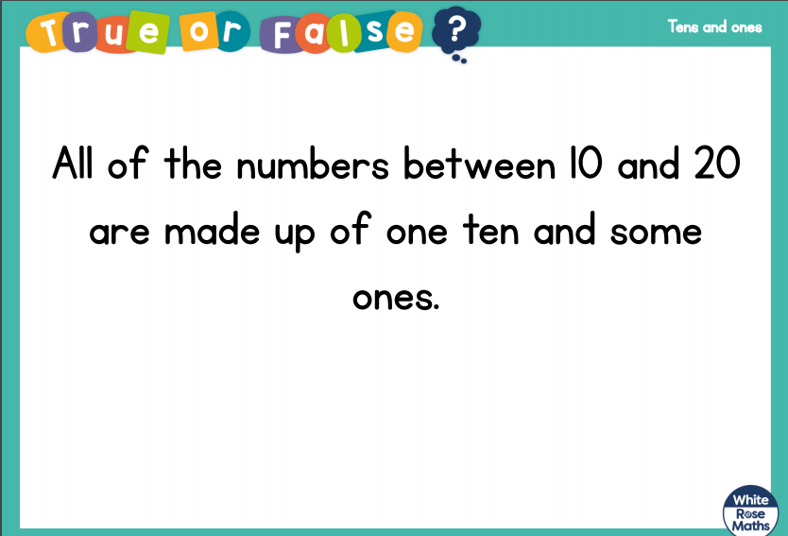
White Rose Maths
Is this true or false? (answer on slide 19)

Slide 19
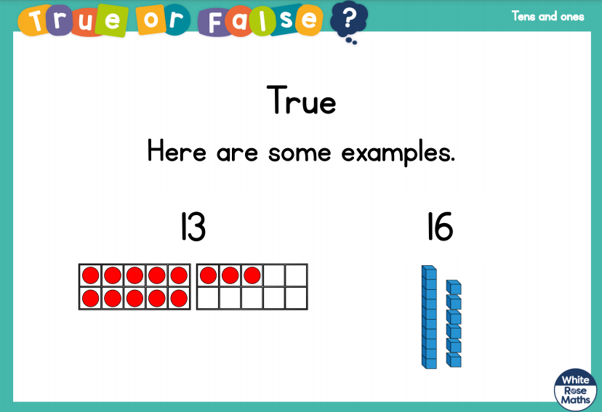
White Rose Maths

Slide 20
White Rose Maths
Use this video link https://vimeo.com/480325207
and have a go at the ‘questions to think about’ slide.
Work through the video, feel free to pause it to explain any of the teaching.
Now you are ready to have a go at the worksheet.
Remember you can write your answers in your blue maths book to save printing it out.

Slide 21
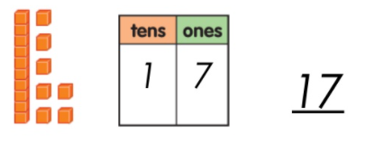
White Rose Maths
Following on from this:
Ask your child to draw different teen numbers e.g. 17
They should show 1 ten and 7 ones
Continue with a few other examples.

Slide 22

If you have used a sheet, stick it into the front of your blue maths book.
We will continue with some White Rose teaching again tomorrow.
I think it is time for lunch and a break from your work.
There is a science session this
afternoon but enjoy your lunch
first.

Slide 23

Most importantly encourage your child to read a suitable book to you. Later on it would be great if you could read a bedtime story to them.
Please remember to send an email containing the work that they have done to teacher@kingslandengland.hereford.sch.uk

