Slide 1
Everyday Materials

Slide 2
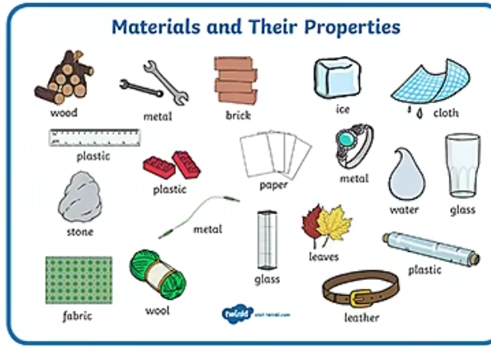
This term we are going to look at different materials and see how each material is useful to us.
What do we mean by materials?

Slide 3
Material – it means what an object is made from.
For example, an object such as a bottle can be made from the materials glass or plastic.
An object like a pencil can be made from the materials wood and lead.

Slide 4
Can you name any types of materials? Have a think…
(click on the next slide when you are ready and see a range of materials)

Slide 5
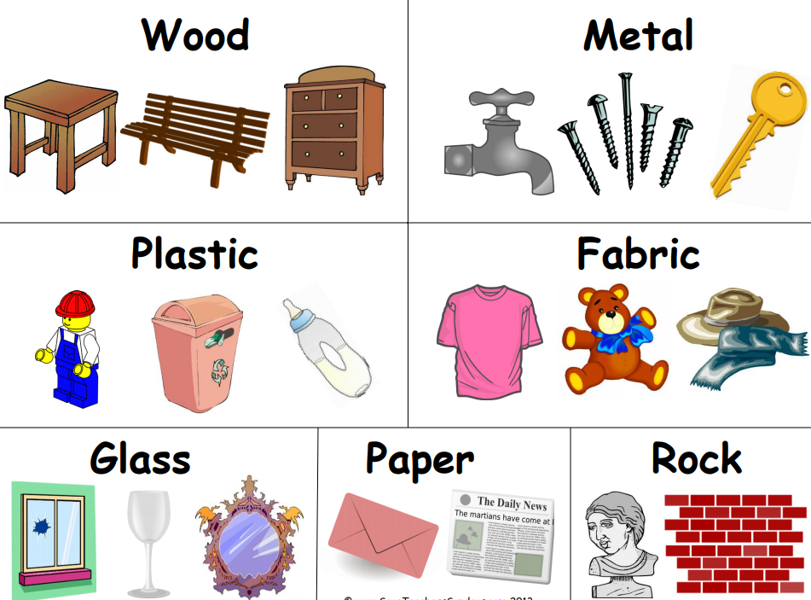
Here is a diagram showing a range of objects and what materials they are made from. Take a look.

Slide 6
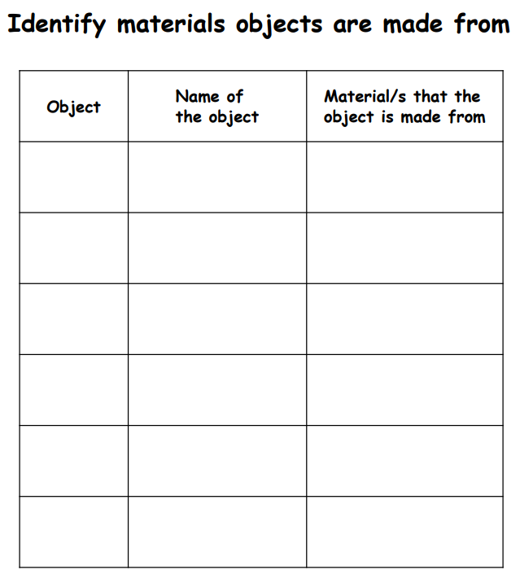
Your task is to look around your house and garden and try to identify the materials of different objects.
There is a worksheet included on the school website but you can do this work on a sheet of paper if you are unable to print.
Some objects may be made of more than one material.
Please draw your object in this row.
There are actually 2 sheets included this one to the right is page 2 of the pdf. Please feel free to do as many as you like, you do not need to limit it to the 6 boxes on the worksheet.

Slide 7
If you are able to include this on the email you are sending into school that would be great. teacher@kingslandengland.hereford.sch.uk
Thank you

