Slide 1


Tuesday 12th January 2021
Below is the timetable for today.
It is here to give you a guide on today’s work.
For maths you will need access to the worksheet and the number words sheet.
 | phonics | RWI |  | maths – White Rose Vimeo link and worksheet |  | afternoon | 2:45 assembly via email | time to share a book
9am On-line registration via TEAMS link | Rainbow Group air -care and share Sunshine Group aw – yawn at dawn | Chips Dressing-up Box -Speed Sounds -Red and Green words -Read story -Hold a Sentence | BREAK | Numbers from 11-20 https://vimeo.com/480769444 | LUNCH | Topic | Mr Debenham | Reading Time

Slide 2




RWI
Each day for RWI you will need:
Rainbow Group Sunshine Group
Chips The Dressing-Up Box book book
‘Weekly Writing sheet’ RWI (from your pack)
If you haven’t got a pack there is one in school for you or one in the file for today.

Slide 3
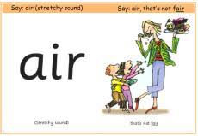
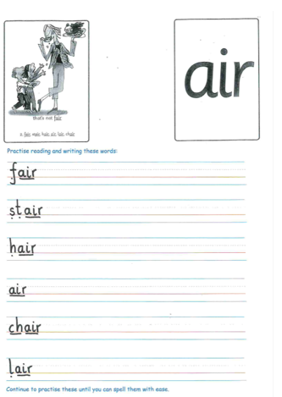
Rainbow Group is our sound for this week
After a brief phonic session can you complete this phonic sheet that is
in the folder.
Once you have finished it, it can be stuck into your green home-learning book.

Slide 4

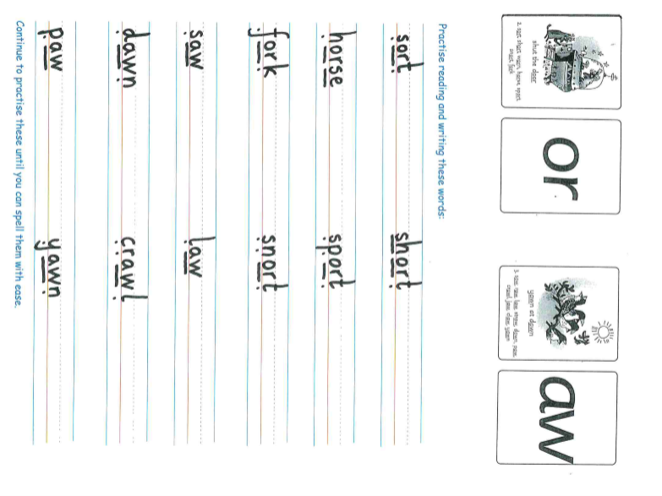
Sunshine Group is our sound for this week
After a brief phonic session can you complete this phonic sheet that is
in the folder.
Once you have finished it, it can be stuck into your green home-learning book.

Slide 5


Continue with RWI
Begin by reading the Speed Sounds to an adult, as you did yesterday.

Slide 6

Continue with RWI
After that, you are ready to read through the Green and Red Words to an adult like you did yesterday.

Slide 7
Continue with RWI
Once you have read the speed sounds, green and red words, you are now ready to read the story to an adult. Remember to pause at the full stops.

Slide 8
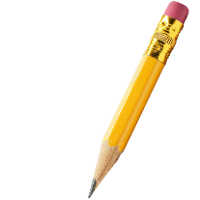
Our Structure for RWI
Now you are ready for the second Hold a Sentence (see next slide for the sentence for each group)
Get your Weekly Writing Sheet for Tuesday and listen to your adult say the sentence out loud to you. Remember to do the actions for capital letter and full stop. Repeat at least 3 times before you write it down.

Slide 9

Rainbow Group
Today’s Hold a Sentence is:
She had no chips left.
tricky word:
she
Sunshine Group
tricky word: put
Today’s Hold a Sentence is:
He put on a pink wig and a cap.

Slide 10
Our Structure for RWI
Now you are ready to write the Hold a Sentence down on your paper.
Don’t forget to use
a capital letter
a full stop
finger spaces
neat handwriting.
Look at slide 11 so you can check your Hold a Sentence.

Slide 11
Time to check
Rainbow Group
She had no chips left.
Sunshine Group
He put on a pink wig and a cap.

Slide 12

Stick your sheet in the front of your purple book.
Thank you for working hard.
Now have a break and a snack.

Slide 13


White Rose Maths
Numbers from 11 – 20
You will need:
- number words sheet
- maths booklet (Monday count forwards and backwards)

Slide 14
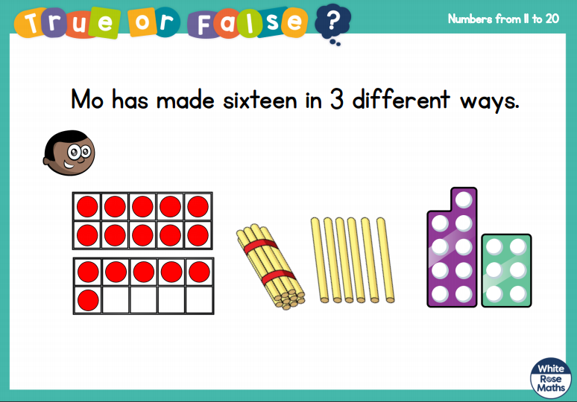
White Rose Maths
Is this true or false?

Slide 15
White Rose Maths
Use this video link https://vimeo.com/480769444 and have a go at the ‘questions to think about’ slide.
Work through the video, feel free to pause it to explain any of the teaching.
Now you are ready to have a go at the worksheet.
Remember you can write your answers in your blue maths book to save printing it out.

Slide 16
White Rose Maths
After you have finished the worksheet, ask an adult to write from 0 - 20 in numerals on pieces of paper.
Place upside down on the table.
Pick 5 cards and see if you are able to write them in words.
At this stage in your child’s education, it is acceptable for their spelling to look (phonetically) correct if not necessarily accurate. If they make a mistake, just point out the correct way of spelling the word but praise them!
5
17
0
13
9

Slide 17

If you have used a sheet, stick it into the front of your blue maths book.
We will continue with some White Rose teaching again tomorrow.
I think it is time for lunch and a break from your work.
There is a topic session this
afternoon but enjoy your lunch
first.

Slide 18
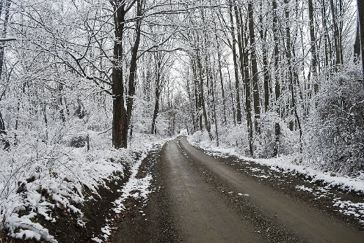
Topic
(Topic work will go at back of your
purple book. Can an adult draw a line at
the top for the date and another for the title.)
This week we are looking at winter in the United Kingdom.
Talk to someone about what you can see during winter. Now look at this link to see if you mentioned any of these things: https://www.youtube.com/watch?v=X0Bv6hchrg0

Slide 19
Topic
Look through the PowerPoint in the files and discuss what you have found out. Did you learn something new?
If possible, can you sort through some summer and winter clothes, which ones would you wear in the winter?

Slide 20
Topic
In the back of your purple book write the date
Tuesday 12th January
and title
Winter Clothes

Slide 21
Topic
Draw and label your winter clothes. Write a sentence or two explaining why you chose them.
Now get dressed into your winter clothes and go outside to play!

Slide 22

Most importantly encourage your child to read a suitable book to you. Later on it would be great if you could read a bedtime story to them.
Please remember to send an email containing the work that they have done to teacher@kingslandengland.hereford.sch.uk

