Slide 1


Monday 11th January 2021
Below is the timetable for today.
It is here to give you a guide on today’s work.
For maths you will need access to the worksheet and the number words sheet.
 | phonics | RWI |  | maths – White Rose Vimeo link and worksheet |  | afternoon | 2:45 assembly via email | time to share a book
9am On-line registration via TEAMS link | Rainbow Group air -care and share Sunshine Group aw – yawn at dawn | The Web Dressing-up Box -Speed Sounds -Red and Green words -Read story -Hold a Sentence | BREAK | Count Forwards and Backwards to 20 https://vimeo.com/480768128 worksheet | LUNCH | RE |  | Reading Time

Slide 2


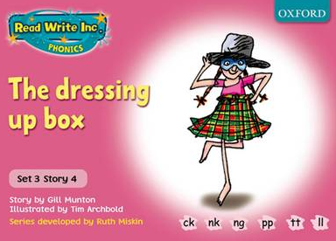

RWI
Each day for RWI you will need:
Rainbow Group Sunshine Group
Chips The Dressing-Up Box book book
‘Weekly Writing sheet’ RWI (from your pack)
If you haven’t got a pack there is one in school for you or one in the file for today.

Slide 3
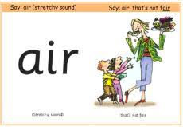
Rainbow Group
Our new sound for this week:

Slide 4

Sunshine Group
Our new sound for this week:

Slide 5


Our Structure for RWI
Begin by reading the Speed Sounds to an adult (just like we do in class).

Slide 6

Our Structure for RWI
After that you are ready to read through the Green and Red Words to an adult (just like we do in class).

Slide 7
Our Structure for RWI
Adults could you look at the vocabulary list and make sure that your child knows what each word means. Then you are ready to talk through the introduction with your child.

Slide 8

Our Structure for RWI
Once you have completed this, then you are ready to work on the Hold a Sentence(see next slide for the sentence for each group)
Get your Weekly Writing Sheet for Monday and listen to your adult say the sentence out loud to you. Remember to do the actions for capital letter and full stop. Repeat at least 3 times before you write it down.

Slide 9


Rainbow Group
Today’s Hold a Sentence is:
He has got lots of chips.
tricky word:
of
Sunshine Group
Today’s Hold a Sentence is:
She put on long spotty socks.
tricky word: spotty

Slide 10
Our Structure for RWI
Now you are ready to write the Hold a Sentence down on your paper.
Don’t forget to use
a capital letter
a full stop
finger spaces
neat handwriting.
Look at slide 11 so you can check your Hold a Sentence.

Slide 11
Time to check
Rainbow Group
He has got lots of chips.
Sunshine Group
She put on long spotty socks.

Slide 12

Stick your sheet in the front of your purple book.
Thank you for working hard.
Now have a break and a snack.

Slide 13


White Rose Maths
count forwards and backwards to 20 in numerals and words
You will need:
- number words sheet
- maths booklet (Monday count forwards and backwards)

Slide 14
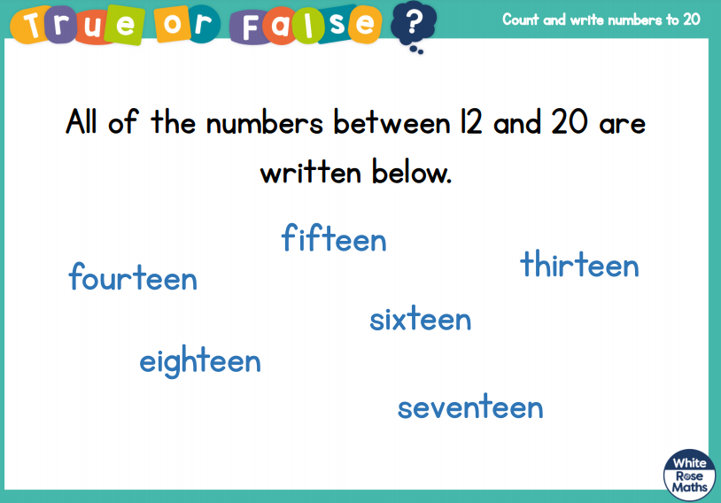
White Rose Maths
Is this true or false?

Slide 15
White Rose Maths
Use this video link https://vimeo.com/480768128 and have a go at the ‘questions to think about’ slide.
Work through the video, feel free to pause it to explain any of the teaching.
Now you are ready to have a go at the worksheet.
Remember you can write your answers in your blue maths book to save printing it out.

Slide 16
White Rose Maths
After you have finished the worksheet, ask an adult to write from 0 - 20 in words on pieces of paper.
Place upside down on the table.
Pick a card and read the number to your adult.
Make a pile of the ones you can read and a pile of
ones you are finding harder.
Look at how they are spelt, some are quite tricky!
one
seven
twenty
thirteen
eight

Slide 17

If you have used a sheet, stick it into the front of your blue maths book.
We will continue with some White Rose teaching again tomorrow.
I think it is time for lunch and a break from your work.
There is an R.E session for this
afternoon but enjoy your lunch
first.

Slide 18


Religious Education
This term we are beginning a new topic on Islam.
First of all watch the story of
Dogger by Shirley Hughes.
https://www.youtube.com/watch?v=jNOYgRf5jes

Slide 19
Religious Education
Using the back of your purple book.
Ask an adult to draw a line for you to write the date and one for the title.
Write a title ‘What Really Matters’
Ask an adult to split the page in half.

Slide 20
Religious Education
Talk to your adult about something that is important to you. Draw in one half of your book.
Now talk to your adult someone that is most important to them and draw in the other side.
What matters most something or someone?
Write a sentence about this.

Slide 21

Most importantly encourage your child to read a suitable book to you. Later on it would be great if you could read a bedtime story to them.
Please remember to send an email containing the work that they have done to teacher@kingslandengland.hereford.sch.uk

