Slide 1

Welcome Back to Online learning
Thank you all for being so cheerful during our online session yesterday morning and for emailing your work to me.
Below is the timetable for today’s lessons.
 | Story | English Session |  | Maths – White Rose |  | Afternoon Session | Assembly
9:00 am Online registration via TEAMS link | The Stinky Cheeseman | Thank you letter | Break | Difference Between https://vimeo.com/470964398 wworksheet | Lunch | PE | ISing Pop via email
You will need: a copy of the letter writing sheet and access to the maths sheet - either printed out for your child to fill in or on the screen and then your child can write the answers in their maths book.

Slide 2
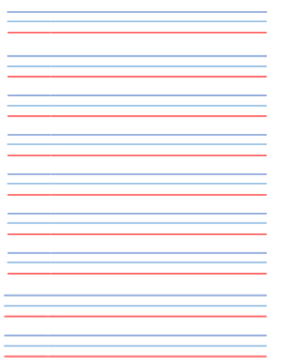

English Activity
In the file there is a piece of paper with handwriting lines on that you can use for today’s letter.
Using a pencil, write the date on the top line.
Friday 8th January (use the red line to write on)

Slide 3
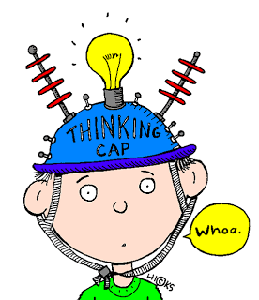
Today we are going to write a thank you letter to someone that gave you a present for Christmas.
Think about who you would like to thank for a present that you had this Christmas.
Why is it so special?

Slide 4

Talk to an adult about your special present.
Remember to use full sentences.
Thank you for…
I really like it because…

Slide 5
Now you are ready to begin your letter.
Think about who you are writing it to.
A letter always begins with Dear_______ so write it on the next line.
Think through the sentences that you have said to an adult. You can write the start of your letter. Don’t forget to use:
capital letters
full stops
finger spaces
neat handwriting.

Slide 6
Now I would like you to talk to an adult about something that you did over the Christmas holidays that you enjoyed.
Remember to use full sentences.
One of my favourite days was….
I was with…

Slide 7
Now you are ready to continue your letter.
Write down about one of your favourite day.
Don’t forget to say where you went or what you did, who you went with or who you saw.
You might like to add some extra details about your day too.
When you have finished you can sign off with love from or from and then your name.

Slide 8


You have finished your first activity.
Ask an adult to copy it so that they can send it to me later on. Perhaps you could put the letter in an addressed envelope and post it to the person who you wrote it to.
Now have a break and a snack.

Slide 9

White Rose Maths
Find the Difference
Well done to all of you for working so hard on the maths yesterday. Today are continuing on with the concept from yesterday.
To begin with I would like you to watch the first slide of the video and then pause it whilst you answer the questions on the screen. You could write these answers down in your maths books.

Slide 10
Now you can continue watching the video, feel free to pause the it to explain any of the teaching.
https://vimeo.com/470964398
Once you have watched the video then complete the Friday Maths – Find the Difference sheet in the Year 1 folder.

Slide 11

I hope you have enjoyed learning all about the difference between two numbers.
We will continue with some White Rose teaching again next week.
I think it is time for lunch and a break from your work.
I hope you all have a good weekend and I
will see you all again on Monday morning.

Slide 12

Please remember to encourage your child to read a suitable book to you. Later on it would be great if you could read a bedtime story to them.
Well done for this week and remember to send your completed work to teacher@kingslandengland.hereford.sch.uk.

