Slide 1

Welcome Back to Online learning
Below is the outline of the timetable for today.
It is here to give you a guide on today’s work.
For maths you will need either 20 raisins, 1ps, Cheerios, same sized buttons, pasta shapes or something similar.
 | English Session |  | Maths – White Rose |  | Afternoon Session | Assembly
9:00 am Online registration via TEAMS link | My Favourite Present | Break | Difference Between https://vimeo.com/470964093 | Lunch | Winter Activity | Epiphany via email

Slide 2
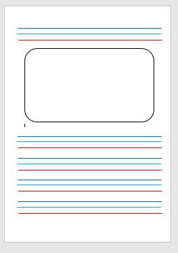

English Activity
Find the sheet of paper.
(or write in your writing book)
Using a pencil, write the date on the top line.
Thursday 7th January (use the red line to write on)

Slide 3
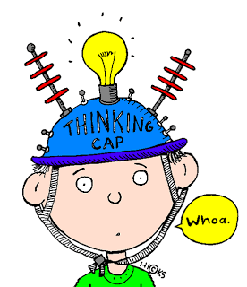
My Favourite Christmas Present
Think about your favourite present that you had for Christmas. Carefully draw a picture of it in the box provided.

Slide 4

Talk to an adult about your favourite present.
Think about what it was, what it looks like/is used for and who it was from.
Remember to use full sentences.
My favourite present was…
It is…..
I had it from…

Slide 5
Now you are ready to write this on the paper.
Remember what you have just said
to an adult. Now write it down using
full sentences. Don’t forget to use
capital letters
full stops
finger spaces
neat handwriting.

Slide 6


Thank you for working hard.
I will look forward to reading all about your favourite present.
Now have a break and a snack.

Slide 7

White Rose Maths
Find the Difference
First of all, can you and your child collect raisins (or whatever you collected as suggested on the first page). One person needs to have 5 objects and the other 3. Place them side by side in 2 columns and see how many more there are in the one column.
There are 2 more.
5 is 2 more than 3

Slide 8
Repeat with different amounts for example 3 and 7.
3 is ___ less than 7.
Keep on until your child is confident with this concept.
Now watch the video https://vimeo.com/470964093 feel free to pause the video to explain any of the teaching.

Slide 9

I hope you have enjoyed this and that you have understood this new concept.
We will continue with some White Rose teaching again tomorrow.
I think it is time for lunch and a break from your work.
See you tomorrow.

Slide 10

Most importantly encourage your child to read a suitable book to you. Later on it would be great if you could read a bedtime story to them.
Please remember to send an email containing the work that they have done, once completed to teacher@kingslandengland.hereford.sch.uk so I can respond and celebrate with your child their achievements.

