Slide 1
An Outline of Today’s Work Friday 5th March 2021
Subject | Subject/Website | Topic | Activity/ Instruction
English | Handwriting | Letter Formation Diagonal Joins | Letters to trace and write Lined handwriting Paper
 | Story Planning | Story Map | Outline in the folder Mrs Smith’s PPT
 | Written Task ‘The Twits’ | Finish the chapter | The Boys Escape!
Maths | White Rose Year 3 Spring Block Statistics | Interpret Pictograms | Watch the White Rose video and pause to complete the activities In the Math’s Folder you will find a related White Rose sheet and extension sheets.
French |  |  | See work set by Mr Powell in our Year 3 folder
PE |  |  | See work set by Mr Powell and Miss Price in our Year 3 folder
Worship | ‘World Prayer Day’ |  | Links on the PPT Slide

Slide 2

Handwriting Lines

Slide 3
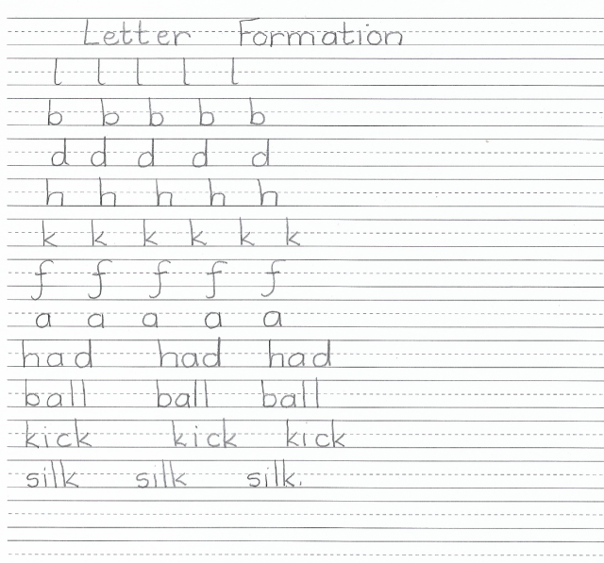

Slide 4
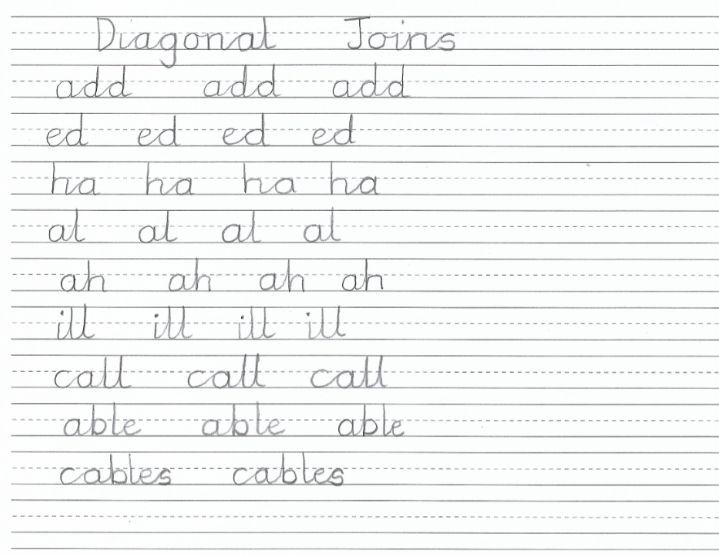

Slide 5

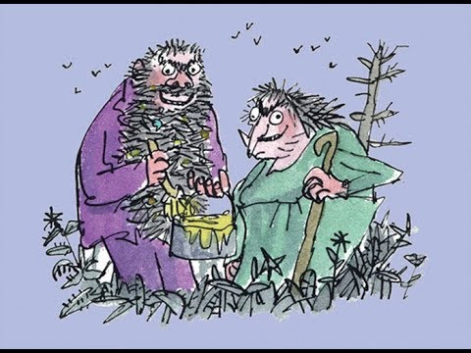
Make sure you have read or listened to the chapters:
Four Sticky Little Boys
The Twits
By
Roald Dahl
24:50
https://www.youtube.com/watch?v=EgppUh8ukZ8
Audio Book

Slide 6
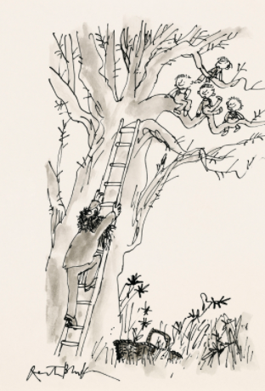
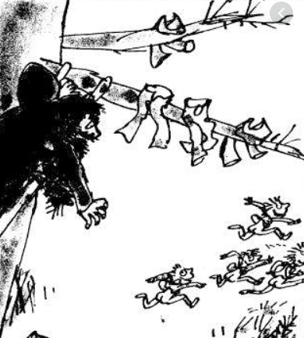

Slide 7
‘…they all tumbled out of the tree and ran for home with their naked bottoms winking at the sun.’
I would like you to add 2 paragraphs to this chapter.
Follow the slides to help you.
There is an example of my story map and story on a separate PPT.
This should give you an idea of what is expected. You are welcome to use some of my ideas but add your own too.
It is fine if yours is shorter but your paragraphs should have a few sentences in each.

Slide 8
A few things to think about:
What did the boys do next?
Did they stay together or go separate ways?
Did anyone see them running home?
Did they try to cover up as they ran?
How were they feeling?
Did they try to hide as they made their way home?
What did they do when they got to their homes?
Did they sneak in or have to explain how they lost their pants?
Your Two Paragraphs
You need to write sentences that include detail, adjectives and interesting words.
Keep your reader engaged and keen to read on.
You can use humour but nothing rude or offensive. Be sensible in your writing.
You are welcome to write a rough copy after your story map and then write a really neat copy.
Either write as if you are one of the boys or as a third person retelling the events.
Your first paragraph could be the journey home.
Your second paragraph could be arriving at their home.

Slide 9
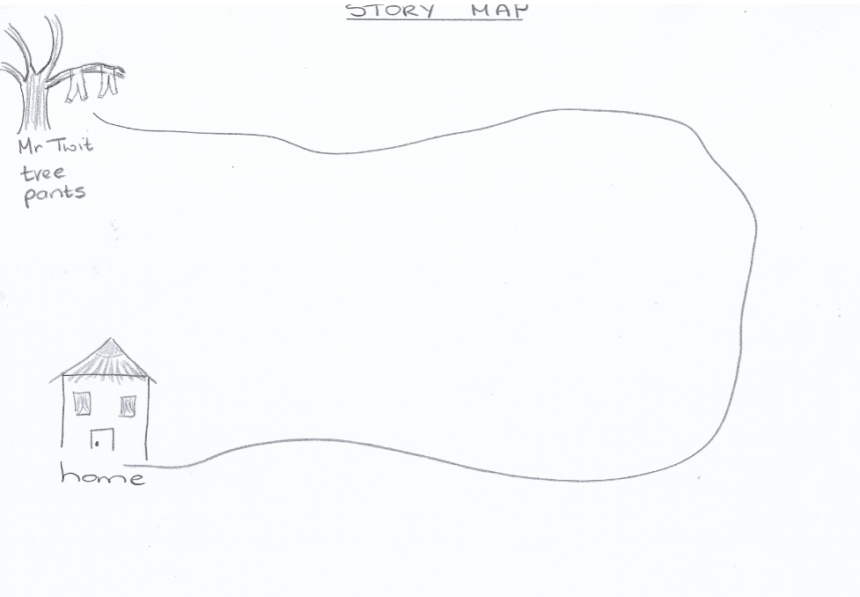
Draw a Story Map

Slide 10
Set out your page for your paragraphs
(There is an example of my story on the separate PPT)
Friday 5th March 2021
The Escape!

Slide 11
Super Work!
Have a short break and then start on the English Tasks.

Slide 12

Maths :
Interpret Pictograms
Follow this link to the White Rose website to watch the video clip and pause to complete the activities. Have paper, a pencil and rubber ready to jot down your answers.
https://vimeo.com/500378019
You will find related worksheets in the math’s folder on the Kingsland Website.

Slide 13

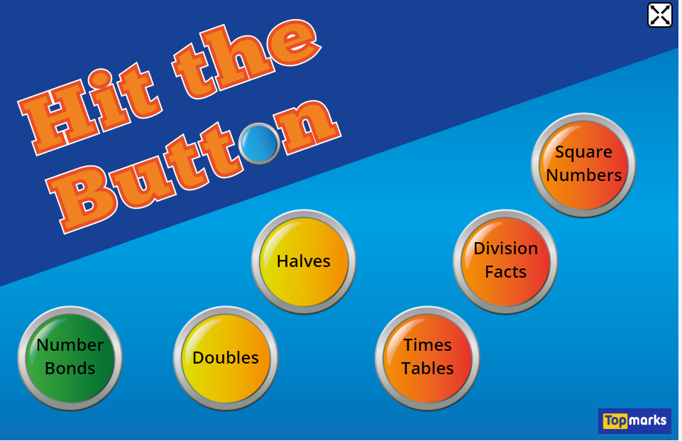

Times Tables Rock
https://play.ttrockstars.com/auth/school/student/78867
https://www.twinkl.co.uk/go
Use your login details to access the games.
PINCODE: QC3571
https://www.topmarks.co.uk/maths-games/hit-the-button

Slide 14
Have a lunch break!

Slide 15

For French and PE, see activities in the Year 3 Folder.

Slide 16

Today is the World Day of Prayer
As such, a special Worship Time has been created by Helen Webb, Chair of Governors, Rev Julie Read and Wendy Maddocks, Foundation Governor. Children should bring a stone or Lego / Duplo brick to the Worship Time.
Please follow this link:
https://youtu.be/rdbSv-A7zH0

Slide 17
Have a super day, give of your best and please send me an e mail this afternoon with examples of your work.
teacher@kingslandengland.hereford.sch.uk
In the subject line could you have :
Year 3 and name of your child
Please only send one email a day with either attachments or a photo of work completed.

