Slide 1
My Story Map and Story
You are welcome to use some of my ideas but add your own too.

Slide 2
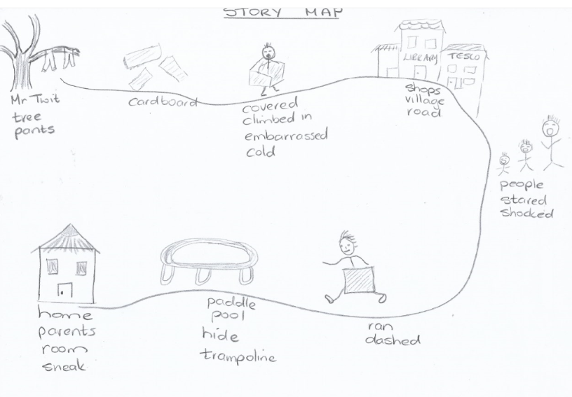

Slide 3
Falling to the ground the boys brushed the grass and sand off themselves and ran towards their homes as fast as they could. Mr Twit could be following and who knows what would happen if they were caught! They looked desperately around them for something to cover their bare, cold bottoms. How embarrassing it would be to be seen by people in the village! Behind the village shops they found a pile of cardboard just the right size to cover all. One or two managed to climb into a box with their legs and heads sticking out the top and bottom. They did look a sight!
Now feeling more confident they made a dash for their houses passing neighbours whose mouths were open wide in shock and surprise. Holding onto their cardboard covers for dear life, they sprinted for shelter near their homes. Trampolines, sheds, dog houses and paddle pools were used to hide under and behind. Where possible, to avoid questioning, they sneaked undetected into their rooms. A few days later, there were questions to be answered when missing pants were noticed by puzzled parents.

