Slide 1
An Outline of Today’s Work Thursday 4th March 2021
Subject | Subject/Website | Topic | Activity/ Instruction
English | Spag Mat | Spelling, punctuation and grammar | Worksheet is in the English folder
 | Writing a Letter | How to write a letter | PPT Twinkle Go resources
 | Written | Letter Writing | Write a letter of complaint
Maths | White Rose Year 3 Spring Block Statistics | Draw Pictograms | Watch the White Rose video and pause to complete the activities In the Math’s Folder you will find a related White Rose sheet and extension sheets.
World Book Day |  |  | Activities in the Whole School Folder

Slide 2

Full House Point Cards
Send a photo of your full card with your home learning email.
Name:__________________________ House:___________________________
Date:_____________
Please add the date.

Slide 3
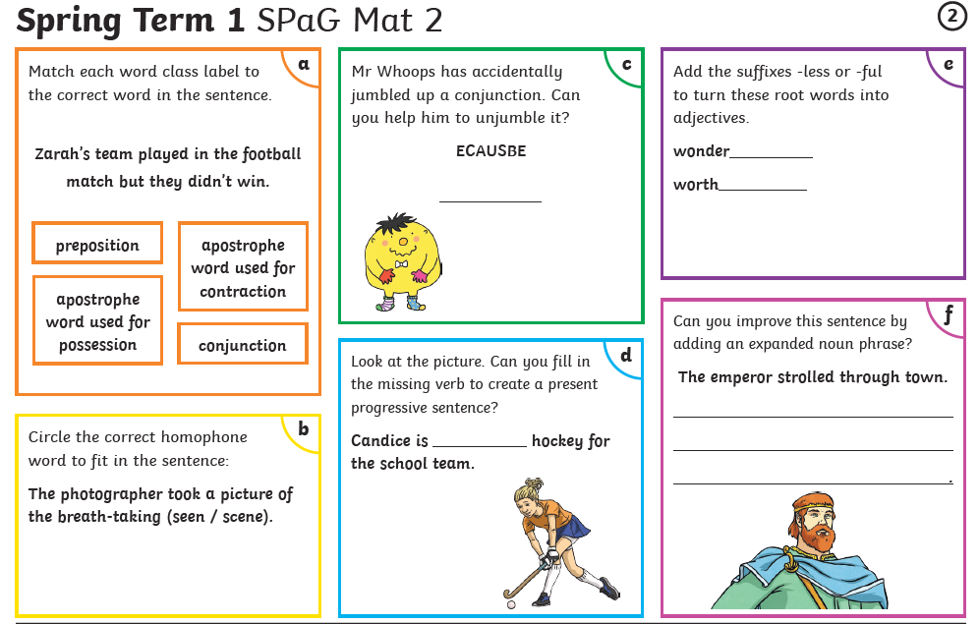

Slide 4

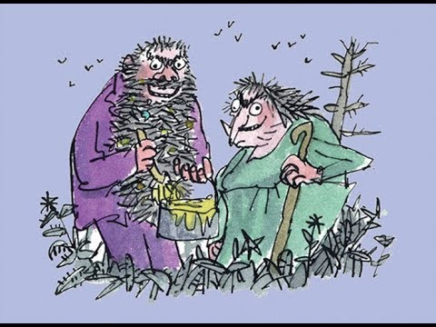
Make sure you have read or listened to the chapters:
The House, the Tree and the Monkey Cage
Hugtight Sticky Glue
Four Sticky Little Boys
The Twits
By
Roald Dahl
22:23 to 26:31
https://www.youtube.com/watch?v=EgppUh8ukZ8
Audio Book

Slide 5
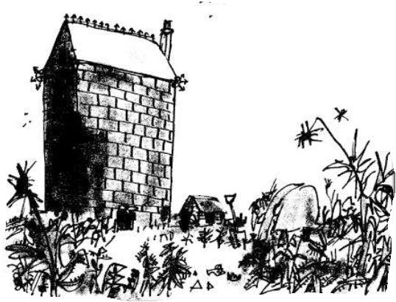
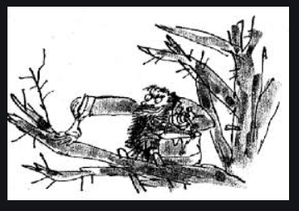
Imagine you are the neighbour living next to The Twits
What do you think it must be like?

Slide 6
1 Read the chapter: The House , the Tree and the Monkey Cage.
You ( the neighbour) are angry and upset with The Twits.
You write a letter addressed to The Twits complaining.
2 Before starting login to ‘Twinkle Go ‘ RG5360 and look through the examples of letter writing and how to set
out and write an informal letter.
3 Now you are ready to plan your letter
Plan your writing ( there is an outline in the folder to jot down ideas)
4 Look at how a letter should be set out ( there is a template in the folder)
This will be an informal but polite letter as you are a neighbour.
Write a very neat and polite letter of complaint to The Twits
5 Edit and check your letter

Slide 7
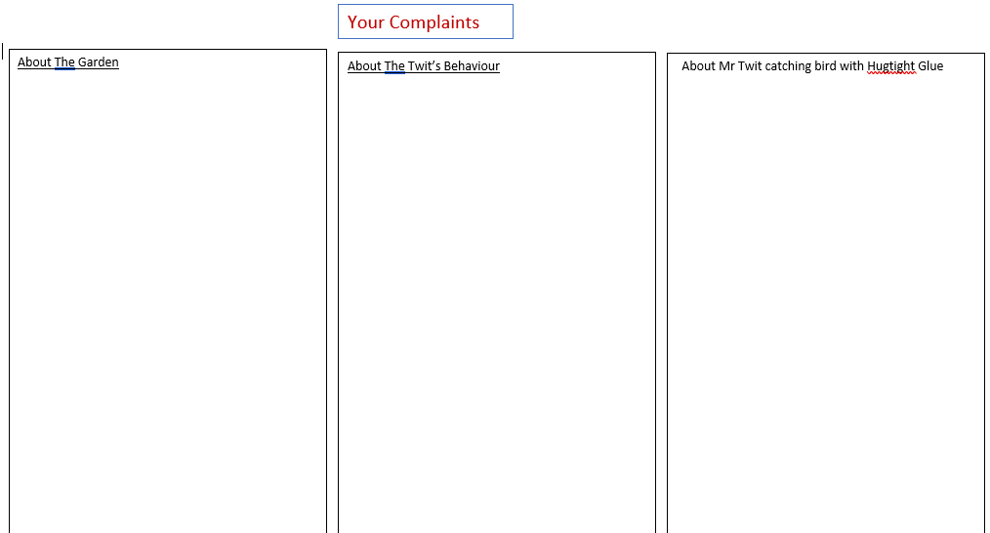

Slide 8

Use the template in the folder to set out your letter correctly or copy the layout when writing on separate lined paper.

Slide 9
Super Work!
Have a short break and then start on the English Tasks.

Slide 10

Maths :
Draw Pictograms
Follow this link to the White Rose website to watch the video clip and pause to complete the activities. Have paper, a pencil and rubber ready to jot down your answers.
https://vimeo.com/500379996
You will find White Rose and related worksheets in the math’s folder on the Kingsland Website.

Slide 11


Times Tables Rock
https://play.ttrockstars.com/auth/school/student/78867
https://www.twinkl.co.uk/go
Use your login details to access the games.
PINCODE: VD0158

Slide 12
Have a lunch break!

Slide 13

Choose from the activities in the ‘Whole School Folder’ on the school website.
There are lots of interactive activities on Twinkle Go! Pincode: GP7310

Slide 14

Tomorrow is the World Day of Prayer, celebrated around the world.
Please could children bring a stone or Lego / Duplo brick/pebble to the Worship Time.
Follow the link for Today’s Worship
This can be found in the
‘Whole School’ folder or in the email sent by Mr Debenham

Slide 15


Tomorrow, please could you have a sheet of paper (lined or blank) ready for our TEAMS meeting.

Slide 16
Have a super day, give of your best and please send me an e mail this afternoon with examples of your work.
teacher@kingslandengland.hereford.sch.uk
In the subject line could you have :
Year 3 and name of your child
Please only send one email a day with either attachments or a photo of work completed.

