Slide 1
An Outline of Today’s Work Wednesday 3rd March 2021
Subject | Subject/Website | Topic | Activity/ Instruction
Maths | Quiz | Flash Back Quiz | PPT in the folder
 | White Rose Year 3 Spring Block Statistics | Make Tally Charts | Watch the White Rose video and pause to complete the activities In the Math’s Folder you will find a related sheet.
English | Dictation | A sentence including spelling words, punctuation and grammar | Listen to the audio on this PPT Write it. Mark it using the PPT slide
 | Grammar | Apostrophe to Show Possession | Follow the PPT Complete the sentences
Science | Rocks and Soils | Testing Properties of Rocks | PPT instructions Activity Sheet
Worship | iSing Pop |  | Links can be found either in emails sent or the ‘Whole School’ folder

Slide 2






Dictation
Click on the speaker to hear the sentence.
Do not go to the next slide until you have written and checked your sentence.

Slide 3

Mark your dictation and see where you need to make corrections.
I laugh a little when you hide under more material.
Give yourself a tick for the following if correct:
spellings: laugh, little, more, material
capital letter and full stop

Slide 4
Super Work!
Have a short break and then start on the English Tasks.

Slide 5

Maths Quiz
Follow the PPT: Math’s Flashback Quiz in the folder.

Slide 6

Maths :
Make Tally Charts
Follow this link to the White Rose website to watch the video clip and pause to complete the activities. Have paper, a pencil and rubber ready to jot down your answers.
https://vimeo.com/500377891
You will find related worksheets in the math’s folder on the Kingsland Website.

Slide 7


Times Tables Rock
https://play.ttrockstars.com/auth/school/student/78867
https://www.twinkl.co.uk/go
Use your login details to access the games.
PINCODE: QC3571

Slide 8
Have a lunch break!

Slide 9
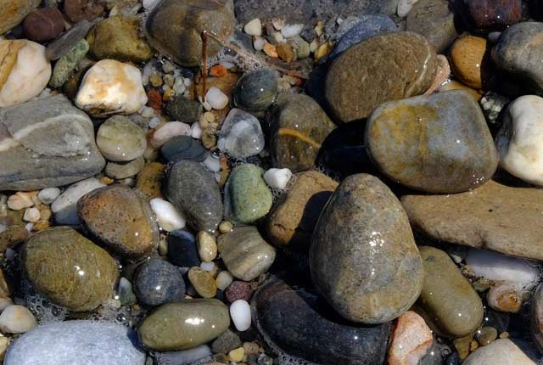
Science
We are going to look at the properties of rocks.
You will need a few rocks/stones to test.
There is an activity sheet in the folder to complete
Follow the Science PPT with instructions

Slide 10

Follow the link for Today’s Worship
This can be found in the
‘Whole School’ folder.

Slide 11
Have a super day, give of your best and please send me an e mail this afternoon with examples of your work.
teacher@kingslandengland.hereford.sch.uk
In the subject line could you have :
Year 3 and name of your child
Please only send one email a day with either attachments or a photo of work completed.

