Slide 1
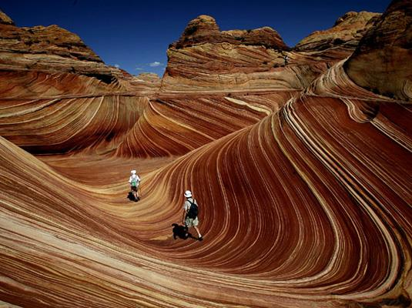
Rocks and Soils

Slide 2
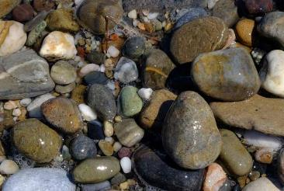
Science
We are going to look at the properties of rocks.
You will need a few rocks/stones to test.
There is an activity sheet in the folder to complete
Follow this Science PPT with instructions

Slide 3
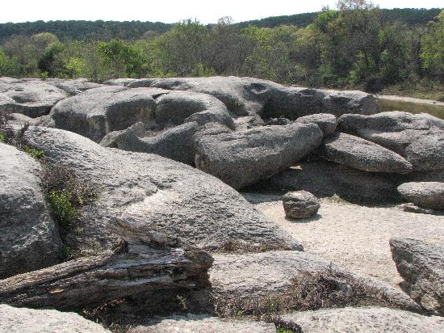
You will be carrying out an investigation to understand the terms durable and permeable.

Slide 4

Previous Lesson:
What are the three types of rocks?
Igneous
Rocks that are made by the heat (magma/lava) in volcanoes.
Sedimentary
Rocks that are formed by layers settling on top of each other.
Metamorphic
Sedimentary or Igneous rocks that have changed because of a lot of heat or pressure.

Slide 5

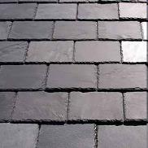
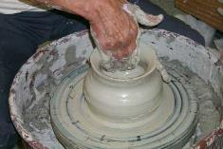
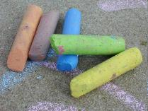
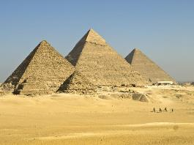
Previous Lesson:
Purposes of rocks
What is the purpose of slate?
roof tiles
Clay?
pottery
Chalk?
writing chalk
Sandstone?
pyramid

Slide 6

How do we know if a rock is fit for purpose?
Which type of rock would be better suited as a kitchen worktop?
Why? What happens in a kitchen?
How can we check if the rock is suitable? What tests could we carry out?

Slide 7

What are we looking for?
Durability: Rocks that are durable are not easily worn away.
Permeability: Rocks that are impermeable do not allow water to pass through them.
Rocks that are permeable do allow water to pass through them.

Slide 8
What tests could we carry out?
Test One – The Rubbing Test
Test Two – The Water Test
Testing: Durability – how easily rocks are worn away.
Method: We will rub each rock with sandpaper/emery boards and watch what happens.
Recording results: We will make notes on what happens to the sandpaper and/or rock.
Testing: Permeability – whether water can pass through rocks.
Method: We will drop water onto each rock and watch what happens.
Recording Results: We will makes notes on what happens to the rocks and/or paper towels underneath.

Slide 9
Don’t worry if you don’t know the name of your sample rock.
Choose a few of your samples to test.
Place them on your sheet when photographing or number your rocks .
Carry out the tests and record your results on the sheet in the folder.
Complete the sentences at the end.

Slide 10
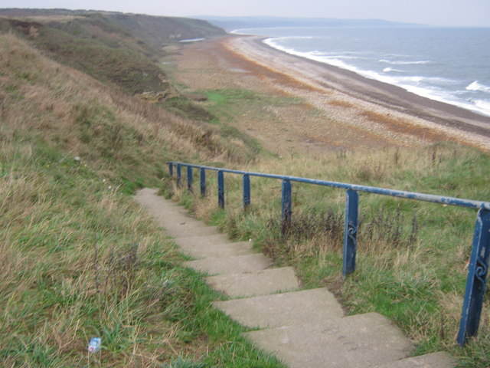
Using the results answer these questions…
If I were building steps outside, _____________ would be the best rock because _____________
______________________________________________________________________________
The worst rock to use would be ____________ because ________________________________
______________________________________________________________________________
There is space on your activity sheet to complete these sentences.

