Slide 1
An Outline of Today’s Work Tuesday 2nd March 2021
Subject | Subject/Website | Topic | Activity/ Instruction
Maths | White Rose Year 3 Spring Block Money | Give Change | White Rose Teaching Video Related worksheets in today’s folder Twinkle Go!
Numberocks , TTR and Twinkle Go songs and games.
English | Grammar | Apostrophe to show possession | Video Clip
 | Written task | Apostrophe Practice | PPT
Topic | Climate Change | Plastic , what can we do? | PPT Video links Twinkle GO!
Worship | Mr Debenham | Live Worship On TEAMS | Links were e mailed out or can be found on the school website.

Slide 2
Apostrophe for singular possession
You will need a pencil and paper to complete the tasks on the video.
National Oak: https://classroom.thenational.academy/lessons/to-introduce-apostrophes-for-singular-possession-6wr66d

Slide 3
Next, follow the PPT in the folder
Write the sentences in your exercise book or on lined paper
They need to be full sentences and neatly written with correct punctuation

Slide 4
Super Work!
Have a short break and then start on the English Tasks.

Slide 5

Maths :
Give Change
Follow this link to the White Rose website to watch the video clip and pause to complete the activities. Have paper, a pencil and rubber ready to jot down your answers.
https://vimeo.com/499227948
You will find related White Rose Sheets and Extension sheets in the folder.

Slide 6


Times Tables Rock
https://play.ttrockstars.com/auth/school/student/78867
https://www.twinkl.co.uk/go
Use your login details to access money resources and activities.
PINCODE: QC3571

Slide 7
Have a lunch break!

Slide 8


Climate Change
On the following slide there are a selection of short clips to watch.
‘Twinkle Go’ Pin code: HI 0871

Slide 9
Fishing Nets
https://www.bbc.co.uk/programmes/p06m0nd5
No Plastic Straws
https://www.bbc.co.uk/programmes/p06m0n9h
Reuse coffee cups and bottles
https://www.bbc.co.uk/programmes/p06bsx6t
David Attenborough –what we can do?
https://www.bbc.co.uk/programmes/p06bsx63
Newsround
https://www.bbc.co.uk/newsround/47979998
Kids Take Action
https://www.youtube.com/watch?v=hKFV9IquMXA

Slide 10


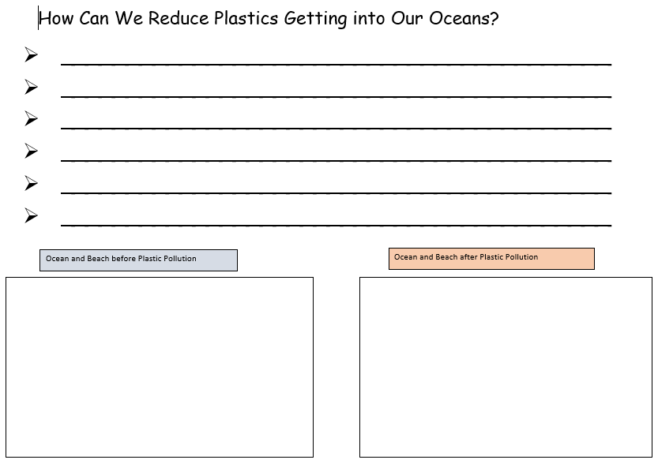
Complete the activity in the folder
Write neat sentences with correct punctuation.
Be specific eg Take Outs need to use recyclable packaging. recycle

Slide 11

Follow the link for Today’s Worship
Live on TEAMS with
Mr Debenham

Slide 12
Have a super day, give of your best and please send me an e mail this afternoon with examples of your work.
teacher@kingslandengland.hereford.sch.uk
In the subject line could you have :
Year 3 and name of your child
Please only send one email a day with either attachments or a photo of work completed.

