Slide 1
An Outline of Today’s Work Monday 1st March 2021
Subject | Subject/Website | Topic | Activity/ Instruction
Maths | White Rose Year 3 Spring Block Money | Subtract Money | White Rose Teaching Video Related worksheets in today’s folder
 | Twinkle Go! | Times Tables | Use your login to access the games.
English | National Curriculum Word | ‘material’ | Worksheet is in the today’s folder
 | High Frequency Spelling Words | Look/ Cover/ Write | 5 High Frequency Words to learn for the week. Sheet in the folder
 | Comprehension | ‘Two Boys’ | Question sheet and Text in the folder
RE | Islam | The Muslim Pilgrimage- Hajj | Video links to watch Twinkle Go resources Activity sheet
Worship | Rev Julie |  | A link can be found in the Whole School Folder

Slide 2

Thursday is World Book Day!
Thursday morning TEAMS:
Have your favourite book with you.
You will need to tell the class the title , author and the type of book you think it is eg: adventure, non fiction, fantasy, humorous…
You may dress up as a book character .This is optional!
In the afternoon:
There will be a list of activities for you to choose from in the ‘Whole School Folder’
Please take a photo of an activity you are doing and email it to me.

Slide 3
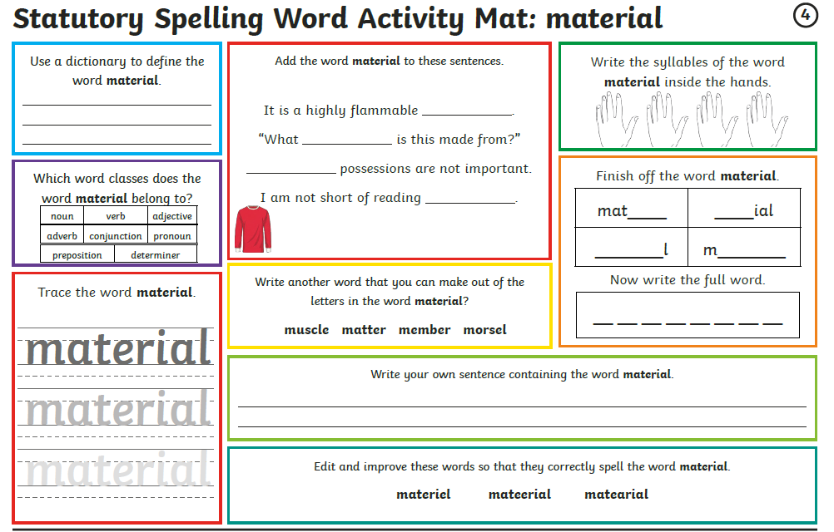

Slide 4
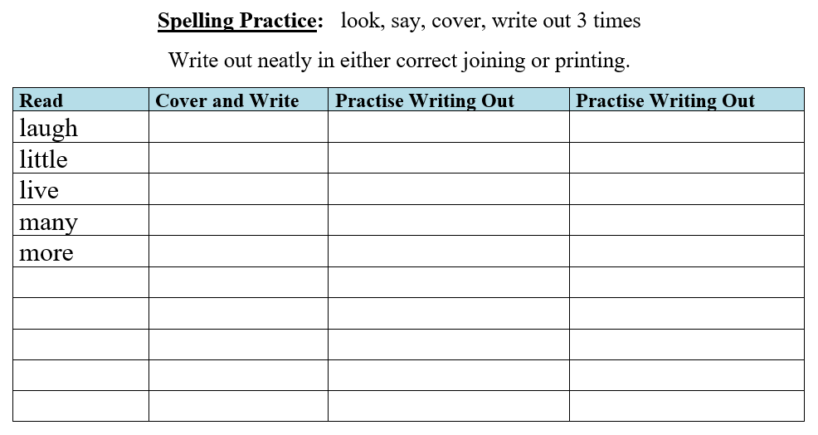
SPELLING
Every Monday I will be setting 5 High Frequency Spelling Words for you to learn to spell.
They are separate to the National Curriculum words, are words that we use often and MUST know how to spell.
I will include some in our weekly dictation and they will be part of our quiz on a Friday.
There is a ‘Look, Cover, Write’ check sheet to help you learn theses words.
Interactive Spelling Game
National Curriculum Words and Words with Spelling Patterns
http://www.ictgames.com/mobilePage/lcwc/index.html

Slide 5
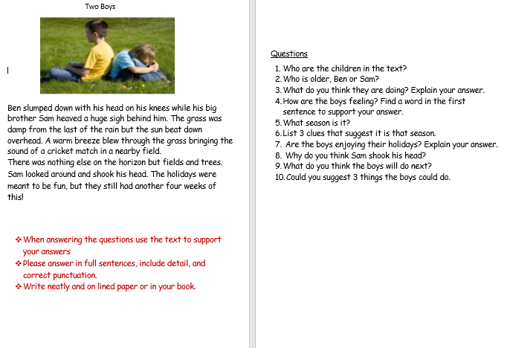
Comprehension:
‘Two Boys’
Ask an adult to discuss the questions with you if you are not feeling confident.
Either answer on the printed sheet or lined paper in full sentences where necessary.
Remember to make inferences. Use the text and the picture to give you clues.

Slide 6
Super Work!
Have a short break and then start on the Math’s Tasks.

Slide 7

Maths :
Subtract Money
Follow this link to the White Rose website to watch the video clip and pause to complete the activities. Have paper, a pencil and rubber ready to jot down your answers.
https://vimeo.com/498297373
Although there are no White Rose sheets you will find related worksheets in the math’s folder on the Kingsland Website.

Slide 8


Times Tables Rock
https://play.ttrockstars.com/auth/school/student/78867
https://www.twinkl.co.uk/go
Use your login details to access the games.
PINCODE: QC3571

Slide 9
Have a lunch break!

Slide 10

The Muslim Pilgrimage- Hajj
Below are two video clips to watch as well as PPTs and activities in the ‘Twinkle Go’ folder you could choose from.
https://www.bbc.co.uk/teach/class-clips-video/religious-education-ks2-my-life-my-religion-muslim-pilgrimage-hajj/zndfcqt
https://www.bbc.co.uk/programmes/p02mwk0y
If you login in to Twinkle Go, you will find:
PPT guide
Photo display
Twinkle Go-PIN:
MF5087

Slide 11
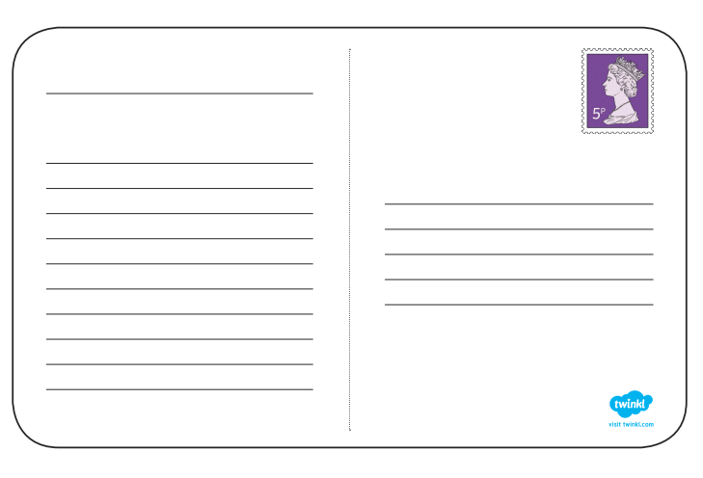
Imagine you have been to Mecca on Hajj.
Write a postcard about your experience
Address it to Class 3
Include:
Where you are
Why you are there
Something you saw
What impressed you
How it made you feel

Slide 12

Follow the link for Today’s Worship
In the Whole School Folder

Slide 13
Have a super day, give of your best and please send me an e mail this afternoon with examples of your work.
teacher@kingslandengland.hereford.sch.uk
In the subject line could you have :
Year 3 and name of your child
Please only send one email a day with either attachments or a photo of work completed.

