Slide 2
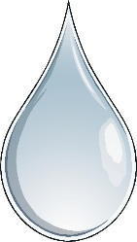


The History of Hajj
According to Islamic tradition, God ordered Abraham to leave his wife, Hagar, and his son, Ishmael, in the desert near ancient Mecca.
Hagar ran seven times between the two hills of Safa and Marwah to find water but was unable to find any.
When she returned to Ishmael, she saw him scratching the ground and a water fountain sprang forth beneath his foot.
Later, God commanded Abraham to build Ka’bah here, which he did with the help of Ishmael. He invited people to perform pilgrimage there.

Slide 3
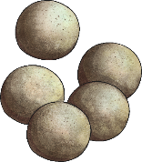
What Do Muslim Pilgrims Do during Hajj?
During Hajj, millions of pilgrims arrive in Mecca and perform a series of rituals.
The pilgrims visit the Ka’bah in Mecca and walk around it seven times.
They run between two mounts called Safa and Marwa.
The pilgrims go to the plains of Mount Arafat to stand in vigil and spend a night on the plain of Muzdalifah.
They camp in Mina and throw seven small stones at three stone pillars, which symbolise the devil.
The men shave their hair and sacrifice an animal as performed by the prophet Abraham.
Finally, the pilgrims return to Mecca to the Ka’bah and circle it seven times again.

Slide 4
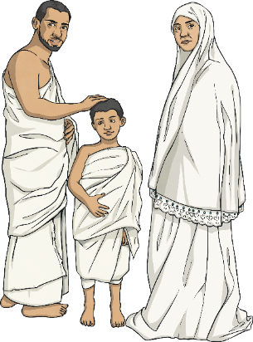
What Do Pilgrims wear?
The cloth of the pilgrim is known as ihram. White cloth is worn so all people are equal, whether rich or poor.

Slide 5
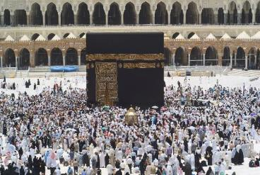
The Ka’bah
The pilgrims visit the Ka’bah in Mecca and walk around it seven times, anti-clockwise.
Photo courtesy of marviikad (@flickr.com) - granted under creative commons licence - attribution
Muslims believe that the Ka’bah was built by the prophet Abraham and his son, Ishmail, 4000 years ago.
It is the first house built to worship Allah and has been made larger over the years.

Slide 6
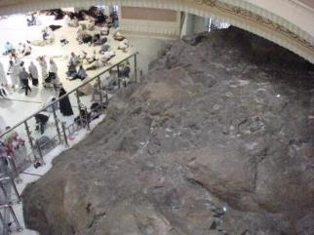
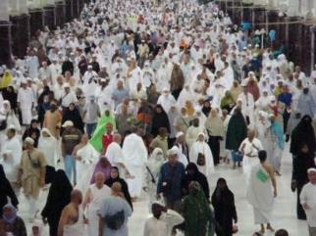
The Two Hills
Safa and Marwah are two small hills, now located in the Masjid al-Haram in Mecca, Saudi Arabia, between which, Muslims travel back and forth seven times during the ritual pilgrimage of Hajj.
Doing this helps Muslims to remember the struggles that Hagar and Ishmael faced when they were in the desert.
A well still remains here and pilgrims drink from it.
Photos courtesy of budakkelantan (@flickr.com) - granted under creative commons licence - attribution

Slide 7
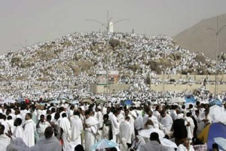
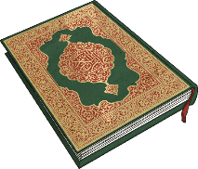
Mount Arafat and the Plain of Muzdalifah
Pilgrims spend the night praying and sleeping outside and gather pebbles for the next day's ritual of the stoning of the devil.
Mount Arafat was the scene of the prophet Muhammad's final sermon. Pilgrims spend the day here in prayer.
Plain of Arafat showing the ‘Mount of Mercy’ on the main Hajj day.
Photos courtesy of Arafat1 (@flickr.com) - granted under creative commons licence - attribution

Slide 8

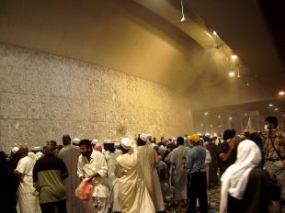
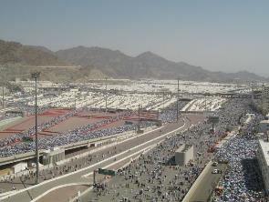

Mina
Pilgrims camp in Mina and throw small stones at three stone walls, which symbolise the devil.
The Stoning of the Devil is where Muslim pilgrims throw seven pebbles at each of the three walls called jamrah, in the city of Mina. It is believed that at this spot, the devil appeared and Abraham threw stones to scare him off.
Pilgrims at Mina
The Stoning of the Devil

Slide 9
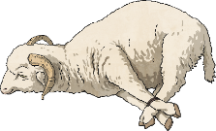
Sacrifice and Halq
Animals are sacrificed to remember the story of Abraham and his son.
In the story, God commanded Abraham to sacrifice his son. As Abraham was about to sacrifice his son, God told Abraham that he had fulfilled his command and replaced his son with a ‘great sacrifice’ instead.
Traditionally, the pilgrims slaughtered the animal themselves but today many pilgrims buy a sacrifice voucher, which allows an animal to be slaughtered in their name. The meat from the sacrificed animals is used to feed people in need in Muslim countries.
After the sacrifice, the next step of Hajj is shaving heads, known as Halq. All male pilgrims are expected to shave their head or trim their hair on the day of Eid and female pilgrims cut the tips of their hair.
This day is known as Eid al-Adha.

Slide 10
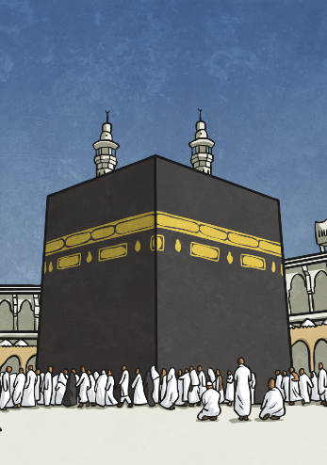
Returning to Mecca
Finally, the pilgrims return to Mecca to the Ka’bah and circle it seven times again.
Once the pilgrims have completed all the rituals, they are given a new title. They can now be known as ‘Hajji’.
After successful pilgrimage, pilgrims can prefix their names with the title 'Al-Hajji' and are held with respect in Muslim society.
Hajj brings together and unites the Muslims from different parts of the world irrespective of their race, colour and culture.

Slide 11
Glossary
Arafat | a plain in the desert where pilgrims spend the day asking for forgiveness
Eid al-Adha | the festival at the end of the Hajj
Hajj | the pilgrimage to Mecca and the fifth pillar of Islam
Hajji | a pilgrim who has completed Hajj
Ihram | clothes worn by pilgrims; the two sheets worn by male pilgrims
Ka’bah | the cubic building built by the prophet Abraham situated at the centre of the Sacred Mosque in Mecca
Mecca | one of the holy cities of Islam in Saudi Arabia
Mina | a campsite in the desert nine miles from Mecca; pilgrims throw stones at the three pillars here
Pilgrimage | a special journey to a holy place for religious purposes
Safa and Marwa | two mounts between which pilgrims run; situated inside the Sacred Mosque

