Slide 1
An Outline of Today’s Work Friday 26th February 2021
Subject | Subject/Website | Topic | Activity/ Instruction
English | Handwriting | Letter Formation Diagonal Joins | Letters to trace and write Lined handwriting Paper
 | Poetry | Listen to ‘Earthrise’ By Amanda Gorman | Record some ‘wow’ words Printable Poem
 | Written Task | Write a Haiku related to the environment and climate change | Write a rough copy Write neatly on lined paper Mount your poem Upload to Skyday
Maths | White Rose Year 3 Spring Block | Add Money | Watch the White Rose video and pause to complete the activities In the Math’s Folder you will find a related White Rose sheet and extension sheets.
French |  |  | See work set by Mr Powell in our Year 3 folder
PE |  |  | See work set by Mr Powell and Miss Price in our Year 3 folder
Worship | ‘Big Joe’ |  | Links are emailed or can be found in the ‘Whole School ‘folder.

Slide 2

Handwriting Lines

Slide 3
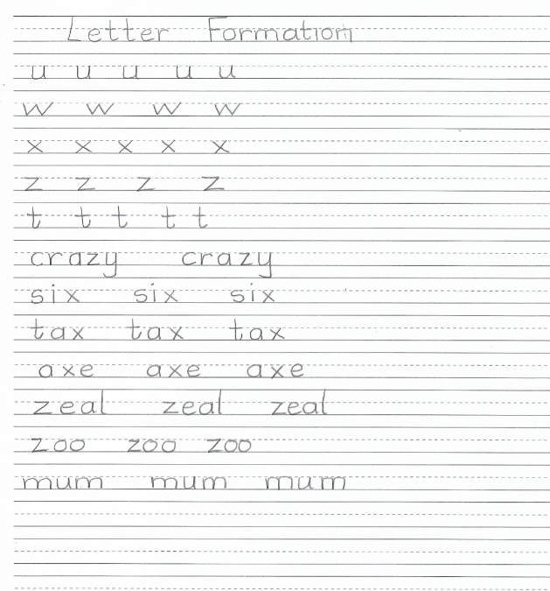

Slide 4
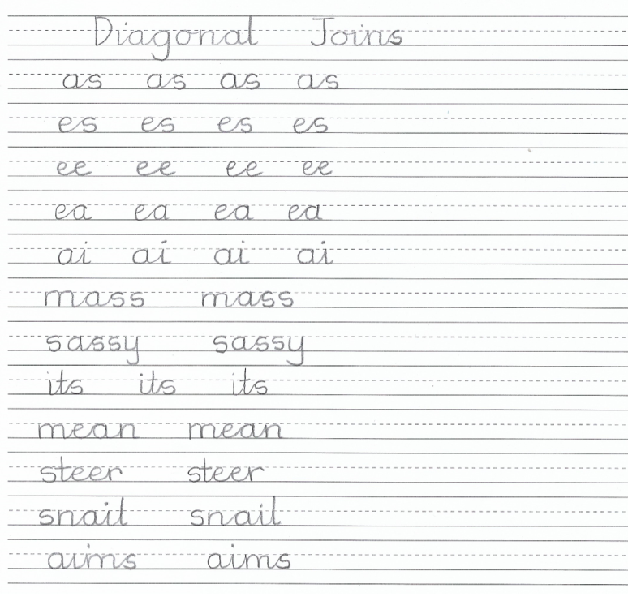

Slide 5
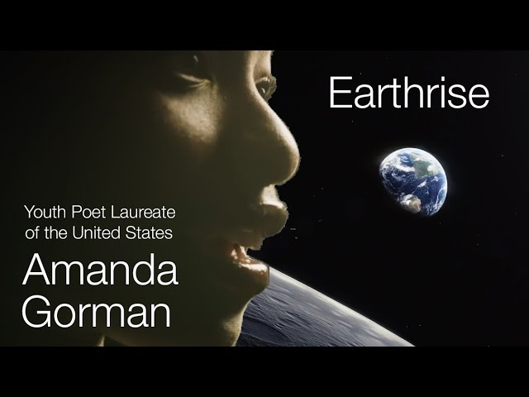
Today, I would like you to write a Haiku Poem
It needs to be on the theme of our environment and climate change.
Go to the Earthrise PPT in the folder and follow the instructions from there.
You will need some help from an adult.

Slide 6
Super Work!
Have a short break and then start on the English Tasks.

Slide 7

Maths :
Add Money
Follow this link to the White Rose website to watch the video clip and pause to complete the activities. Have paper, a pencil and rubber ready to jot down your answers.
https://vimeo.com/498286318
You will find related worksheets in the math’s folder on the Kingsland Website.

Slide 8

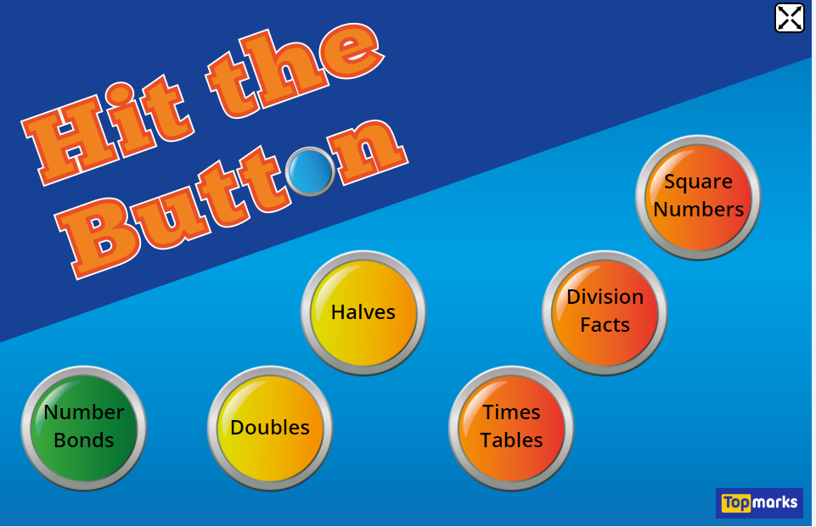

Times Tables Rock
https://play.ttrockstars.com/auth/school/student/78867
https://www.twinkl.co.uk/go
Use your login details to access the games.
PINCODE: QC3571
https://www.topmarks.co.uk/maths-games/hit-the-button

Slide 9
Have a lunch break!

Slide 10

For French and PE, see activities in the Year 3 Folder.

Slide 11

Follow the link for Today’s Worship
This can be found in the
‘Whole School’ folder.

Slide 12
Have a super day, give of your best and please send me an e mail this afternoon with examples of your work.
teacher@kingslandengland.hereford.sch.uk
In the subject line could you have :
Year 3 and name of your child
Please only send one email a day with either attachments or a photo of work completed.

