Slide 1


Slide 2
Yesterday you practised writing a Haiku Poem
Here is an outline of your tasks today :
Listen to the Earthrise Poem.
Record some ‘wow’ words .
Write a Haiku Poem on the topic of our environment and climate change.
Have it checked by an adult
Photograph your poem on a background.
Email your poem to Mrs Smith.
Keep your original poem.
Now, follow the instructions on the slides

Slide 3
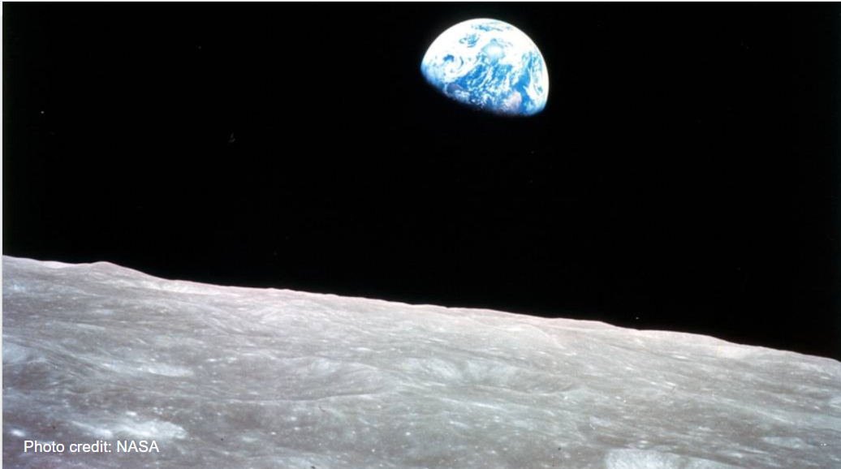
Look carefully at this photo.

Slide 4
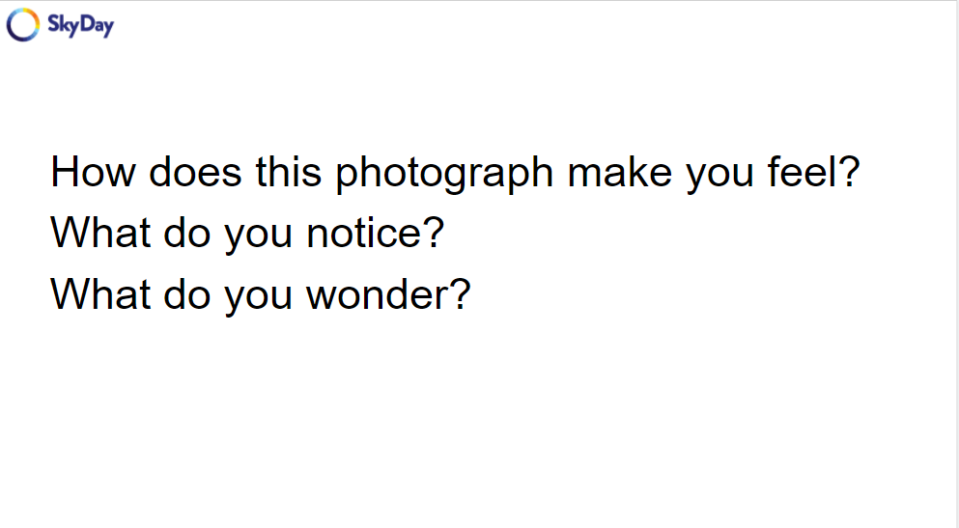
Click on the next slide to listen to Earthrise by Amanda Gorman

Slide 5
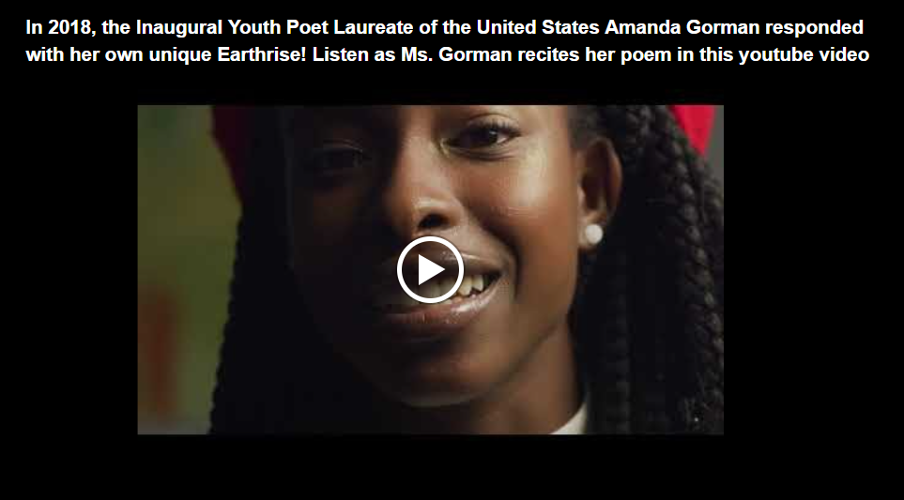
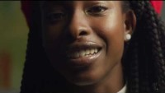
https://www.youtube.com/watch?v=xwOvBv8RLmo

Slide 6
Use the printed ‘Earthrise’ poem (in the folder) to underline and record some powerful
‘wow’ words. You may be able to use these in your Haiku.

Slide 7
Choose an environment/climate change theme or topic and write down some key words:
        Ideas: sky, oceans, plastic, pollution, earth, world…

Slide 8
Use your key words to create 3 sentences in the form of a Haiku
This is a rough copy so play around with the words and syllables.
5 syllables: ______________________________________________________
7 syllables: _______________________________________________________
5 syllables:________________________________________________________
Clap out or tap out the words /syllables on your fingers .
See ‘Mrs Smith’s ‘ Haiku Planning PPT if unsure

Slide 9
Very Important!!
Ask an adult to check your spellings as your poem will be on display in school and uploaded onto the ‘Skyday’ website

Slide 10
Now, using your neatest printing or joined writing, write out your poem.
Write your first name at the bottom of your poem: by ___________
Check It!

Slide 11
Find a background to stick or lay your poem on.
It could be:
Fabric
Patterned paper
Natural grass, wood, bark etc
Take a photo of your poem on the background. Make sure it is clear, readable and any other backgrounds are not included. Ask an adult to help you as you may need to crop the photo.

Slide 12
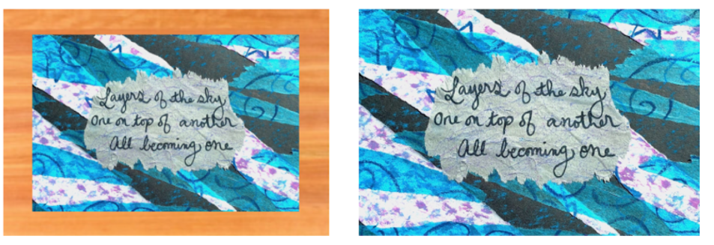
EXAMPLE
Before cropping
Ready to be photographed

Slide 13
Take a few close –up photos of your poem on its background.
Make sure there are no other backgrounds in the photo.
Email your photo to Mrs Smith ( teacher@kingslandengland,hereford.sch.uk).
Keep your original mounted poem and bring it into school on the 8th March 2021.
Mrs Smith will upload your poem onto ‘SKYDAY’ and it will be on display at school.

Slide 14
Remember to keep your mounted poem and bring it
into school when we return as it will be included in a display.
On Monday morning (if you want) have one of your Haiku poems to read out on TEAMS

Slide 15
Well Done!!
You are now a Haiku Poet!

