Slide 1





My Key Words:

Slide 2










My Rough Haiku Attempts

Slide 3






My Neatly Written Haiku

Slide 4
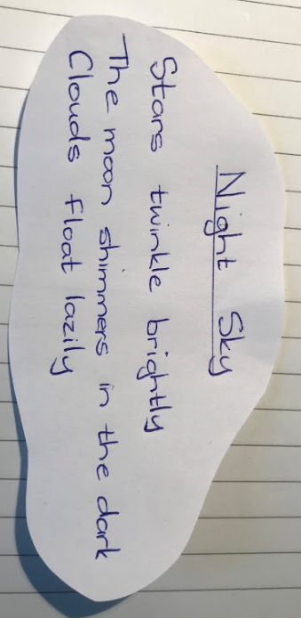
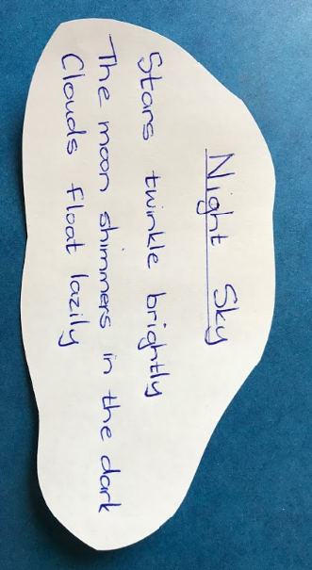
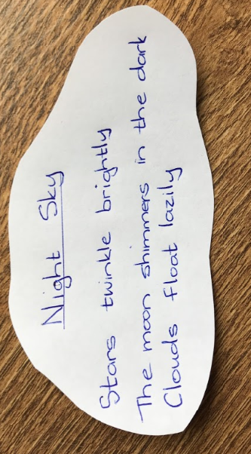
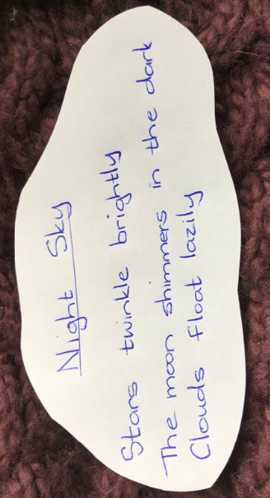
Photographing my Haiku on different backgrounds.

Slide 5
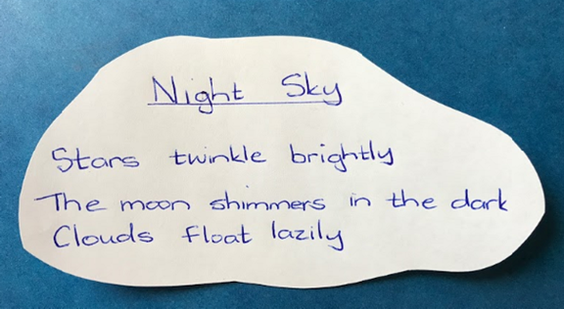
I took a few photos and chose the best one to e mail to: teacher@kingslandengland.Hereford.sch.uk
Write your first name:
by ____________

