Slide 1


Slide 2
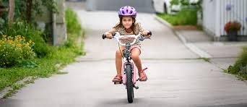
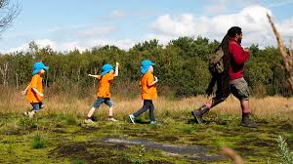
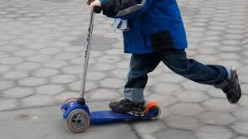
Wherever possible we would love for you to get outside and be active. If you have the chance to get outside maybe you could:
Go for a walk
Get on your bike
Use your scooter / hoverboard / skateboard
Have a kick about with family members
Play on any apparatus you may have in the garden e.g. swings, slides etc…
Play with any sports equipment you own e.g. football, netball, rugby ball, basketball

Slide 3
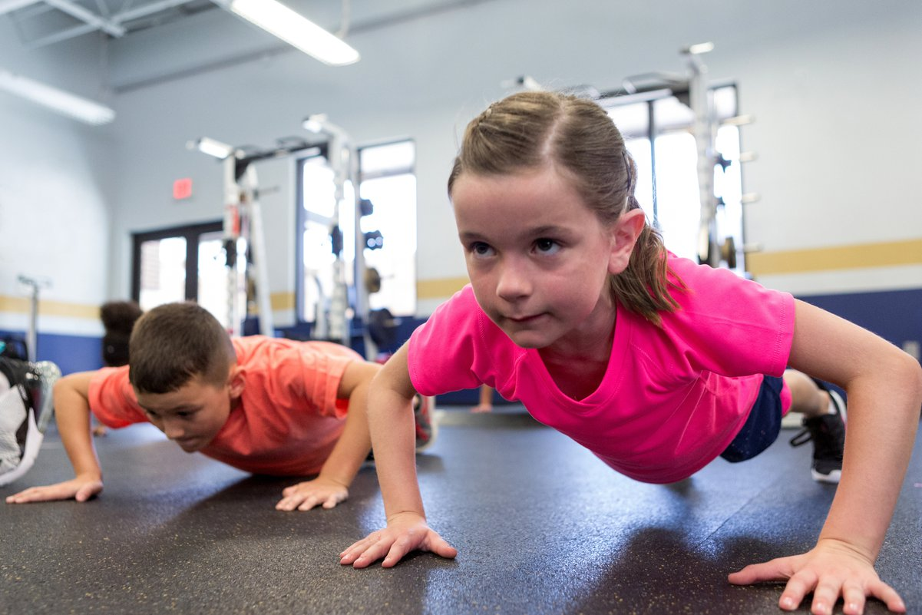
There is also Miss Price’s Circuit Training Challenge (it’s on the school website)!

Slide 4

The one and only Joe wicks!
https://www.youtube.com/watch?v=hnOtrnh80hs

Slide 5

Learn a dance – ‘Can’t stop this feeling’
https://www.youtube.com/watch?v=9sxifR0Ltqk

