Slide 1
An Outline of Today’s Work Thursday 25th February 2021
Subject | Subject/Website | Topic | Activity/ Instruction
English | Spag Mat | Spelling, punctuation and grammar | worksheet is in the English folder
 | Poetry | What is a Haiku? How to write a Haiku. | Video PPT
 | Writing | Write a Haiku | Lockdown Haiku
 | Reading | ‘The Twits’ | Listen to and read the next few chapters
Maths | White Rose Year 3 Spring Block Money | Convert Pounds and pence | Watch the White Rose video and pause to complete the activities In the Math’s Folder you will find a related White Rose sheet and extension sheets.
ICT | Digital Literacy | Algorithms Coding | video lesson links PPT activity Sheet
PE | Movement/Dance | Go Noodle | ‘Footloose’ ‘Milkshake’ ‘Piano Man’
Worship

Slide 2

Full House Point Cards
Send a photo of your full card with your home learning email.
Name:__________________________ House:___________________________
Date:_____________
Please add the date.

Slide 3
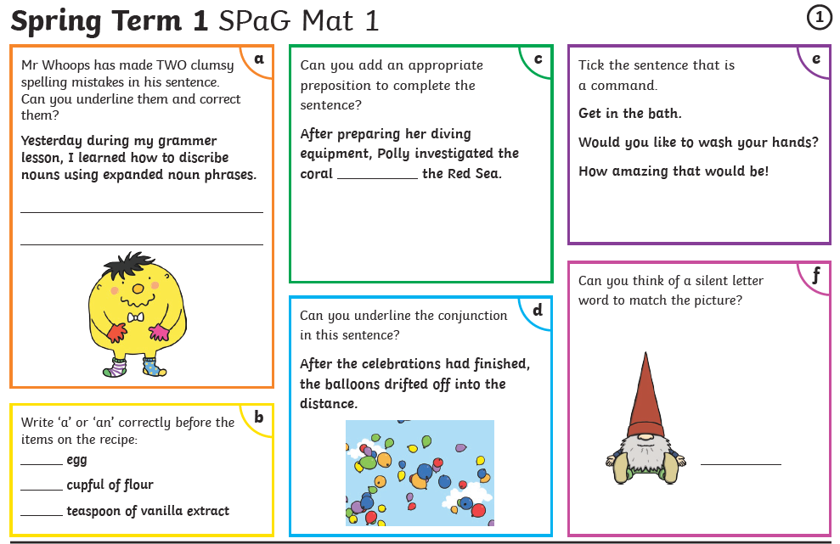

Slide 4
A Haiku Poem
Today I would like you to learn about a Haiku Poem.
Watch the video link
Go through the PPT
Write your own Haiku
There is a template in the folder
https://www.youtube.com/watch?v=tb6RC0zB_-4

Slide 5
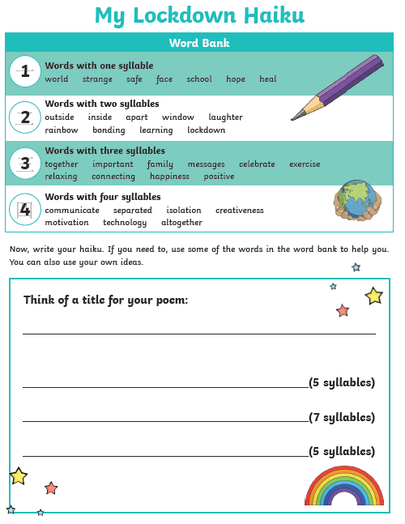

Slide 6

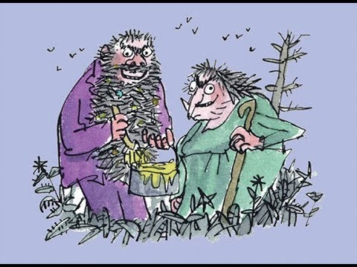
We will continue with ‘The Twits’ next week.
Make sure you have read or listened to the chapters:
The House, the Tree and the Monkey Cage
Hugtight Sticky Glue
Four Sticky Little Boys
The Twits
By
Roald Dahl
22:23 to 26:31
https://www.youtube.com/watch?v=EgppUh8ukZ8
Audio Book

Slide 7
Super Work!
Have a short break and then start on the English Tasks.

Slide 8

Maths :
Convert Pounds and Pence
Follow this link to the White Rose website to watch the video clip and pause to complete the activities. Have paper, a pencil and rubber ready to jot down your answers.
https://vimeo.com/497942634
You will find White Rose and related worksheets in the math’s folder on the Kingsland Website.

Slide 9


Times Tables Rock
https://play.ttrockstars.com/auth/school/student/78867
https://www.twinkl.co.uk/go
Use your login details to access the games.
PINCODE: VD0158

Slide 10
Have a lunch break!

Slide 11

Digital Literacy
This term we will be following the BBC Bitesize computing curriculum.
We will be using both KS1 and KS2 lessons where appropriate for Year 3.
Each short lesson contains games, interactive programmes or video clips to help you understand the topic.
As the lessons are short we may cover two in one session.
This week we will be looking at:
Lesson : What is an algorithm?
Click on the video links below.
There is a PPT to go through with an activity in the folder
https://www.bbc.co.uk/bitesize/topics/z3tbwmn/articles/z3whpv4
Lesson: What is a code?
There is a video to watch and a game to play
https://www.bbc.co.uk/bitesize/topics/z3tbwmn/articles/zykx6sg

Slide 12
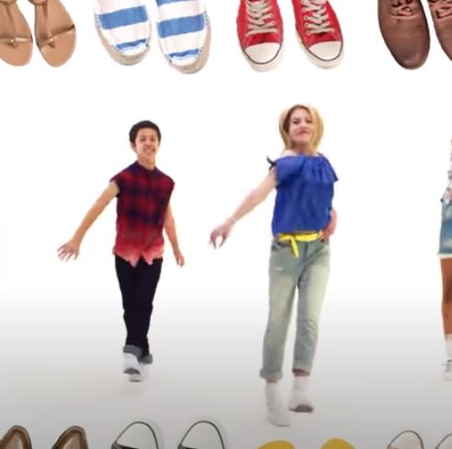
I Am The Music Man https://www.youtube.com/watch?v=22kqia2ibVU
Go Noodle
Get Up, Move and Have Some Fun!
Can’t Stop the Feeling
https://www.youtube.com/watch?v=KhfkYzUwYFk
Koo Koo Kanga Roo - Milkshake
https://www.youtube.com/watch?v=Y9LLfv7yauM

Slide 13

Follow the link for Today’s Worship
This can be found in the
‘Whole School’ folder or click on the link below.
https://youtu.be/zisXE4KlLAI

Slide 14


Tomorrow, please could you have a sheet of paper (lined or blank) ready for our TEAMS meeting.

Slide 15
Have a super day, give of your best and please send me an e mail this afternoon with examples of your work.
teacher@kingslandengland.hereford.sch.uk
In the subject line could you have :
Year 3 and name of your child
Please only send one email a day with either attachments or a photo of work completed.

