Slide 1
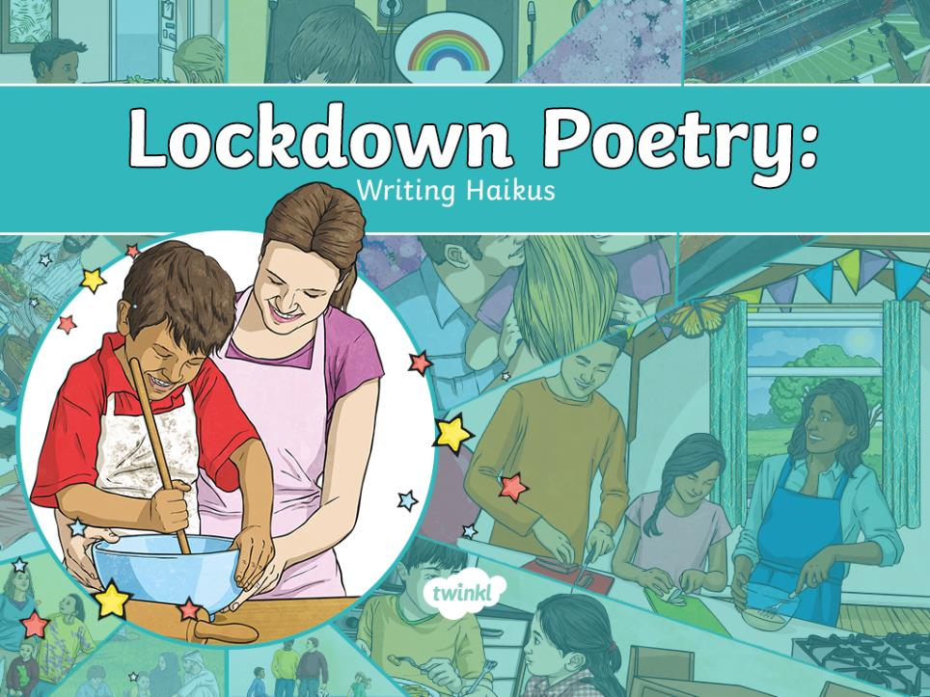

Slide 2


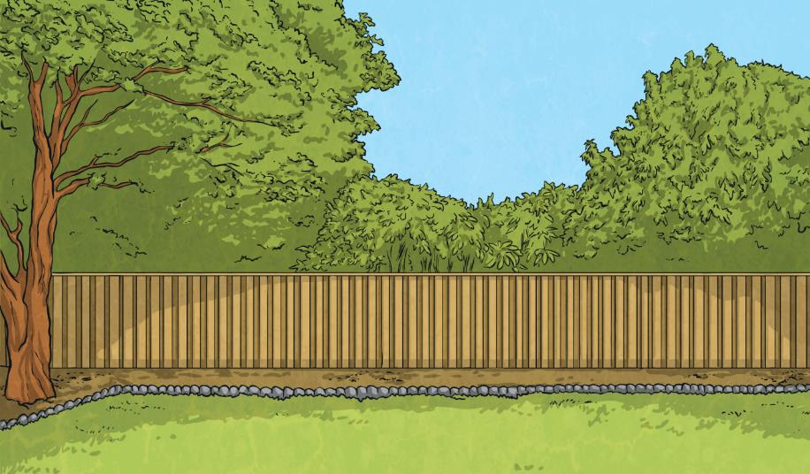

What is a Haiku?
A haiku is a traditional form of Japanese poetry.
Haikus do not require a rhyming pattern but they do require a particular pattern of syllables.
俳句
Next
Do you know what a syllable is?
Next

Slide 3
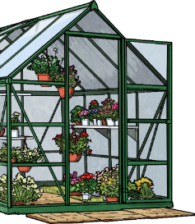
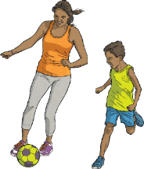





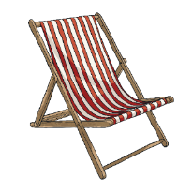



What is a Haiku?
Syllables are the separate beats/parts of words.
Can you work out how many syllables are in these words?
Clap them out as you say them if it helps.
Next
?
butterfly
The word ‘butterfly’ has three syllables.
candle
The word ‘candle’ has two syllables.
?
?
?
watermelon
ball
The word ‘watermelon’ has four syllables.
The word ‘ball’ has one syllable.
Click each ‘?’ to reveal the answers.
Next

Slide 4
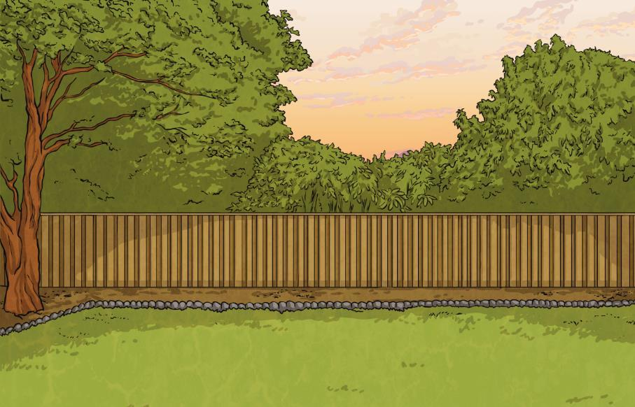




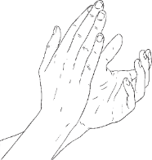
What is a Haiku?
Look at each of these lockdown haikus. Can you recognise a common syllable pattern within them both?
We are going to write haikus about our time during lockdown.
Next
Together
Although apart now,
we are in this together;
never forget that.
Haikus always have three lines of poetry with:
Showing Our Thanks
We clap together,
with our neighbours and our friends,
thanking those who help.
五
七
五
5
7
5
syllables
syllables
syllables
Read each of the haikus again.
This time, clap the syllable pattern as you read.
Next
Next

Slide 5


Lockdown Haiku Examples
Read and discuss this lockdown haiku.
Keeping in Touch
Communicating
in high-tech ways with loved ones
so our world can heal.
Does it have a 5-7-5 syllable pattern?
Next
What is the poem about?
Next
How does it make you feel?
Next

Slide 6


Lockdown Haiku Examples
Read and discuss this lockdown haiku.
Keeping in Touch
Communicating
in high-tech ways with loved ones
so our world can heal.
Family Time
Outside the window,
the world is silent; inside,
it’s full of laughter.
Does it have a 5-7-5 syllable pattern?
What is the poem about?
How does it make you feel?
Next

Slide 7
Creating a Haiku
Rearrange these words to create a haiku about
learning at home during school closures.
My
Teaching
closed
new
now
School
Next
dad
is
is
my
today.
me
skills.
teacher!
五
七
五
Remember the 5-7-5 syllable pattern.
5
7
5
syllables
syllables
syllables
Hint
Done!

Slide 8
Creating a Haiku
Rearrange these words to create a haiku about
learning at home during school closures.
My
Teaching
closed
new
now
School
dad
is
is
my
today.
me
skills.
teacher!
My
dad
is
now
my
teacher!
Here’s an idea to help you. Remember the 5-7-5 syllable pattern.
五
七
五
5
7
5
syllables
syllables
syllables
Hint
Done!

Slide 9
Creating a Haiku
Did you manage to rearrange the words so that it had the correct numbers of syllables to fit the 5-7-5 syllable pattern to make a haiku? You could have done it like this…
School
is
closed
today.
My
dad
is
now
my
teacher!
Teaching
me
new
skills.
Next

Slide 10









Planning a Haiku
Now, write your own haiku about your time in lockdown.
What could your haiku be about?
Click on each note to reveal an idea for your Haiku.
Next
fun times with the people that you live with
?
keeping in
touch with
friends and
family
?
?
learning
at home
your feelings
and thoughts
during lockdown
?
?
?
daily
exercise
thanking
key workers
Next

Slide 11
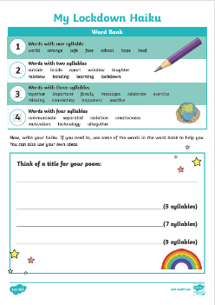

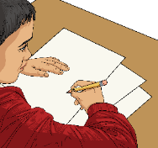
Writing a Haiku
Use our Lockdown Haiku Writing Frame to write and illustrate your haiku. You could even write a collection of haikus and perform them for the people you live with.
Try out some ideas. Clap the syllables of your haiku lines to check that you have the correct 5-7-5 pattern.
Finish
Next

