Slide 1
An Outline of Today’s Work Wednesday 24th February2021
Subject | Subject/Website | Topic | Activity/ Instruction
Maths | Quiz | Flash Back Quiz | PPT in the folder
 | White Rose Year 3 Spring Block Money | Pounds and Pence | Watch the White Rose video and pause to complete the activities In the Math’s Folder you will find a related sheet.
English | Dictation | A sentence including spelling words, punctuation and grammar | Listen to the audio on this PPT Write it. Mark it using the PPT slide
 | Written | Improve the Sentences | Follow the PPT Stretch and improve the sentences
Science | Rocks and Soils | Types of rocks and where we find them | Video clips Instructions in the folder
Worship | iSing Pop |  | Links can be found either in emails sent or the ‘Whole School’ folder

Slide 2



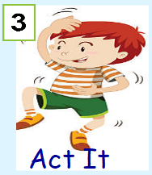


Dictation
Click on the speaker to hear the sentence.
Do not go to the next slide until you have written and checked your sentence.

Slide 3

Mark your dictation and see where you need to make corrections.
I’m so angry with my brother because he messed up my room and I have just had enough!
Give yourself a tick for the following if correct:
Correct spelling of:
brother, because, just, enough, I’m
Exclamation Mark !

Slide 4

Go to the separate PPT to improve the sentences.

Slide 5
Super Work!
Have a short break and then start on the English Tasks.

Slide 6

Maths Quiz
Follow the PPT: Math’s Flashback Quiz in the folder.

Slide 7

Maths :
Pounds and pence
Follow this link to the White Rose website to watch the video clip and pause to complete the activities. Have paper, a pencil and rubber ready to jot down your answers.
https://vimeo.com/497345587
You will find related worksheets in the math’s folder on the Kingsland Website.

Slide 8


Times Tables Rock
https://play.ttrockstars.com/auth/school/student/78867
https://www.twinkl.co.uk/go
Use your login details to access the games.
PINCODE: QC3571

Slide 9
Have a lunch break!

Slide 10
Science: Types of Rocks
Watch the following short clips and then go through the PPT in the folder.
Types of rocks and how they are used. (no narration-35 seconds)
https://www.bbc.co.uk/bitesize/clips/zvrb4wx
Rocks in Daily Life
https://www.youtube.com/watch?v=60wmyyCaUgQ
Stonemason ( 30 seconds)
https://www.bbc.co.uk/bitesize/clips/z2cg9j6
Limestone and its uses ( 1min 24 sec)
https://www.bbc.co.uk/bitesize/clips/z3ynvcw

Slide 11
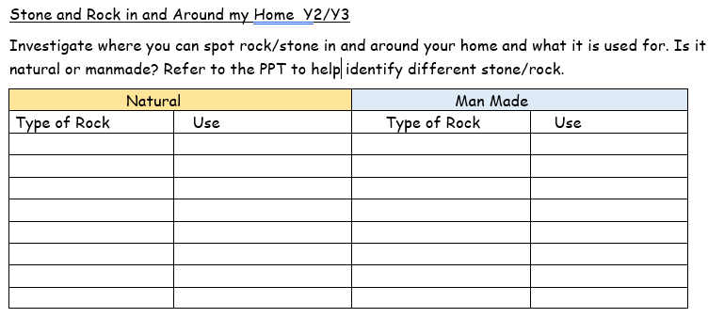
Use the worksheet to record different rocks/ stone you can find in your home or outside in your garden.

Slide 12

Follow the link for Today’s Worship
This can be found in the
‘Whole School’ folder.

Slide 13
Have a super day, give of your best and please send me an e mail this afternoon with examples of your work.
teacher@kingslandengland.hereford.sch.uk
In the subject line could you have :
Year 3 and name of your child
Please only send one email a day with either attachments or a photo of work completed.

