Slide 1
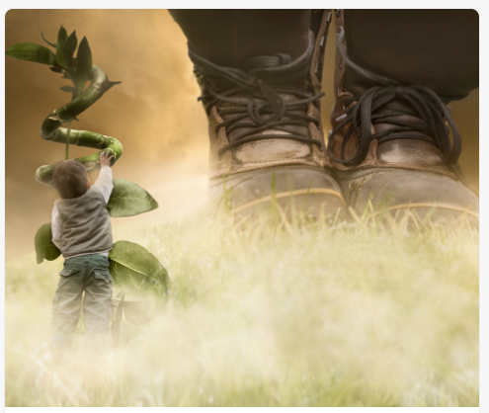
Spend a few minutes looking closely at this picture. Discuss it with an adult.

Slide 2
I have got a rather simple sentence about the picture.
You need to improve this sentence, step by step, following the instruction on the PPT slides.
Clicking on the page and it will give you the next instruction.
After each instruction you need to rewrite the sentence neatly on your page.
Start a new line for each new improved sentence.
Go back to the large picture if you need some inspiration.
You will need:
A pencil and a rubber
Lined paper

Slide 3
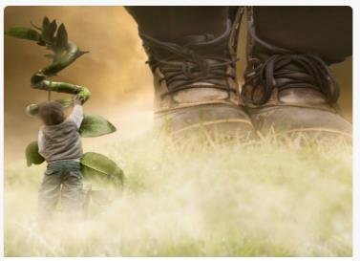
The boy climbed .
Write this simple sentence neatly on your page.

Slide 4

The boy climbed .
Add: adjective (to describe how the boy felt) Write the sentence.
Add: ‘when’ (when was he climbing?) Write the sentence.
Add: ‘why’ (why is he climbing?) Write the sentence.
Add: ‘where’ (where is he climbing?) Write the sentence.
.

Slide 5

Read your last sentence and ‘tweak’ it:
Make sure it makes sense.
Could you change the sentence structure to make it more interesting?
Have you got a capital letter and full stop?
Could you start the sentence without ‘the’

Slide 6
Now start another sentence about the boots.
I have given you another simple sentence to improve using similar steps.
Write this sentence in your book .
There are boots.

Slide 7

There are boots
Add: adjective ( Describe the boots) Write the sentence.
Add: ‘where’ ( Where are the boots?) Write the sentence.
Add: ‘who’ (Who do the boots belong to?) Write the sentence.
Add: ‘when ’ (When were the boots there?) Write the sentence.

Slide 8
Read your last sentence and ‘tweak’ it:
Make sure it makes sense.
Could you change the sentence structure to make it more interesting?
Have you got a capital letter and full stop?
Try not to start with ‘the’

Slide 9
Well Done!
That is a huge improvement!

