Slide 1


Slide 2

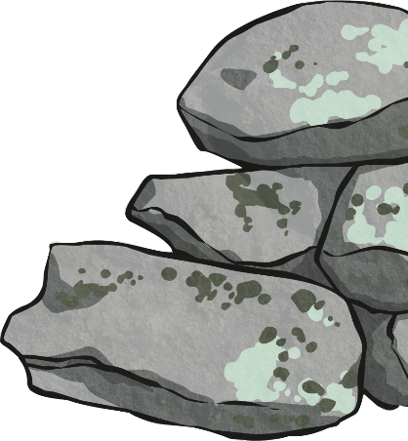
Rocks/Stone
On the following slide, read about manmade rock.
Look carefully at the identification chart and refer to it later.
Rock and stone are used all around us. Can you spot some uses in the following pictures?

Slide 3


Man-Made Rocks
The scientific name for man-made rocks is anthropic rocks. Anthropic rocks are made, modified or moved by humans. They have been around for 100s of years.
Concrete
The Romans first invented concrete.
Concrete is a mixture of water, aggregate (either sand, rock or gravel) and cement (a mixture of chalk and clay).
Bricks are usually made of clay soil, sand and lime or concrete materials. They can be air dried or fire-hardened.
Mock Rock
Include pulhamite, which looked like gritty sandstone.
Coade stone (made from grog, flint, quartz, soda lime glass and clay) is another type of mock rock.

Slide 4













Natural or Man-Made
Natural Rocks
Man-Made Rocks
Igneous
Sedimentary
Metamorphic
Obsidian
Chalk
Marble
Brick
Granite
Sandstone
Quartzite
Concrete
Basalt
Limestone
Slate
Coade Stone

Slide 5
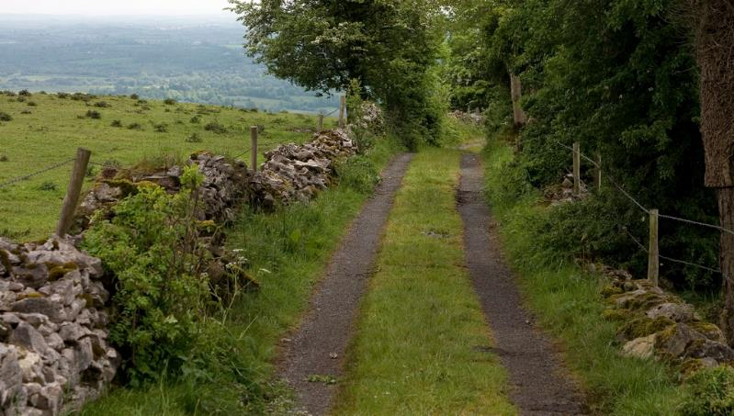
Spot the Rocks
Stone Wall
Photo courtesy of Jimmy Harris (@flickr.com) - granted under creative commons licence – attribution

Slide 6
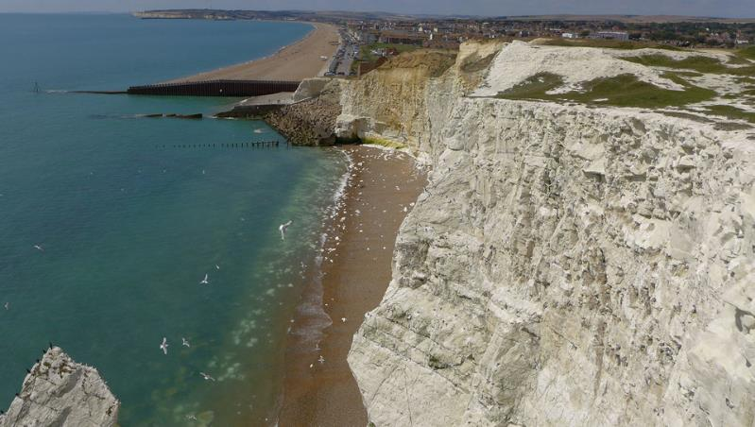
Spot the Rocks
Chalk Cliffs
Photo courtesy of tsbl2000 (@flickr.com) - granted under creative commons licence – attribution

Slide 7
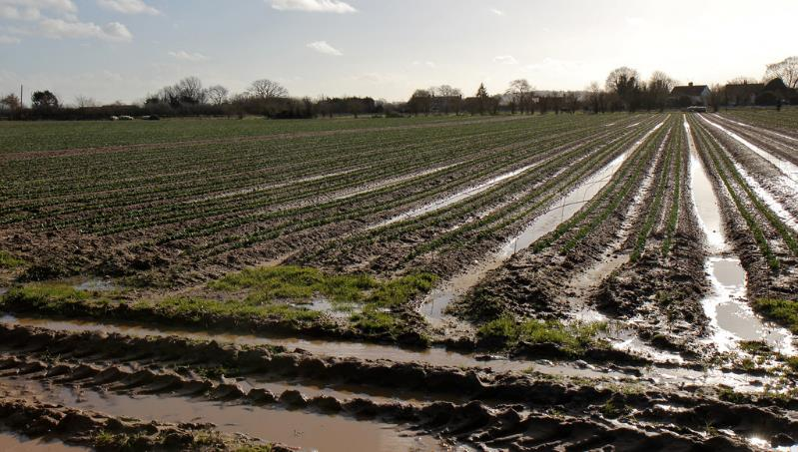
Spot the Rocks
Small pebbles and stones in the mud.
Photo courtesy of Marianne Bevis (@flickr.com) - granted under creative commons licence – attribution

Slide 8

Spot the Rocks
Stone slabs on the walk way.
Photo courtesy of joncandy (@flickr.com) - granted under creative commons licence – attribution

Slide 9
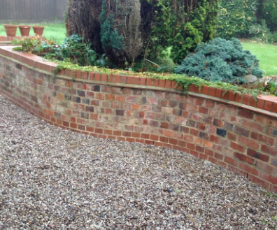
Spot the Rock/Stone
Brick wall-is it man made or natural?
stone ground cover
Photo courtesy of mikecogh (@flickr.com) - granted under creative commons licence – attribution

Slide 10

Spot the Rock
marble statue
Photo courtesy of coolinsights (@flickr.com) - granted under creative commons licence – attribution

Slide 11
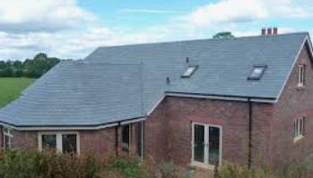
Spot the Rock/Stone
slate roof
brick walls
Photo courtesy of Doug Scortegagna (@flickr.com) - granted under creative commons licence – attribution

Slide 12

Rock/Stone in the Kitchen
marble work top
Photo courtesy of zemistor (@flickr.com) - granted under creative commons licence – attribution

Slide 13

Fact or Fiction?
Igneous rock is formed by magma and lava.
Fact
Fiction
Metamorphic rock turns into liquid.
Fact
Fiction
Sedimentary rock forms on land.
Fact
Fiction
There are two types of igneous rock.
Fact
Fiction
Chalk is a type of man-made rock.
Fact
Fiction
Man-made rocks do contain natural rocks as well.
Fact
Fiction
The man who invented pulhamite took the recipe to the grave.
Fact
Fiction

