Slide 1
An Outline of Today’s Work Tuesday 23rd February2021
Subject | Subject/Website | Topic | Activity/ Instruction
Maths | White Rose Year 3 Spring Block Money | Count Money (pounds) | White Rose Teaching Video Related worksheets in today’s folder
Numberocks , TTR and Twinkle Go songs and games.
English | Spelling | apostrophes and contractions | Video Clip Worksheet Twinkle Go!
 | Written task | Use contractions | Sentence including contractions
 | Alphabetical Order | To list in alphabetical order | Use neatest handwriting to list alphabetically
Topic | Climate Change | Plastic in Our Oceans | PPT Video links Twinkle GO!
Worship | Mr Debenham | Live Worship On TEAMS | Links were e mailed out or can be found on the school website.

Slide 2
Apostrophes and Contractions
Watch the video clips with pencil and paper ready to pause and complete the activities.
National Oak:
https://classroom.thenational.academy/lessons/to-understand-the-two-functions-of-apostrophes-68vk6t
There is a ‘Spot the Contraction’ practice sheet and sentence to complete in the folder.
Twinkle Go! Pin Code: EQ1276
Practice Activities

Slide 3

Alphabetical Order
Using the list of words on the worksheet and the help of the alphabet, order the words alphabetically underneath each other.
If you find these tricky , you could write each word on a separate piece of paper, that you could order and move around.
Once you are sure, write them neatly in alphabetical order.

Slide 4
Super Work!
Have a short break and then start on the English Tasks.

Slide 5

Maths :
Count Money
(pounds)
Follow this link to the White Rose website to watch the video clip and pause to complete the activities. Have paper, a pencil and rubber ready to jot down your answers.
https://vimeo.com/497344241
There are related worksheets in the folder for today.

Slide 6


Times Tables Rock
https://play.ttrockstars.com/auth/school/student/78867
https://www.twinkl.co.uk/go
Use your login details to access money activities
PINCODE: QC3571

Slide 7
Have a lunch break!

Slide 8
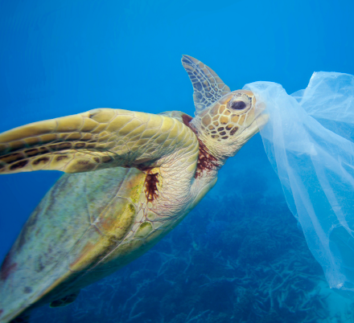
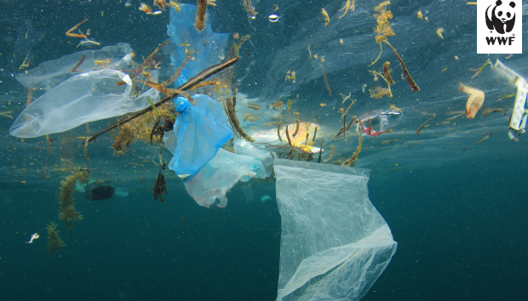
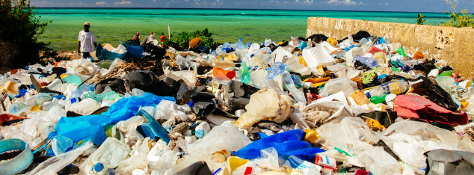
Plastic in Our Oceans

Slide 9

Climate Change
Plastic in Our Oceans
Have your worksheet ( in the folder) with you to pause and take notes on the information in the videos and PPTs
Watch the following Video clips
David Attenborough- plastic in our oceans (2min)
https://www.bbc.co.uk/programmes/p05q49hq
Newsround (3min)
https://www.bbc.co.uk/newsround/42810179
Plastic in Our Oceans
https://www.greenpeace.org.uk/news/why-is-there-so-much-plastic-in-the-ocean/
‘Twinkle Go’ Pin code: SQ1078
For more resources

Slide 10
Climate Change
Plastic in Our Oceans
Have your worksheet with you to pause and take notes on the information in the videos and PPTs
Use your Twinkle Go logins emailed previously and the ‘Twinkle Go’ Pin code: SQ1078 for the resources you will need:
PPTS
Interactive resources
e book story
Blue Planet PPT

Slide 11

Follow the link for Today’s Worship
Live on TEAMS with
Mr Debenham

Slide 12
Have a super day, give of your best and please send me an e mail this afternoon with examples of your work.
teacher@kingslandengland.hereford.sch.uk
In the subject line could you have :
Year 3 and name of your child
Please only send one email a day with either attachments or a photo of work completed.

