Slide 1
An Outline of Today’s Work Monday 22nd February 2021
Subject | Subject/Website | Topic | Activity/ Instruction
Maths | White Rose Year 3 Spring Block Money Week 4 | Count money (Pence) | White Rose Teaching Video Related worksheets in today’s folder
 | Twinkle Go! | Money resources and activities | Use your login to access the games.
English | National Curriculum Word | ‘enough’ | Worksheet is in the today’s folder
 | High Frequency Spelling Words | Look/ Cover/ Write | 5 High Frequency Words to learn for the week. Sheet in the folder
 | Comprehension | ‘Rap Up Warm’ | Question sheet and Text in the folder
RE | Islam | Eid- Celebrating the end of Ramadan | Video links to watch and PPT Twinkle Go resources Activity sheet
Worship | Rev Julie |  | A link can be found in the Whole School Folder

Slide 2
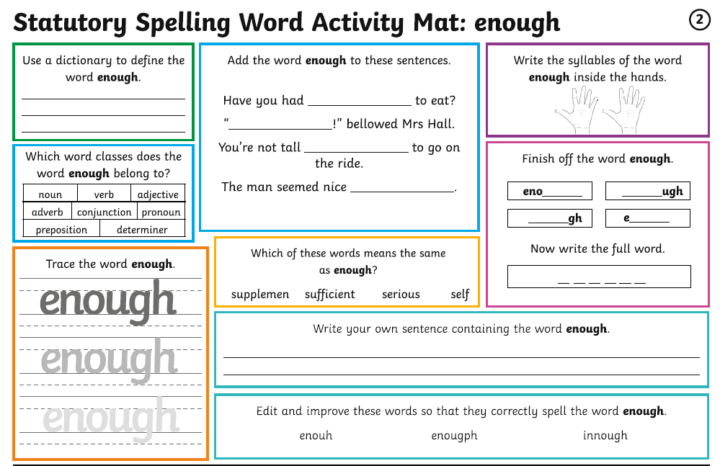

Slide 3
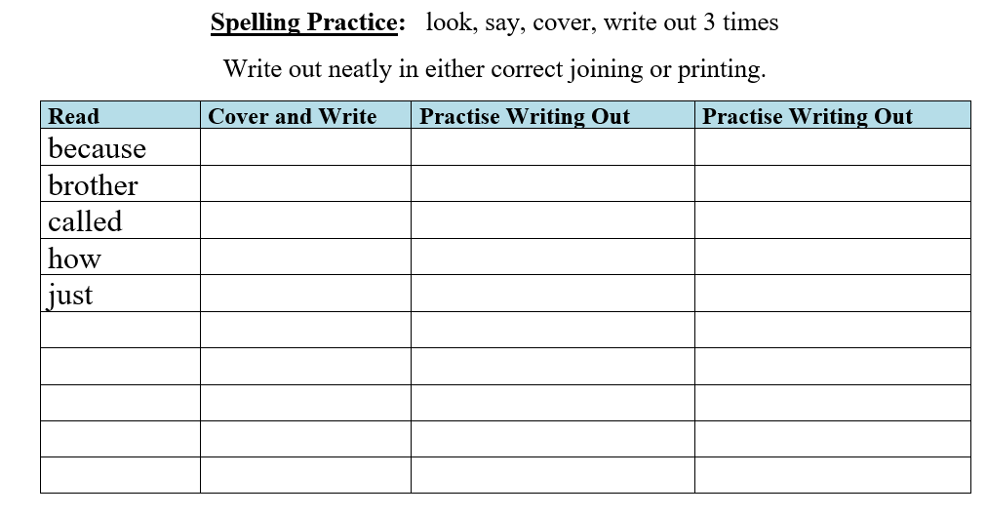
SPELLING
Every Monday I will be setting 5 High Frequency Spelling Words for you to learn to spell.
They are separate to the National Curriculum words, are words that we use often and MUST know how to spell.
I will include some in our weekly dictation and they will be part of our quiz on a Friday.
There is a ‘Look, Cover, Write’ check sheet to help you learn theses words.
Interactive Spelling Game
National Curriculum Words and Words with Spelling Patterns
http://www.ictgames.com/mobilePage/lcwc/index.html

Slide 4

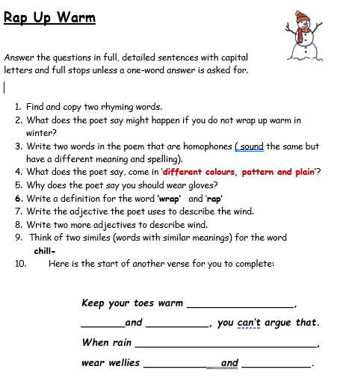
Comprehension:
‘Rap Up Warm’
Ask an adult to discuss the questions with you if you are not feeling confident.
Either answer on the printed sheet or lined paper in full sentences where necessary.
You will find different levels of the reading comprehension in the folder.

Slide 5
Super Work!
Have a short break and then start on the Math’s Tasks.

Slide 6

Attention parents and carers. Some clarity on maths expectation:
Your child is expected to complete the White Rose maths sheet related to the video they watched.
The last 2 or 3 questions can be trickier . Give help if needed and don’t worry if they are more challenging.
Your child should be trying one of the extra sheets:
* if they found most of the White Rose Sheet to be challenging
** if they are feeling confident with the White Rose Sheet
*** if they are very confident and want a challenge (sometimes best to try the ** first)
They are not expected to complete the White Rose and all three extra sheets. Use practical equipment
(money, beans, match sticks etc) if they need help understanding a concept. Draw representations eg: PV counters
1
10
100

Slide 7

Maths :
Count Money (pence)
Follow this link to the White Rose website to watch the video clip and pause to complete the activities. Have paper, a pencil and rubber ready to jot down your answers.
https://vimeo.com/497343674
There are White Rose sheets and related worksheets in the math’s folder on the Kingsland Website.

Slide 8


Times Tables Rock
https://play.ttrockstars.com/auth/school/student/78867
https://www.twinkl.co.uk/go
Use your login details to access money activities and resources.
PINCODE: QC3571

Slide 9
Have a lunch break!

Slide 10

The Celebration of Eid
Below are three video clips to watch as well as a PPT .
What is Eid?
https://www.bbc.co.uk/bitesize/topics/zpdtsbk/articles/zhjjf4j
Preparing for Eid, Celebrating Eid, Eid Performance:
https://www.bbc.co.uk/cbeebies/puzzles/lets-celebrate-eid
If you login in to Twinkle Go, you will find: Eid PPT
Eid Recipes
Eid Display photos
Twinkle Go-PIN:
Z J 3859

Slide 11
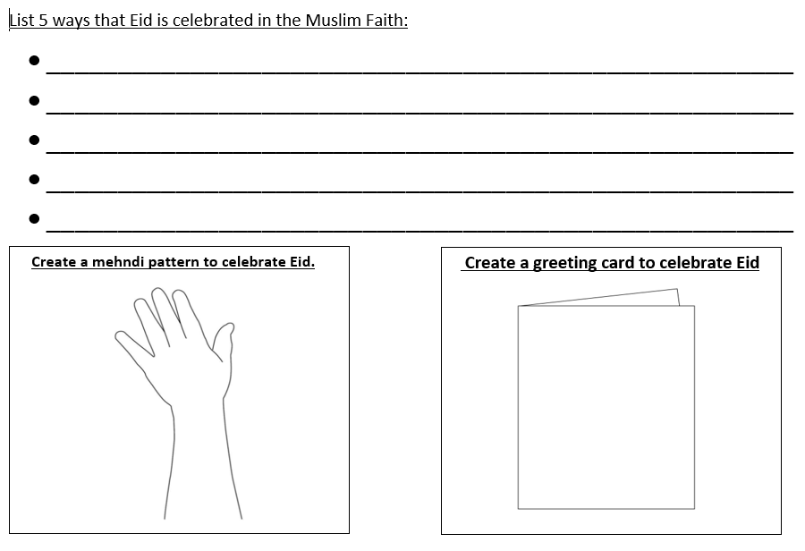
There is a related sheet to complete in the folder.

Slide 12

Follow the link for Today’s Worship
In the Whole School Folder

Slide 13
Have a super day, give of your best and please send me an e mail this afternoon with examples of your work.
teacher@kingslandengland.hereford.sch.uk
In the subject line could you have :
Year 3 and name of your child
Please only send one email a day with either attachments or a photo of work completed.

