Slide 1
An Outline of Today’s Work Friday 12th January 2021
Subject | Subject/Website | Topic | Activity/ Instruction
English | Handwriting | Letter Formation Diagonal Joins | Letters to trace and write Lined handwriting Paper
 | Written Task | Direct Speech | Rewrite ‘speech bubbles’ into direct speech
Maths | White Rose Year 3 Spring Block Multiplication and Division Week 3 | Scaling | Watch the White Rose video and pause to complete the activities In the Math’s Folder you will find a related White Rose sheet and extension sheets.
French |  |  | See work set by Mr Powell in our Year 3 folder
PE |  |  | See work set by Mr Powell and Miss Price in our Year 3 folder
Worship | ‘Big Joe’ |  | Links are emailed or can be found in the ‘Whole School ‘folder.

Slide 2

Handwriting Lines

Slide 3
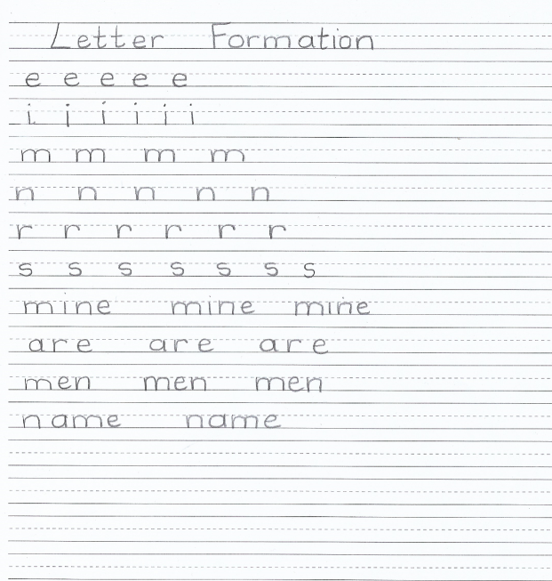

Slide 4
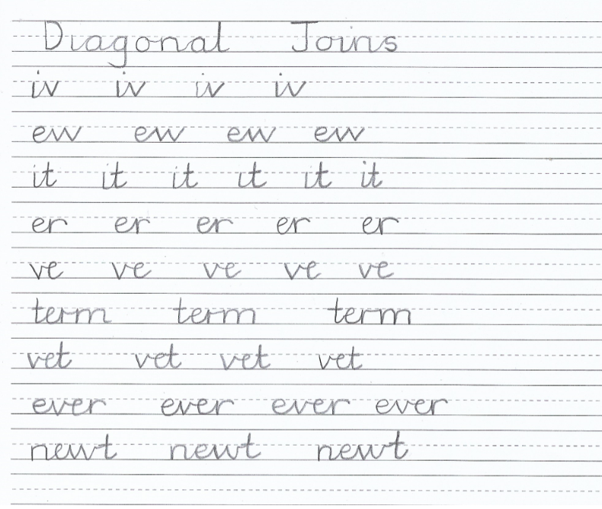

Slide 5
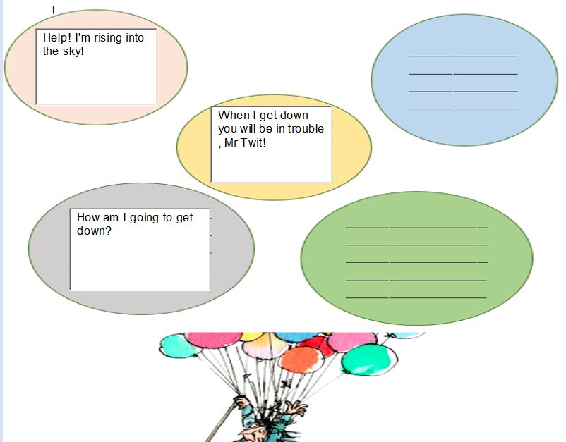
You will need:
pencil
lined paper
speech bubble sheet from yesterday
Instructions
Set out your page with a date and heading ‘Mrs Twit’
Take the speech in the speech bubble and write it as direct speech.
You should have 5 different sentences .
Remember your punctuation:
‘’ ‘’ . , ? !
Start a new line for each sentence of speech.
Add a response from Mr Twit

Slide 6
Super Work!
Have a short break and then start on the English Tasks.

Slide 7

Maths :
Scaling
Follow this link to the White Rose website to watch the video clip and pause to complete the activities. Have paper, a pencil and rubber ready to jot down your answers.
https://vimeo.com/494127943
You will find related worksheets in the math’s folder on the Kingsland Website.

Slide 8
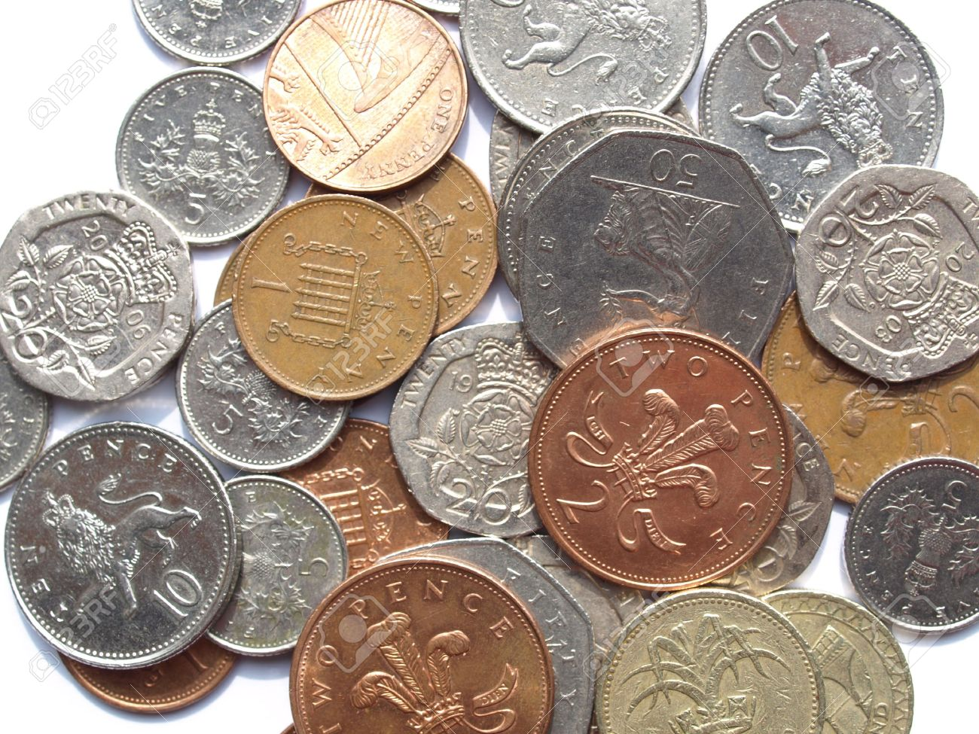
Maths After Half Term
We will be moving onto ‘money’ in maths.
It may help you to have a selection of coins to use as concrete apparatus .
A suggested good selection would be: 15x 1p 10x 2p 10x5p 10x 10p 10x20p 5x50p 2x £1

Slide 9

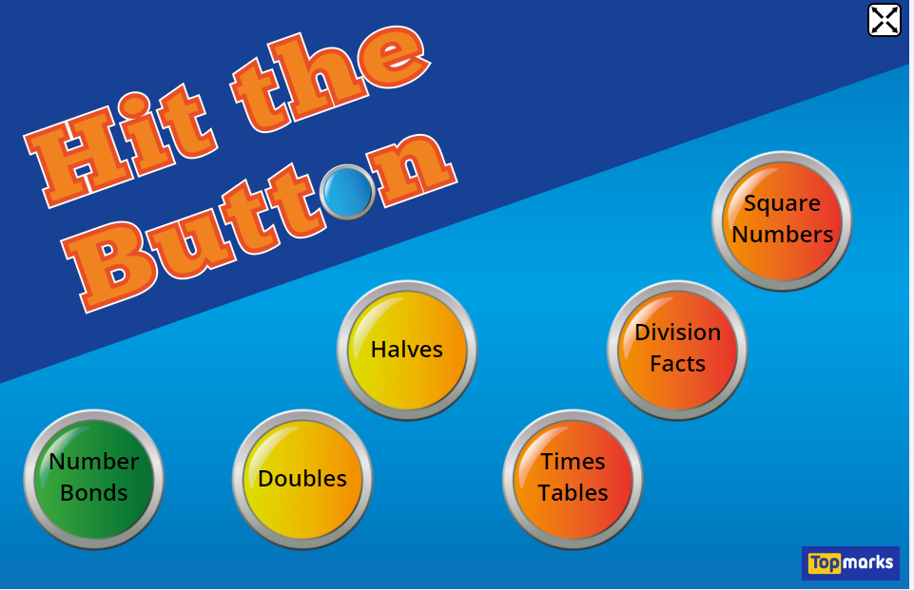

Times Tables Rock
https://play.ttrockstars.com/auth/school/student/78867
https://www.twinkl.co.uk/go
Use your login details to access the games.
PINCODE: VD0158
https://www.topmarks.co.uk/maths-games/hit-the-button

Slide 10
Have a lunch break!

Slide 11
SKYDAY
Follow the instructions on the PPT in the folder
I’ll be looking out for your Sky Photos
You have all of half term to upload photos
Because We Only Have One Sky!
Join hundreds around the world taking pictures of the sky.
Here is how to take part:
Follow the link to watch the important videos:
https://skydayproject.com/january
Now, take a few photos of the sky. Only the sky!
It can be night, day, sunset or sunrise.
Upload it onto the following website
http://skydayproject.org/

Slide 12

For French and PE, see activities in the Year 3 Folder.

Slide 13

Follow the link for Today’s Worship
This can be found in the
‘Whole School’ folder.

Slide 14
Have a super day, give of your best and please send me an e mail this afternoon with examples of your work.
teacher@kingslandengland.hereford.sch.uk
In the subject line could you have :
Year 3 and name of your child
Please only send one email a day with either attachments or a photo of work completed.

