Slide 1


Slide 2
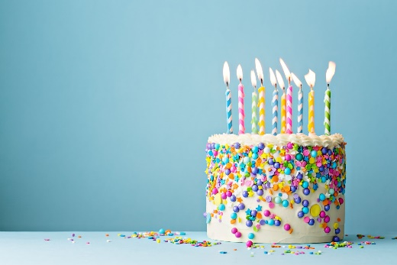

We are going to continue with National Oak Academy for French this week
This week we are going to say the month that our birthday is in.

Slide 3

First there is an introduction quiz – this will check your prior knowledge (please do not worry if you do not get any of these correct).
https://classroom.thenational.academy/lessons/saying-the-month-your-birthday-is-in-6nk36r?step=1&activity=intro_quiz

Slide 4

Then we have the video lesson, which can be found by using this link.
https://classroom.thenational.academy/lessons/saying-the-month-your-birthday-is-in-6nk36r?step=2&activity=video

Slide 5

Next we have the end of lesson quiz.
https://classroom.thenational.academy/lessons/saying-the-month-your-birthday-is-in-6nk36r?step=3&activity=exit_quiz
Then finally I have a song that you can see along with.
https://www.youtube.com/watch?v=jcwcGwaS_2w

