Slide 1
An Outline of Today’s Work Thursday 11th January 2021
Subject | Subject/Website | Topic | Activity/ Instruction
English | Spag Mat | Spelling, punctuation and grammar | Worksheet is in the English folder
 | Grammar | Punctuation | Punctuate the direct speech
 | Writing | Mrs Twit’s comments | Fill the balloons on the worksheet
Maths | White Rose Year 3 Spring Block Multiplication and Division Week 3 | Divide 2 digit by 1-digit (3) | Watch the White Rose video and pause to complete the activities In the Math’s Folder you will find a related White Rose sheet and extension sheets.
Art | Sculpture | Use plastic | Create a plastic sculpture
Music |  |  | Clapping 4 beats in a bar

Slide 2

Full House Point Cards
Send a photo of your full card with your home learning email.
Name:__________________________ House:___________________________
Date:_____________
Please add the date.

Slide 3
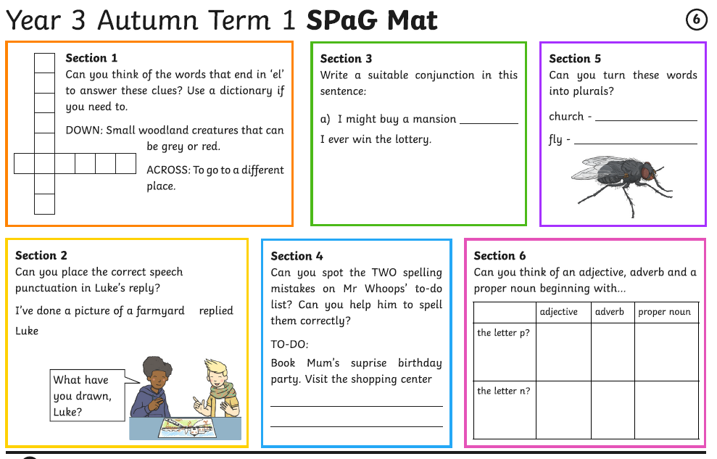

Slide 4
Use the correct punctuation to punctuate the direct speech.
Add the correct verb in the space.

Slide 5
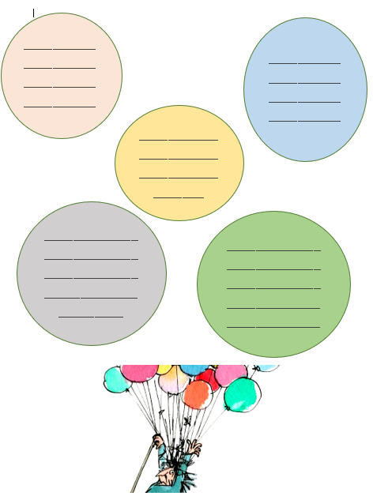

Slide 6
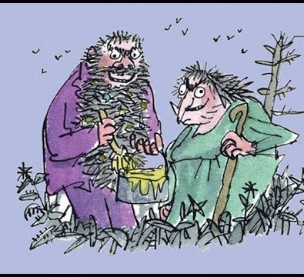

The Twits
By Roald Dahl
https://www.youtube.com/watch?v=EgppUh8ukZ8
Audio Book

Slide 7
Super Work!
Have a short break and then start on the English Tasks.

Slide 8

Maths :
Divide 2-digit by 1-digit (3)
Follow this link to the White Rose website to watch the video clip and pause to complete the activities. Have paper, a pencil and rubber ready to jot down your answers.
https://vimeo.com/494126561
You will find White Rose and related worksheets in the math’s folder on the Kingsland Website.

Slide 9


Times Tables Rock
https://play.ttrockstars.com/auth/school/student/78867
https://www.twinkl.co.uk/go
Use your login details to access the games.
PINCODE: VD0158

Slide 10

Follow the link for Today’s Worship
This can be found in the
‘Whole School’ folder or click on the link below.
https://youtu.be/zisXE4KlLAI

Slide 11
Have a lunch break!

Slide 12
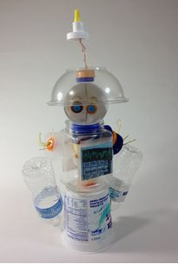
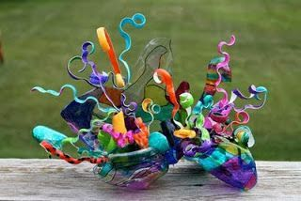
I would like you to create a sculpture using the plastic you have collected.
The main part of your sculpture needs to be plastic but you may
use a few other materials if necessary.
It can be abstract or a model of something.

Slide 13
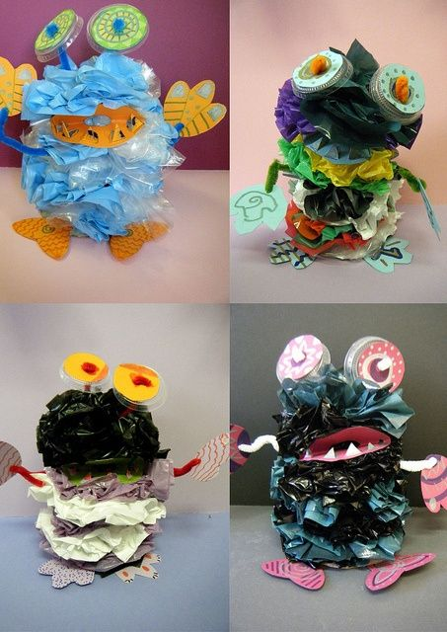
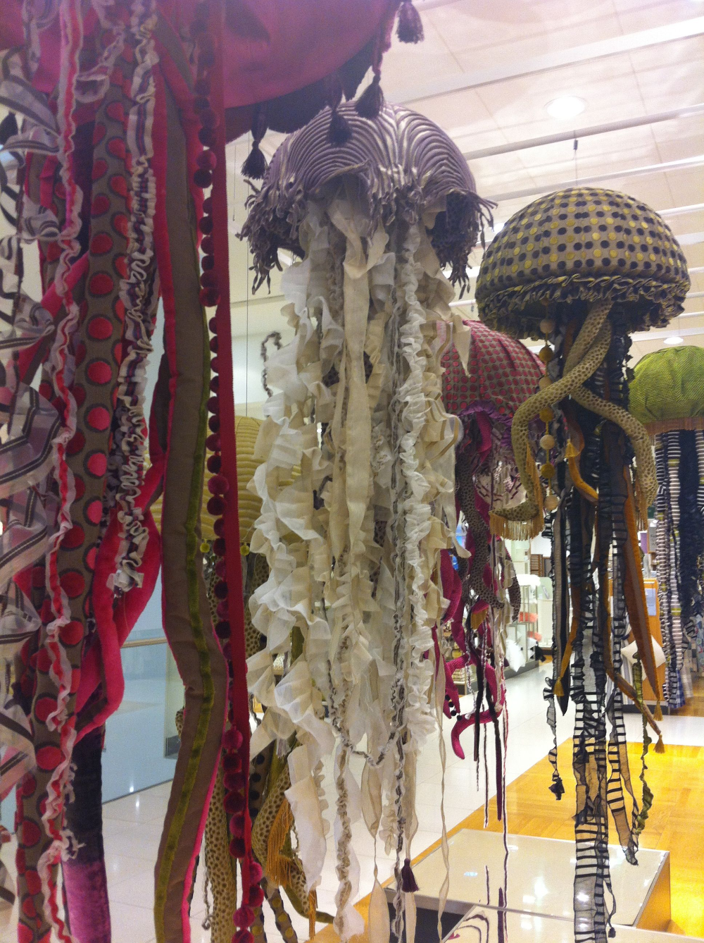
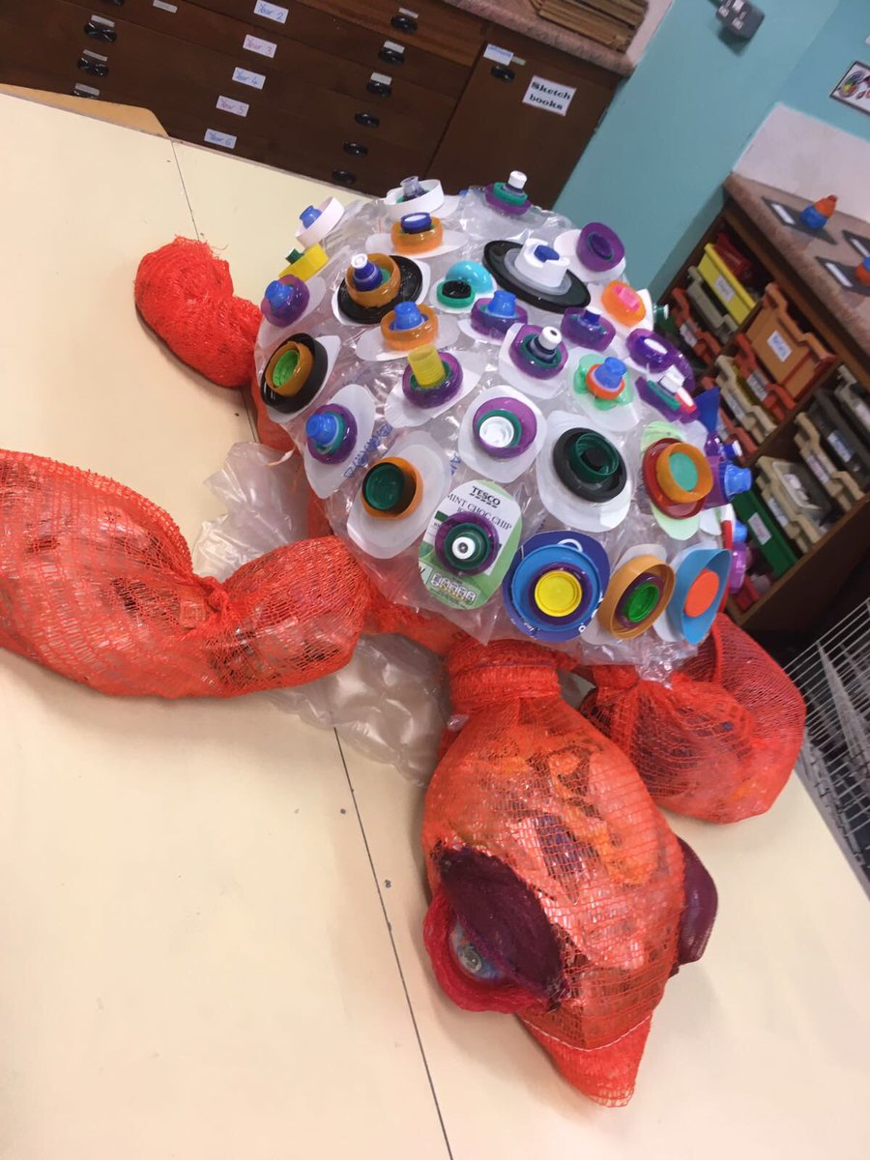
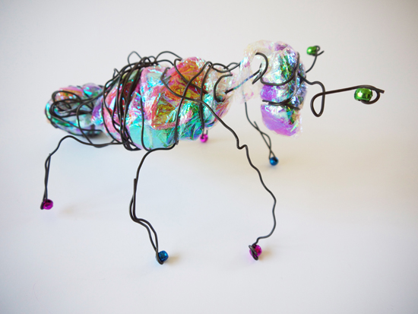
Some ideas to think about.
Be creative!

Slide 14


Music
Click on the link below and follow the lesson .
The lesson looks at clapping 4 beats in a bar.
https://classroom.thenational.academy/lessons/exploring-4-beats-in-a-bar-cgwk2t?activity=video&step=1

Slide 15


Tomorrow, please could you have a sheet of paper (lined or blank) ready for our TEAMS meeting.

Slide 16
Have a super day, give of your best and please send me an e mail this afternoon with examples of your work.
teacher@kingslandengland.hereford.sch.uk
In the subject line could you have :
Year 3 and name of your child
Please only send one email a day with either attachments or a photo of work completed.

