Slide 1
An Outline of Today’s Work Wednesday 10th February2021
Subject | Subject/Website | Topic | Activity/ Instruction
Maths | Quiz | Flash Back Quiz | PPT in the folder
 | White Rose Year 3 Spring Block Multiplication and Division Week 3 | Divide with remainders -activity | Watch the White Rose video and pause to complete the activities In the Math’s Folder you will find a related sheet. There are no White Rose Sheets
English | Dictation | A sentence including spelling words, punctuation and grammar | Listen to the audio on this PPT Write it. Mark it using the PPT slide
 | Grammar | Direct Speech and using inverted commas | Follow the PPT Complete the worksheet
Science | Rocks and Soils | How rocks are formed Demonstration using Starbursts and Chocolate | Video clips Instructions in the folder
Worship | iSing Pop |  | Links can be found either in emails sent or the ‘Whole School’ folder

Slide 2



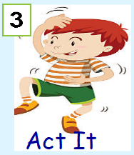


Dictation
Click on the speaker to hear the sentence.
Do not go to the next slide until you have written and checked your sentence.

Slide 3

Mark your dictation and see where you need to make corrections.
‘’Did you eat another eight cakes ?’’ asked mum.
Give yourself a tick for the following if correct:
Correct spelling of ‘eight’ ‘another ‘
Question mark ?
Inverted commas ‘’
Full stop after mum .

Slide 4
Follow the PPT in the folder on Direct Speech
Complete the worksheet in the folder.

Slide 5
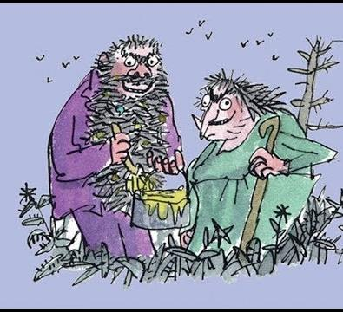

The Twits
By Roald Dahl
Read or Listen
‘Mrs Twit Gets a Stretching.’ to
‘Mr Twit Gets a Horrid Shock’
16:54 -22:24
https://www.youtube.com/watch?v=EgppUh8ukZ8
Audio Book

Slide 6
Super Work!
Have a short break and then start on the English Tasks.

Slide 7

Maths Quiz
Follow the PPT: Math’s Flashback Quiz in the folder.

Slide 8

Maths :
Divide with remainders- activity
Follow this link to the White Rose website to watch the video clip and pause to complete the activities. Have paper, a pencil and rubber ready to jot down your answers.
https://vimeo.com/492449125
You will find related worksheets in the math’s folder on the Kingsland Website.

Slide 9


Times Tables Rock
https://play.ttrockstars.com/auth/school/student/78867
https://www.twinkl.co.uk/go
Use your login details to access the games.
PINCODE: VD0158

Slide 10
Science
Go to the Rock Formation PPT in the folder and
follow the instructions .
You must have an adult with you for the experiment!

Slide 11
Have a lunch break!

Slide 12
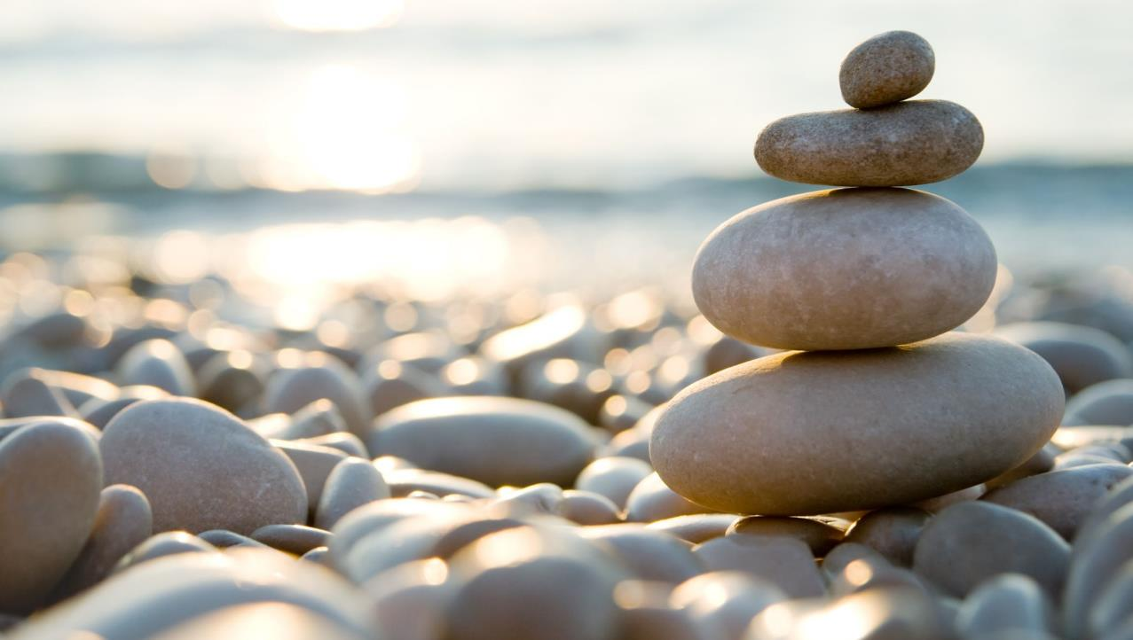
Follow the link for Today’s Worship
This can be found in the
‘Whole School’ folder.

Slide 13
Have a super day, give of your best and please send me an e mail this afternoon with examples of your work.
teacher@kingslandengland.hereford.sch.uk
In the subject line could you have :
Year 3 and name of your child
Please only send one email a day with either attachments or a photo of work completed.

