Slide 1
An Outline of Today’s Work Tuesday 9th February2021
Subject | Subject/Website | Topic | Activity/ Instruction
Maths | White Rose Year 3 Spring Block Multiplication and Division Week 2 | Divide 100 into 2,4,5 and 10 equal parts-activity | White Rose Teaching Video Related worksheets in today’s folder No White Rose Sheets
Numberocks , TTR and Twinkle Go songs and games.
English | Spelling Suffixes | -tion, -cian, -sion | Video Clip Worksheet
 | Written task | Sentences | on the PPT
Topic | Climate Change | The Wonder of Plastic | PPT Video links Twinkle GO!
Internet Safety Day |  | Resources can be found in the ‘Twinkle Go’ folder
Worship | Mr Debenham | Live Worship On TEAMS | Links were e mailed out or can be found on the school website.

Slide 2
Adding the Suffix -tion, -sion, -cian
Watch the video clips and then complete the worksheet in the folder.
National Oak:
https://classroom.thenational.academy/lessons/to-investigate-suffixes-tion-cian-sion-ssion-6xhkje?activity=video&step=1
-tion, -sion,-sion, -cian
https://www.bbc.co.uk/bitesize/topics/zt62mnb/articles/zyv4qhv

Slide 3
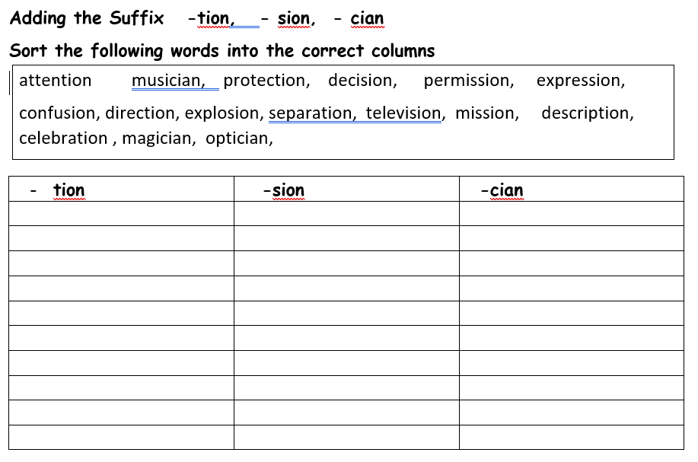

Slide 4


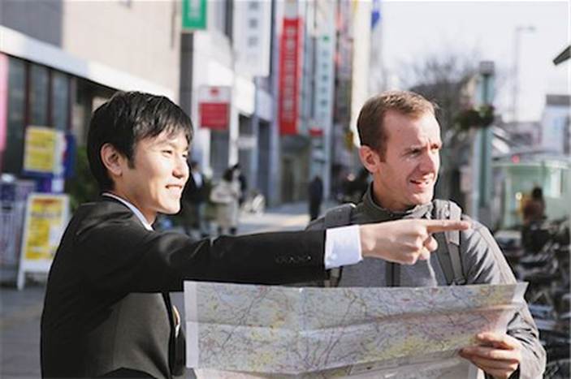
Have a pencil and paper ready to write 3 interesting sentences
Link your sentence to the picture.
Use the highlighted word, add adjectives, interesting verbs and 5Ws
( who, where, when, what, when)
magician
confusion
direction

Slide 5
Super Work!
Have a short break and then start on the English Tasks.

Slide 6

Maths :
Divide 100 into 2,4,5,and 10 equal parts-activity
Follow this link to the White Rose website to watch the video clip and pause to complete the activities. Have paper, a pencil and rubber ready to jot down your answers.
https://vimeo.com/489848691
Although there are no White Rose Sheets, you will find related worksheets in the math’s folder and an extra PPT with a related sheet on the Kingsland Website.

Slide 7


Times Tables Rock
https://play.ttrockstars.com/auth/school/student/78867
https://www.twinkl.co.uk/go
Use your login details to access the games.
PINCODE: VD0158

Slide 8
Have a lunch break!

Slide 9

Climate Change
Plastic!
The Wonder of Plastic.
Use the Tinkle Go pin code to access the ppts:
Environment Day –plastic
E-story book
Interactive comprehension
Hotspots of plastic
‘Twinkle Go’ Pin code: KO1983
Watch the following Video clip
The Wonder of Plastic
https://www.bbc.co.uk/programmes/p06bvjgf
Production and use of plastic
https://www.bbc.co.uk/bitesize/clips/zvg3cdm

Slide 10
In the folder you will find a worksheet to complete.
On Thursday we are going to be creative with plastic so please collect as much plastic as you can around the house:
Save plastic items often thrown in the recycling
Fruit trays, bags, cups, utensils, containers, bottle tops, ribbon etc
Make sure they are clean and dry

Slide 11

You will find resources in the ‘Twinkle Go’ folder.
Use your log in details and the pin code: DP5072
https://www.twinkl.co.uk/go

Slide 12

Follow the link for Today’s Worship
Live on TEAMS with
Mr Debenham

Slide 13
Have a super day, give of your best and please send me an e mail this afternoon with examples of your work.
teacher@kingslandengland.hereford.sch.uk
In the subject line could you have :
Year 3 and name of your child
Please only send one email a day with either attachments or a photo of work completed.

