Slide 1
An Outline of Today’s Work Monday 8th February 2021
Subject | Subject/Website | Topic | Activity/ Instruction
Maths | White Rose Year 3 Spring Block Multiplication and Division Week 2 | Divide2-digit by 1-digit(2) | White Rose Teaching Video Related worksheets in today’s folder
 | Twinkle Go! | Times Tables | Use your login to access the games.
English | National Curriculum Word | ‘ eight’ | Worksheet is in the today’s folder
 | High Frequency Spelling Words | Look/ Cover/ Write | 5 High Frequency Words to learn for the week. Sheet in the folder
 | Comprehension | Greta Thunberg | Question sheet and Text in the folder
RE | Islam | What is Ramadan? | Video links to watch Twinkle Go resources Activity sheet
Worship | Rev Julie |  | A link can be found in the Whole School Folder

Slide 2
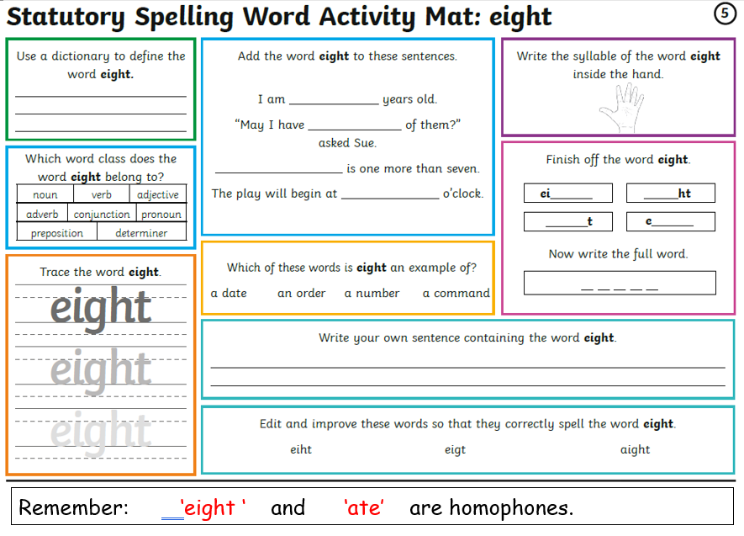

Slide 3
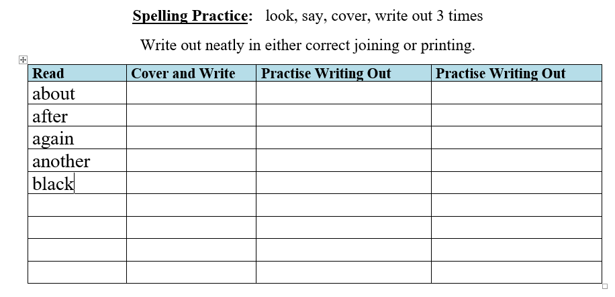
SPELLING
Every Monday I will be setting 5 High Frequency Spelling Words for you to learn to spell.
They are separate to the National Curriculum words, are words that we use often and MUST know how to spell.
I will include some in our weekly dictation and they will be part of our quiz on a Friday.
There is a ‘Look, Cover, Write’ check sheet to help you learn theses words.
Interactive Spelling Game
National Curriculum Words and Words with Spelling Patterns
http://www.ictgames.com/mobilePage/lcwc/index.html

Slide 4
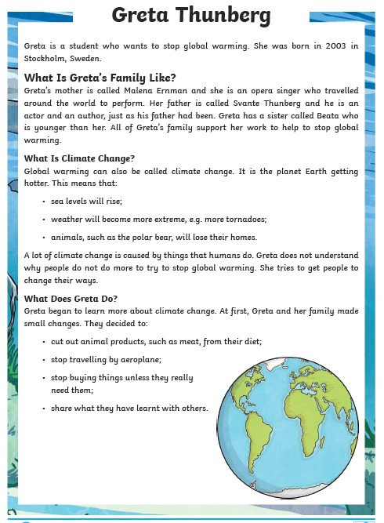
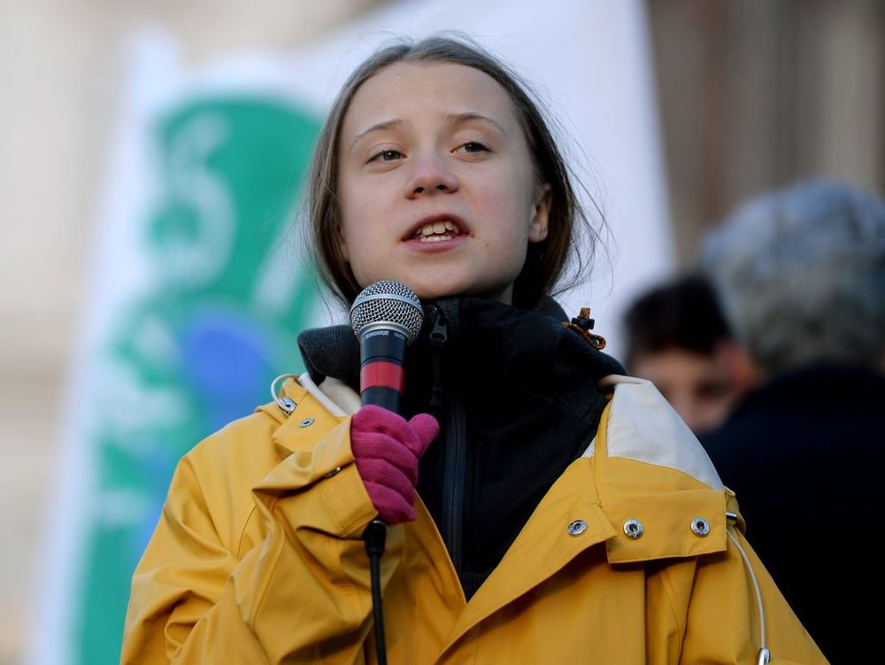
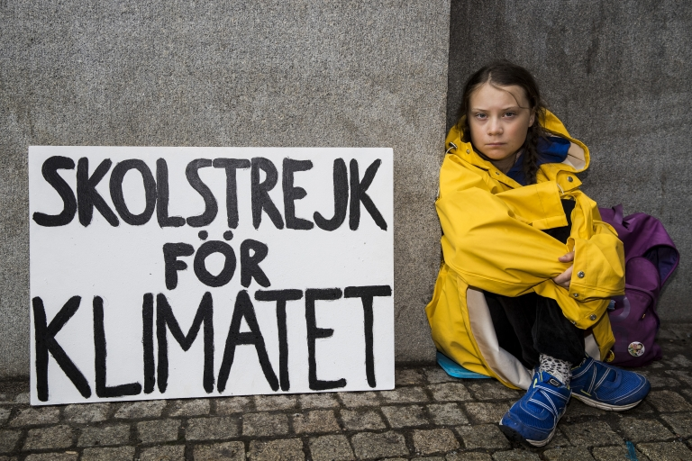
Comprehension:
Greta Thunberg
Ask an adult to discuss the questions with you if you are not feeling confident.
Either answer on the printed sheet or lined paper in full sentences where necessary.
You will find different levels of the reading comprehension in the folder.

Slide 5
Super Work!
Have a short break and then start on the Math’s Tasks.

Slide 6

Maths :
Divide 2-digit by 1-digit (2)
Follow this link to the White Rose website to watch the video clip and pause to complete the activities. Have paper, a pencil and rubber ready to jot down your answers.
https://vimeo.com/489845622
Although there are no White Rose sheets you will find related worksheets in the math’s folder on the Kingsland Website.

Slide 7


Times Tables Rock
https://play.ttrockstars.com/auth/school/student/78867
https://www.twinkl.co.uk/go
Use your login details to access the games.
PINCODE: VD0158

Slide 8
Have a lunch break!

Slide 9

What is Ramadan and why do Muslims fast?
Below are two video clips to watch as well as PPTs and activities in the ‘Tinkle Go’ folder you could choose from.
What is Ramadan
https://www.bbc.co.uk/programmes/p02mwdxf
Why Muslims Fast:
https://www.bbc.co.uk/bitesize/clips/z434wmn
If you login in to Twinkle Go, you will find: information PPT
wordsearch
interactive comprehension
audio book
Twinkle Go-PIN:
Y14726

Slide 10
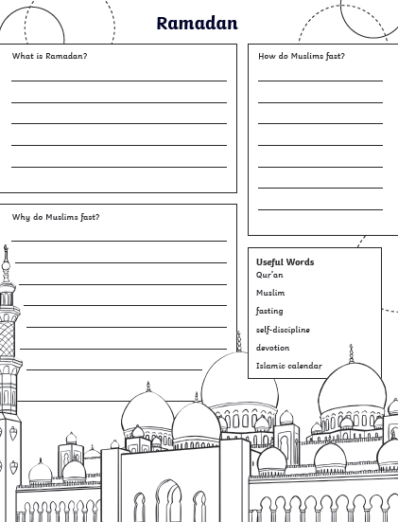


After you have watched the video clips and accessed the resources, complete the following activities:
Follow the instructions to make a Ramadan Lantern or a Ramadan Moon and Star symbol
Complete the worksheet in the folder

Slide 11

Follow the link for Today’s Worship
In the Whole School Folder

Slide 12
Have a super day, give of your best and please send me an e mail this afternoon with examples of your work.
teacher@kingslandengland.hereford.sch.uk
In the subject line could you have :
Year 3 and name of your child
Please only send one email a day with either attachments or a photo of work completed.

