Slide 1
An Outline of Today’s Work Friday 29th January 2021
Subject | Subject/Website | Topic | Activity/ Instruction
English | Handwriting | Letter Formation Diagonal Joins | Letters to trace and write Lined handwriting Paper PPT to watch
 | Writing | How to write a diary entry. | PPT in the folder
 | Written Task | Write a diary entry | Mrs Twit’s Diary ‘I think I’ve got the shrinks!’
Maths | White Rose Year 3 Spring Block Multiplication and Division | Divide 2-digit by 1-digit (1) | Watch the White Rose video and pause to complete the activities In the Math’s Folder you will find a related White Rose sheet and extension sheets.
French |  |  | See work set by Mr Powell in our Year 3 folder
PE |  |  | See work set by Mr Powell and Miss Price in our Year 3 folder
Worship | ‘Big Joe’ |  | Links are emailed or can be found in the ‘Whole School ‘folder.

Slide 2

Handwriting Lines

Slide 3
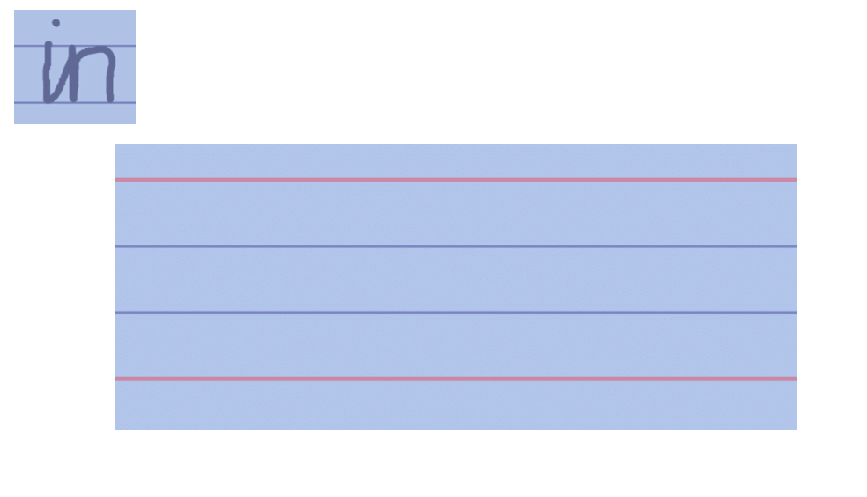
In the folder you will find:
PPT to follow printing letter formation
PPT to follow joining formation

Slide 4
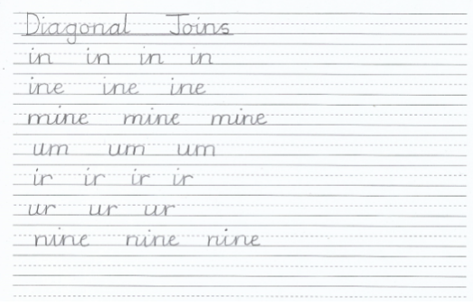

Slide 5
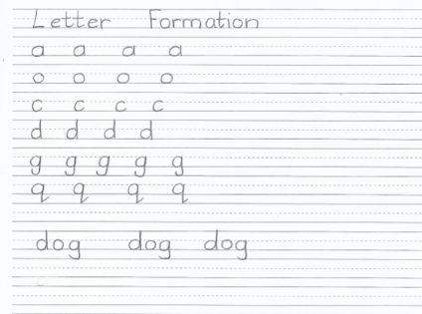

Slide 6
Go to the PPT in the folder which explains how to write a diary.
You are going to be Mrs Twit and write a diary entry about the day she got the shrinks.
Listen to or read the chapters before writing.
The Audio link is on the next slide

Slide 7
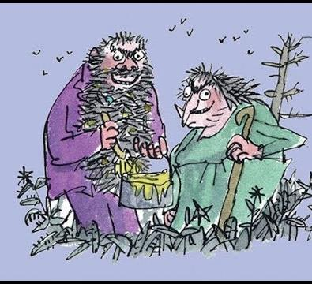

The Twits
By Roald Dahl
The Funny Walking Stick
and
Mrs Twit has the Shrinks
11:29
https://www.youtube.com/watch?v=EgppUh8ukZ8
Audio Book

Slide 8
Super Work!
Have a short break and then start on the English Tasks.

Slide 9

Maths :
Divide 2-digit by 1-digit (1)
Follow this link to the White Rose website to watch the video clip and pause to complete the activities. Have paper, a pencil and rubber ready to jot down your answers.
https://whiterosemaths.com/homelearning/year-3/spring-week-2-number-multiplication-division/
You will find related worksheets in the math’s folder on the Kingsland Website.

Slide 10


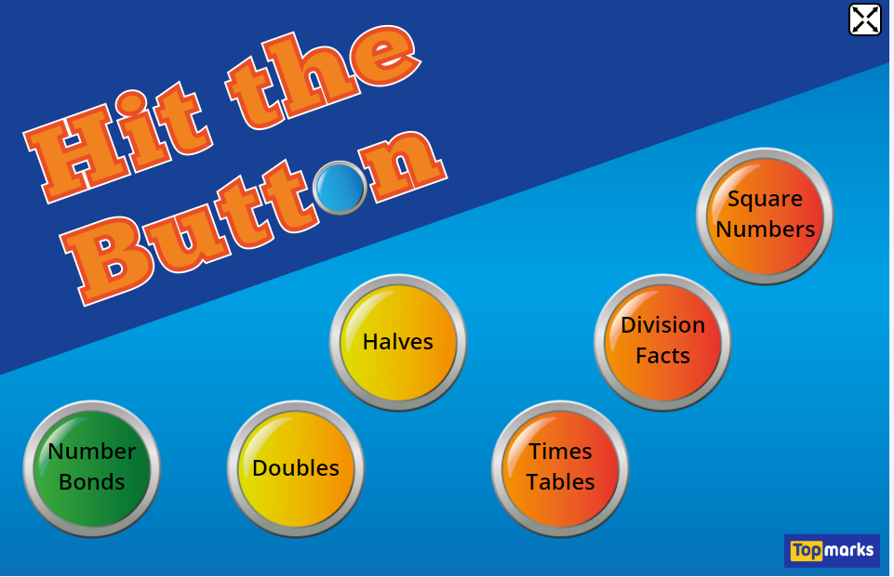
Times Tables Rock
https://play.ttrockstars.com/auth/school/student/78867
8x table
https://www.youtube.com/watch?v=TdqAA9Ky2DY
https://www.topmarks.co.uk/maths-games/hit-the-button

Slide 11
Have a lunch break!

Slide 12

For French and PE, see activities in the Year 3 Folder.

Slide 13

Follow the link for Today’s Worship
This can be found in the
‘Whole School’ folder.

Slide 14
Have a super day, give of your best and please send me an e mail this afternoon with examples of your work.
teacher@kingslandengland.hereford.sch.uk
In the subject line could you have :
Year 3 and name of your child
Please only send one email a day with either attachments or a photo of work completed.

