Slide 1

Writing a Diary Entry
When you write a diary entry, you are writing about a day in the life of a real person or character.
The diary entry needs to sound as if the person or character has written it, so it needs to be written from their point of view.
It also needs to be exciting
and interesting to read.
To get this right,
just follow a few easy steps...

Slide 2







Diary Writing Checklist
Can you remember all the things you need to do to write a fantastic diary entry?
Diary writing must...
include the date and/or time;
be written in the past tense
use the words ‘I’, ‘my’, ‘we’ and ‘our’;
write as if I was there;
write about the most important events in order;
describe feelings;
use time linking words, e.g. ‘next’, ‘first’ and ‘then’;

Slide 3
Your Writing Task Today:
Imagine you are Mrs Twit.
Write a diary entry .
The entry is only about Mrs Twit thinking she has the shrinks.
Write in the 1st Person.
Add feelings and important detail.
When you write a diary entry, you are writing about a day in the life of a real person or character.
The diary entry needs to sound as if the person or character has written it, so it needs to be written from their point of view.
It also needs to be exciting
and interesting to read.
To get this right,
just follow a few easy steps...
Use your list of ‘feelings and actions’ from yesterday to help you.

Slide 4
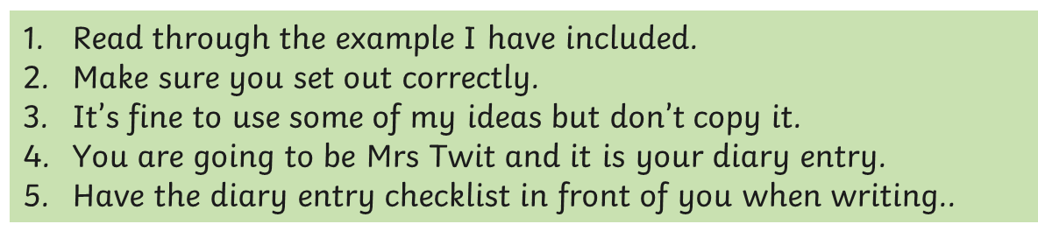

Slide 5
Thursday 20 June
5pm
Dear Diary,
I have had the most puzzling and rather upsetting day. Mr Twit was his usual annoying self and I would catch him glaring at me through the day .Something felt wrong.
Mr Twit then told me it was my stick, it was too long! He thinks I’m shrinking! I got really worried and upset as he laughed and jeered at me. When I tried to sit on my chair , my feet would not touch the ground! I truly was shrinking.
If I continue to shrink at this rate, there will be nothing left of me. I will disappear forever. I can feel myself shaking in fear as I write. What am I going to do?
Mr Twit seems to have an idea . The question is, do I trust him? I don’t seem to have a choice as I will have to do something to stop the dreaded shrinks!

Slide 6
Now start writing your diary. Remember you are Mrs Twit.
Keep the Diary Writing Checklist Visible.

