Slide 1
An Outline of Today’s Work Thursday 28th January 2021
Subject | Subject/Website | Topic | Activity/ Instruction
English | Spag Mat 4 | Spelling, punctuation and grammar | Worksheet is in the English folder
 | Writing in first person | 1st, 2nd and 3rd person | Writing in the first person
 | Written Task | ‘I got the shrinks!’ | Make a list of feelings and actions
Maths | White Rose Year 3 Spring Block Multiplication and Division | Multiply 2-digit by 1-digit (2) | Watch the White Rose video and pause to complete the activities In the Math’s Folder you will find a related White Rose sheet and extension sheets.
Worship Before lunch! | Mental Well Being |  | Links are in the Whole School folder or has been email to you.
Screen Free Afternoon! There is a list of ‘screen free’ activities to choose from. It would be lovely to see a photo of what you chose to do.

Slide 2

Full House Point Cards
Send a photo of your full card with your home learning email.
Name:__________________________ House:___________________________
Date:_____________
Please add the date.

Slide 3
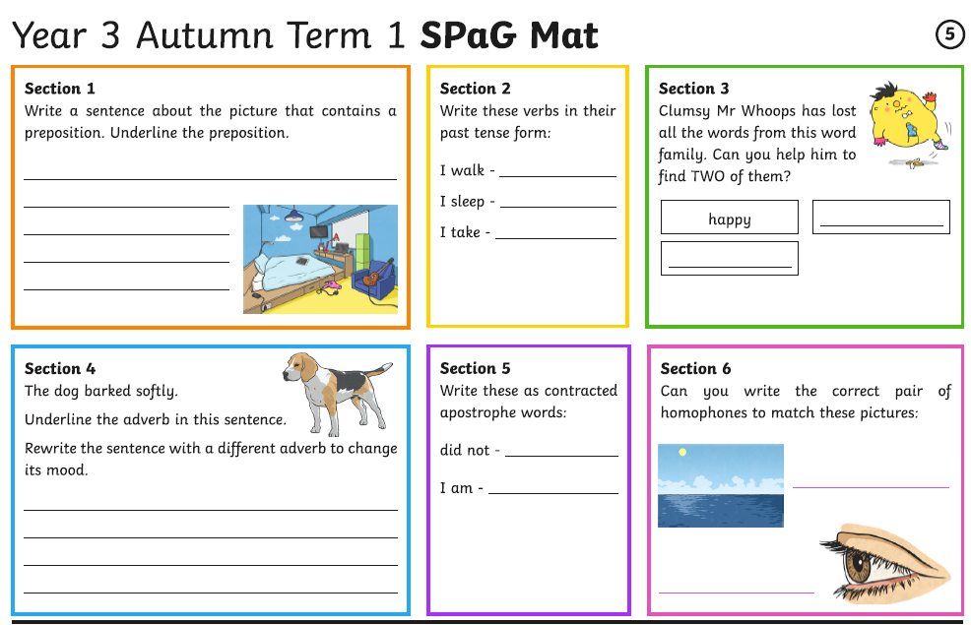

Slide 4
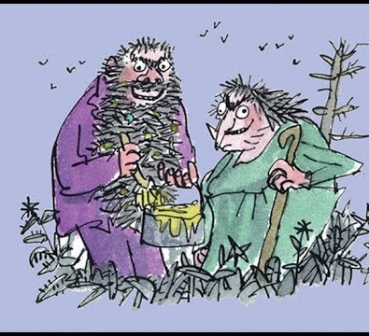

The Twits
By Roald Dahl
https://www.youtube.com/watch?v=EgppUh8ukZ8
Audio Book

Slide 5
Writing in the First, Second, Third Person
1. Watch the video clip and complete the short activity.
https://www.bbc.co.uk/bitesize/topics/zrqqtfr/articles/zxdhsg8
2. Go through the PPT and complete the worksheet in the folder
3 . Go to the next slide to record some of Mrs Twit’s feelings.
There is a worksheet in the folder.

Slide 6
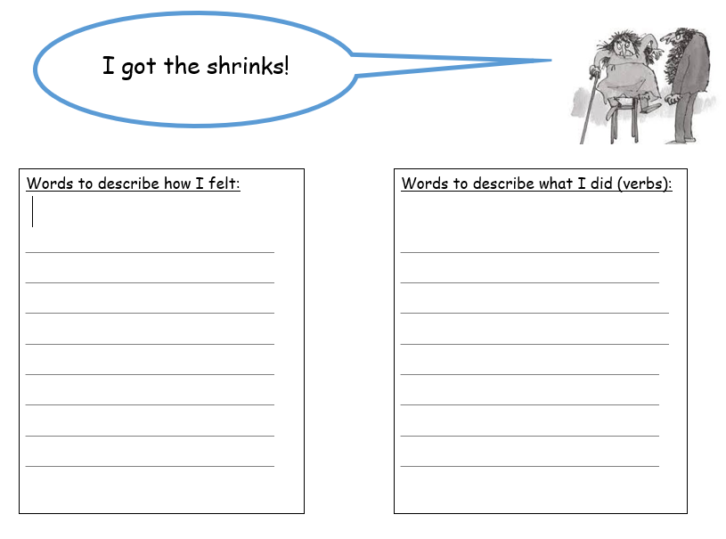

Slide 7
Super Work!
Have a short break and then start on the English Tasks.

Slide 8

Maths :
Multiply 2-digit by 1-digit (2)
Follow this link to the White Rose website to watch the video clip and pause to complete the activities. Have paper, a pencil and rubber ready to jot down your answers.
https://whiterosemaths.com/homelearning/year-3/spring-week-2-number-multiplication-division/
You will find related worksheets in the math’s folder on the Kingsland Website.

Slide 9



Times Tables Rock
https://play.ttrockstars.com/auth/school/student/78867
https://www.twinkl.co.uk/go
Use your login details to access the games.
PINCODE: VD0158
https://www.youtube.com/watch?v=z_BJjR9rdwA

Slide 10

Follow the link for Today’s Worship
This can be found in the
‘Whole School’ folder or click on the link below.
https://youtu.be/zisXE4KlLAI

Slide 11
Have a lunch break!

Slide 12


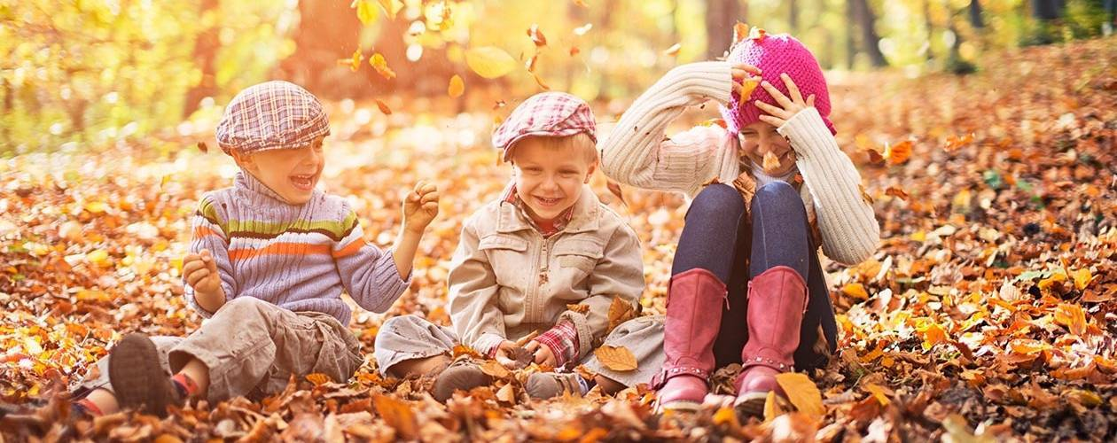
Have a Screen Free Afternoon
You will find a selection of activities to choose from on the school website, in Whole School Folder.

Slide 13


Tomorrow, please could you have a sheet of paper (lined or blank) ready for our TEAMS meeting.

Slide 14
Have a super day, give of your best and please send me an e mail this afternoon with examples of your work.
teacher@kingslandengland.hereford.sch.uk
In the subject line could you have :
Year 3 and name of your child
Please only send one email a day with either attachments or a photo of work completed.

