Slide 1
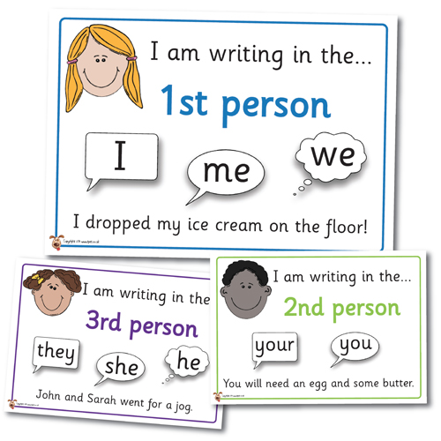

Lesson Objective
To know how to identify 1st, 2nd, and 3rd Person correctly.
For tomorrow, we need to be clear on how to write in the first person.

Slide 2
1st, 2nd, and 3rd Person

Slide 3

1st Person
1st Person is when the writer speaker is talking about themselves as an individual or group:
I, me, we, us, mine, myself, ours, ourselves

Slide 4

2nd Person
2nd Person is when the writer/speaker is talking to another individual or group:
you, yourself, yours

Slide 5

3rd Person
3rd Person is when the writer/speaker is talking about another individual or group:
he, she, they, them, himself, herself, theirs, themselves

Slide 6
Pick the Right One
For the following sentences, identify whether they are 1st, 2nd, or 3rd Person:
1. I like the sound of that.
2. You need to whisper.
3. This one is mine.
4. They all went to the party together.
5. It gave them a huge shock.
Remember:
First Person:I, me, we, us, mine, myself, ours, ourselves
Second Person:you, yourself, yours
Third Person:he, she, they, them, himself, herself, theirs, themselves

Slide 7
Now complete the sheet in the folder

