Slide 1
An Outline of Today’s Work Wednesday 3rd February2021
Subject | Subject/Website | Topic | Activity/ Instruction
Maths | Quiz | Flash Back Quiz | PPT in the folder
 | White Rose Year 3 Spring Block Multiplication and Division | Multiply 2-digit by 1-digit exchange | Watch the White Rose video and pause to complete the activities In the Math’s Folder you will find a related sheet.
English | Dictation | A sentence including spelling words, punctuation and grammar | Listen to the audio on this PPT Write it. Mark it using the PPT slide
 | Writing | Improve the sentence | Follow the PPT step by step
 | Pre Reading The Twits | The Funny Walking –stick AND Mrs Twit has the Shrinks | Listen/read and think about how Mrs Twit may be feeling.
Science | Rocks and Soils | Layers of the Earth | PPT Twinkle Go Video clips Selection of activities in the folder
Worship | iSing Pop |  | Links can be found either in emails sent or the ‘Whole School’ folder

Slide 2



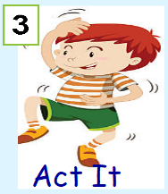


Dictation
Click on the speaker to hear the sentence.
Do not go to the next slide until you have written and checked your sentence.

Slide 3

Mark your dictation and see where you need to make corrections.
The very tired boy does not want to get up really early.
Give yourself a tick for the following if correct:
Correct spelling for : early
Correct spelling for:
does, they, very, really, want
capital letter and full stop
If it was shouted you could use an !

Slide 4
Follow the PPT in the folder to improve the sentences.

Slide 5
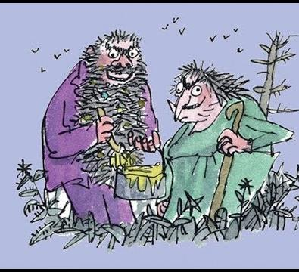

The Twits
By Roald Dahl
The Funny Walking Stick
and
Mrs Twit has the Shrinks
11:29
https://www.youtube.com/watch?v=EgppUh8ukZ8
Audio Book

Slide 6
Super Work!
Have a short break and then start on the English Tasks.

Slide 7

Maths Quiz
Follow the PPT: Math’s Flashback Quiz in the folder.

Slide 8

Maths :
Multiply 2-digit by 1-digit)
Exchange
Follow this link to the White Rose website to watch the video clip and pause to complete the activities. Have paper, a pencil and rubber ready to jot down your answers.
https://whiterosemaths.com/homelearning/year-3/spring-week-2-number-multiplication-division/
You will find related worksheets in the math’s folder on the Kingsland Website.

Slide 9



Times Tables Rock
https://play.ttrockstars.com/auth/school/student/78867
https://www.twinkl.co.uk/go
Use your login details to access the games.
PINCODE: VD0158
https://www.youtube.com/watch?v=z_BJjR9rdwA

Slide 10
Have a lunch break!

Slide 11
Layers of the Earth
Watch the following Video Clips:
https://www.youtube.com/watch?v=2Kku4Ifcl7w
https://www.youtube.com/watch?v=bXdFBAk6MBM
Twinkle Go: Use your login details and the pincode: CK2387
to view the PPTs

Slide 12
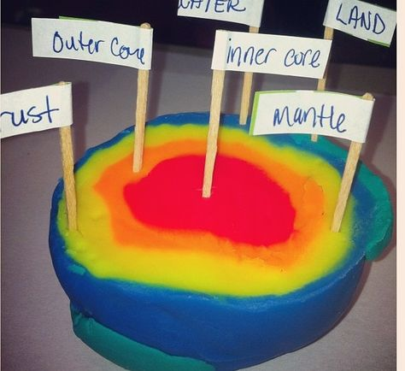
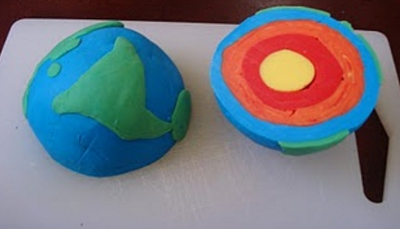
Activities
There are 2 activities in the folder. Choose one or both to complete.
Use different colours of plasticine or playdough to demonstrate the layers of the earth. See the link below .
*There is a playdough recipe on the next slide.
https://www.youtube.com/watch?v=zmx-r2wU6-M

Slide 13
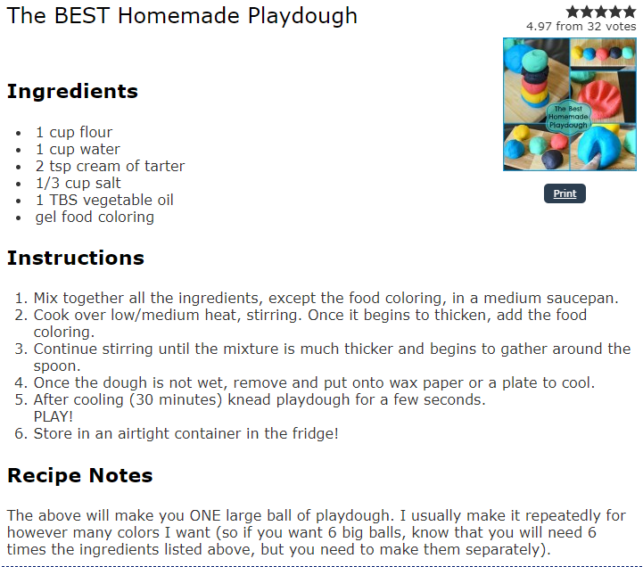

Slide 14
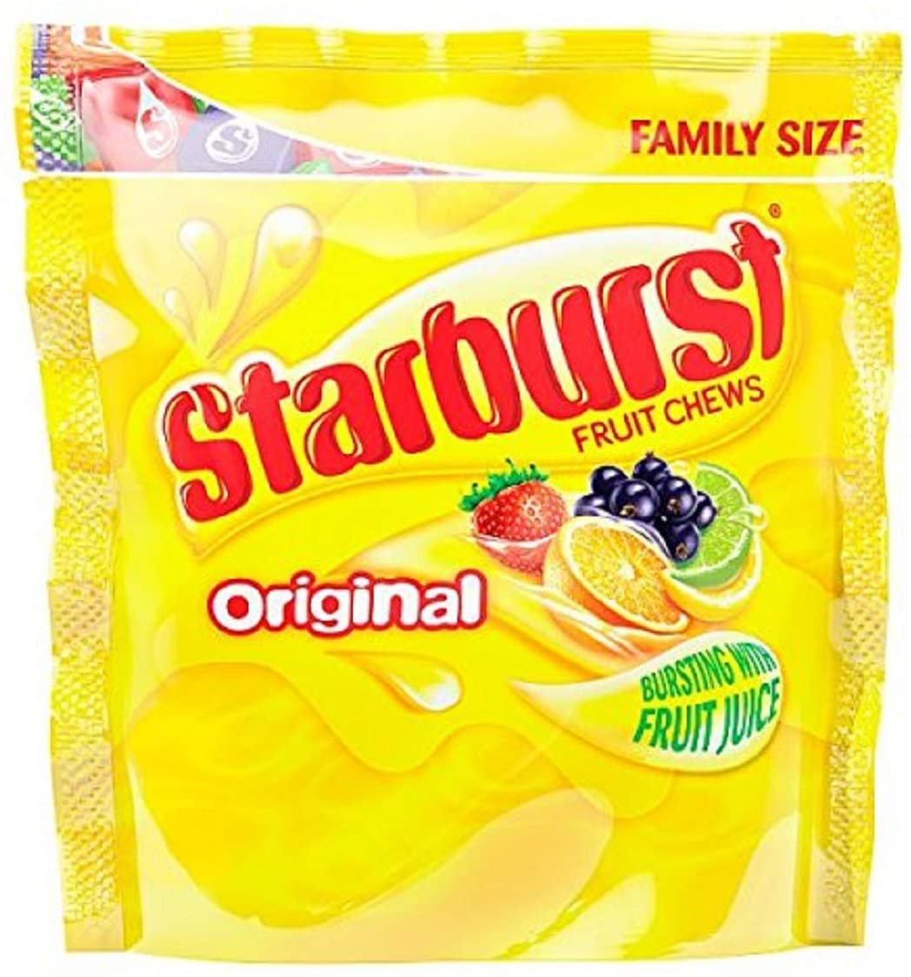
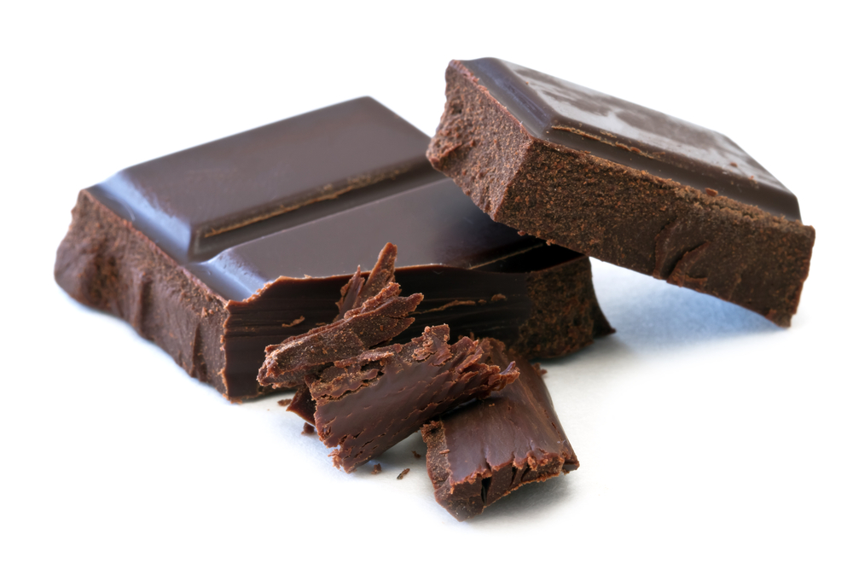
Next Week you will need the following if you want to follow the science experiments.
Starburst Sweets (about different colours)
Plain chocolate (about 50g)

Slide 15
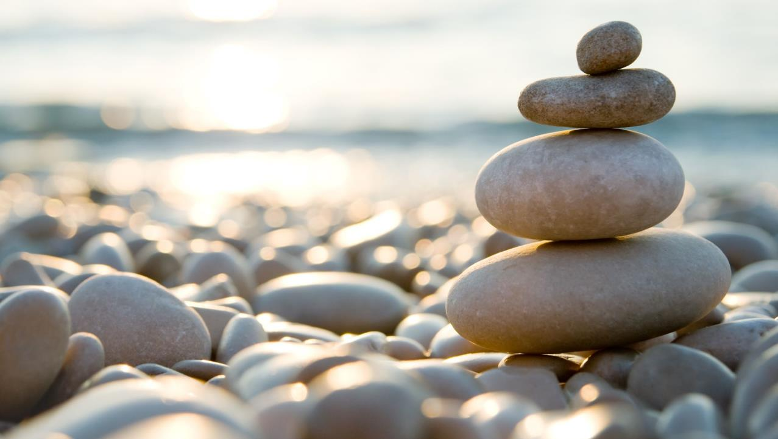
Follow the link for Today’s Worship
This can be found in the
‘Whole School’ folder.

Slide 16
Have a super day, give of your best and please send me an e mail this afternoon with examples of your work.
teacher@kingslandengland.hereford.sch.uk
In the subject line could you have :
Year 3 and name of your child
Please only send one email a day with either attachments or a photo of work completed.

