Slide 1

Spend a few minutes looking closely at this picture. Discuss it with an adult.

Slide 2
I have got a rather simple sentence about the picture.
You need to improve this sentence, step by step, following the instruction on the PPT slides.
Clicking on the page and it will give you the next instruction.
After each instruction you need to rewrite the sentence neatly on your page.
Start a new line for each new improved sentence.
Go back to the large picture if you need some inspiration.
You will need:
A pencil and a rubber
Lined paper

Slide 3
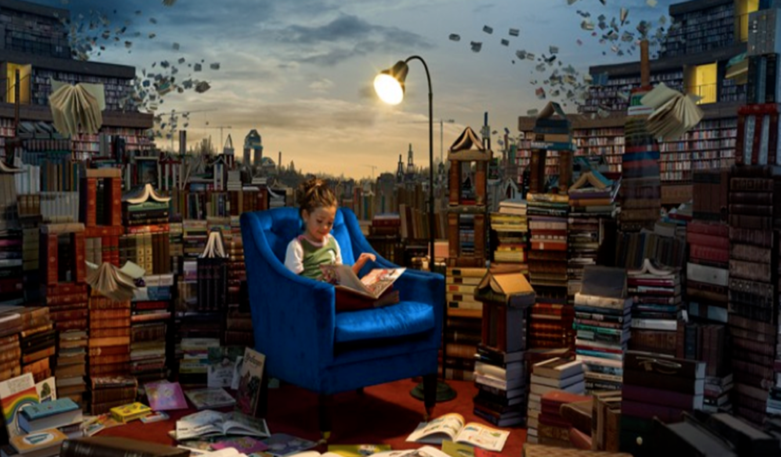
Lucy sat in a chair.
Write this simple sentence neatly on your page.

Slide 4
Lucy sat in a chair.
Add: adjective (to describe the chair) Write the sentence.
Add: ‘when’ (when was she there?) Write the sentence.
Add: ‘what’ (what is she doing?) Write the sentence.
Add: ‘where’ (where is she?) Write the sentence.
.

Slide 5

Read your last sentence and ‘tweak’ it:
Make sure it makes sense.
Could you change the sentence structure to make it more interesting?
Have you got a capital letter and full stop?

Slide 6

Now start another sentence to describe what is happening around her.
I have given you another simple sentence to improve using similar steps.
Write this sentence in your book .
There are books around her.

Slide 7
There are books around her.
Add: adjective (to describe the room or books) Write the sentence.
Add: ‘why’ ( Why is this happening?) Write the sentence.
Add: ‘what’ (What are the books doing?) Write the sentence.
Add: ‘where’ (Where are the books?) Write the sentence.

Slide 8
Read your last sentence and ‘tweak’ it:
Make sure it makes sense.
Could you change the sentence structure to make it more interesting?
Have you got a capital letter and full stop?

Slide 9
Well Done!
That is a huge improvement!

