Slide 1
Here are some quick think quiz questions
Have a pencil and paper ready to record your answer.
Work out the first one
Mark it and continue.

Slide 2

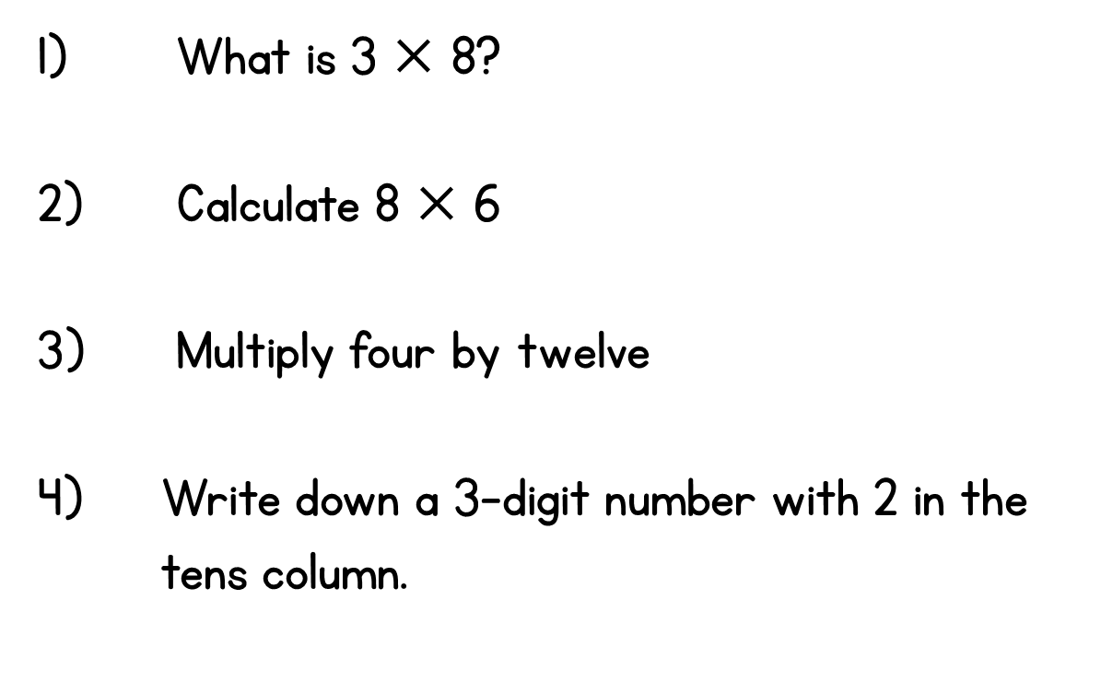


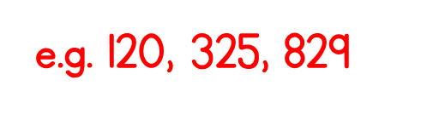
Year 3 | Week 1 | Day 1

Slide 3
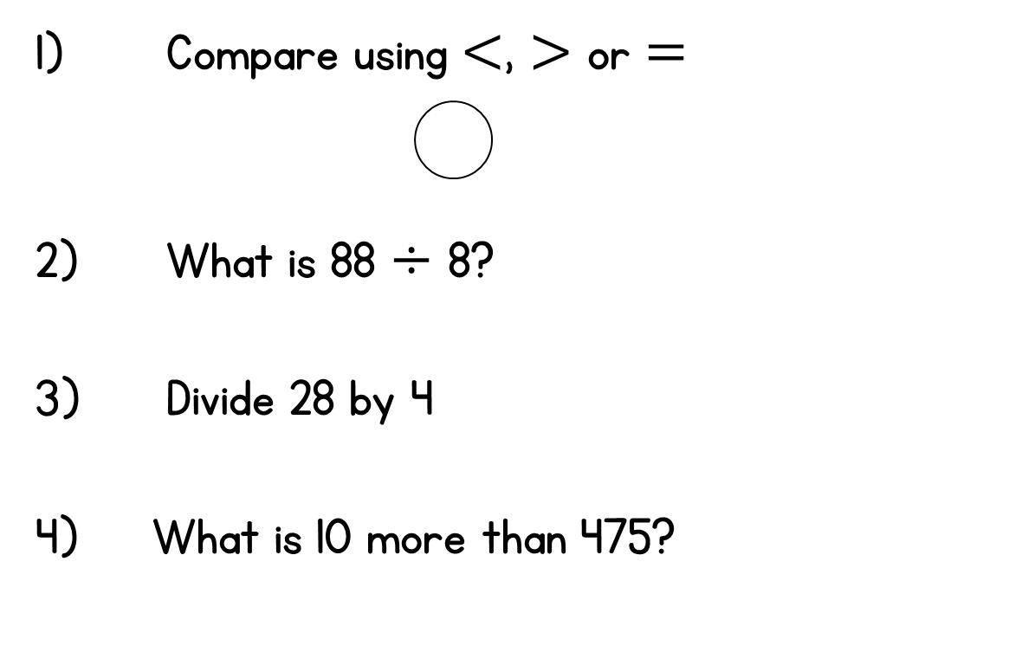
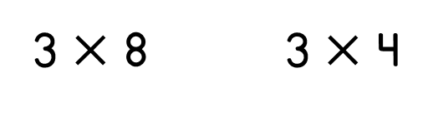




Year 3 | Week 1 | Day 2

Slide 4
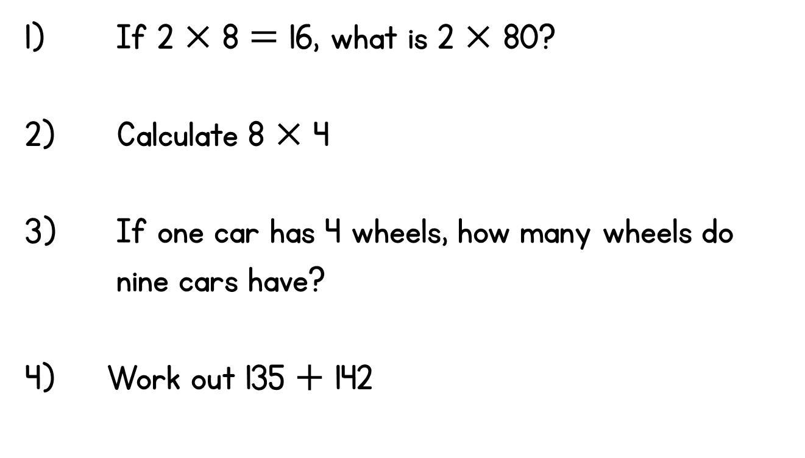
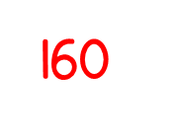
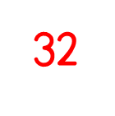
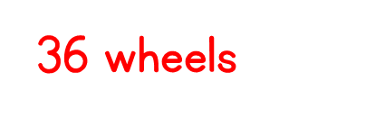
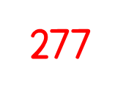
Year 3 | Week 1 | Day 3

Slide 5
Well Done!!

