Slide 1
An Outline of Today’s Work Tuesday 2nd February2021
Subject | Subject/Website | Topic | Activity/ Instruction
Maths | White Rose Year 3 Spring Block Multiplication and Division | Multiply 2-digit by 1-digit (1) | White Rose Teaching Video Related worksheets in today’s folder
Numberocks , TTR and Twinkle Go songs and games.
English | Spelling | Adding the suffix -ful and -less | Video Clip Worksheet
 | Written task | Choose the Correct adjective | words to record
Topic | Climate Change | What is waste and where does it go? | PPT Video links Research task
Worship | Mr Debenham | Live Worship On TEAMS | Links were e mailed out or can be found on the school website.

Slide 2
Adding the Suffix - ful and -less
There is a video link below to watch Lesson 1
Go through the PPT in the folder
Now complete the worksheets
https://classroom.thenational.academy/units/suffixes-ful-and-less-bd5c

Slide 3
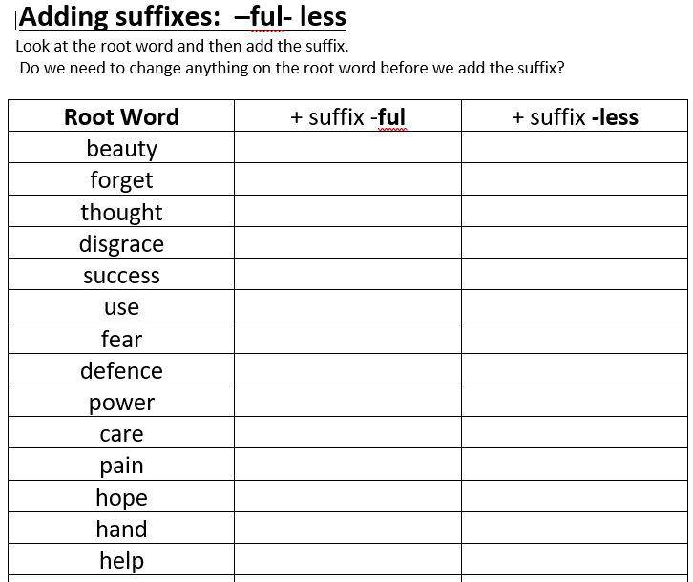
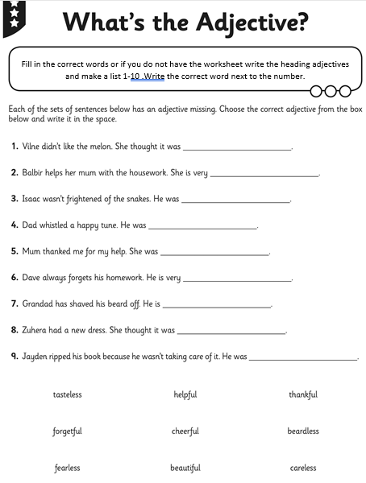

Slide 4
Super Work!
Have a short break and then start on the English Tasks.

Slide 5

Maths :
Multiply 2-digit by 1-digit (1)
Follow this link to the White Rose website to watch the video clip and pause to complete the activities. Have paper, a pencil and rubber ready to jot down your answers.
https://whiterosemaths.com/homelearning/year-3/week-1-number-multiplication-division/
You will find related worksheets in the math’s folder on the Kingsland Website.

Slide 6



Times Tables Rock
https://play.ttrockstars.com/auth/school/student/78867
11 Times Table
https://www.twinkl.co.uk/go
Use your login details to access the games.
PINCODE: VD0158
https://www.youtube.com/watch?v=p9AxbcO4Kp4

Slide 7
Have a lunch break!

Slide 8
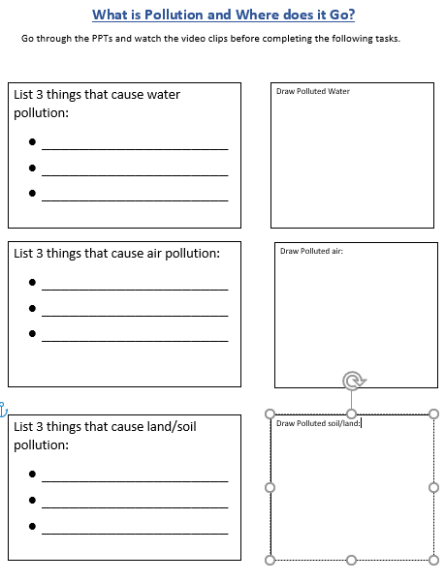
It may be useful to have your worksheet instructions with you while watching the PPT and Video clips. You could then fill in a section as each topic is covered.

Slide 9

Climate Change
What is waste and where does it go?
Use the Tinkle Go pin code to access the ppts:
YR8279
Watch the following Video clip
You may want to pause after each section to fill in your worksheet:
Air , Water and Land Pollution
https://www.youtube.com/watch?v=OqHp03RRTDs

Slide 10
If you are interested and would like to watch a few extra clips:
Rubbish in the River Thames
https://www.bbc.co.uk/bitesize/clips/zr2jmp3
Human impact on the environment.
https://www.bbc.co.uk/teach/class-clips-video/science-ks2--ks3-human-impact-on-the-environment/zf9nvk7

Slide 11

Follow the link for Today’s Worship
Live on TEAMS with
Mr Debenham

Slide 12
Have a super day, give of your best and please send me an e mail this afternoon with examples of your work.
teacher@kingslandengland.hereford.sch.uk
In the subject line could you have :
Year 3 and name of your child
Please only send one email a day with either attachments or a photo of work completed.

